Slide 1
Instructions for Use
Preparation: Read the accompanying PDF, A Journey Through Surah Qaf, in advance to ensure smooth delivery
Recitation: Recite the passage aloud and encourage attendees to repeat after you. Begin the session with the passage from Part 1 and recite the passage from Part 2 in the middle of the session.
Session Structure: Each session is divided into two parts with a short break in between.
Reflection & Discussion: Dedicate the recommended time to reflection and discussion questions—this is essential for fostering a culture of tadabbur (deep contemplation).
Timings: Suggested timings for each slide are provided in the slide descriptions for guidance.
Engagement: Display the starter question as attendees arrive and settle in.
Memorisation: Encourage all attendees to memorise both the Arabic and English translations of the verses.
Notes:
2 mins

Slide 2
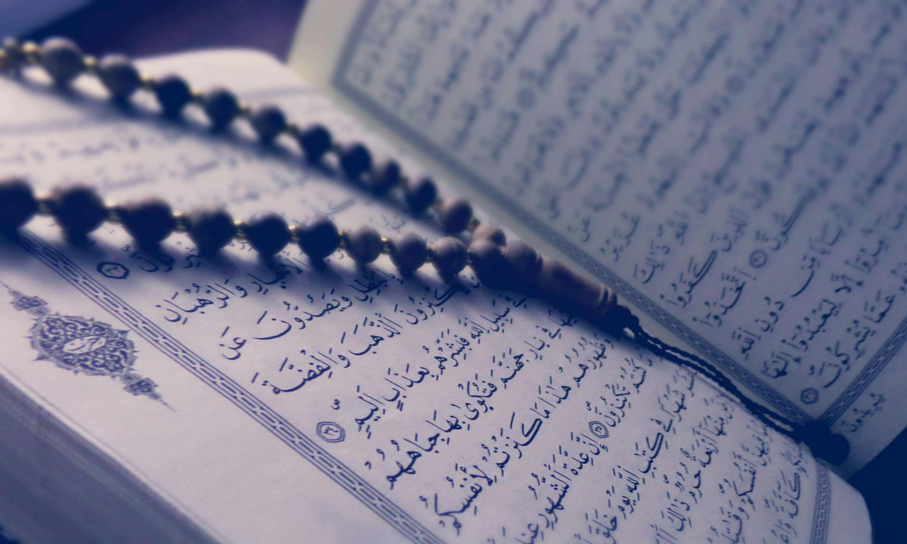
Starter
What does your current relationship with the Qur’ān look like?
Notes:
Play in background Surah Qāf: https://www.youtube.com/watch?v=jLQXotfD0dw&t=12s
Have the question ready on the board so learners can start thinking as they walk in/wait for the session to start.

Slide 3
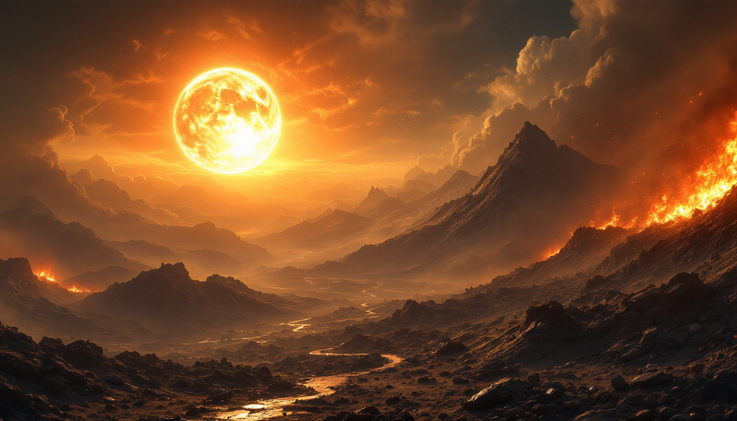
TRUTH &
DENIAL
Surah Qāf: Session 1

Slide 4
Duʿā for opening of the heart
O Allah, I am Your servant and the son of Your male servant and the son of Your female servant. My forehead is in Your Hand (i.e. you have control over me). I am subject to Your judgement and Your decree concerning me is just. I ask You – by every name that is Yours, by which You have named Yourself, or taught any one of Your creation, or revealed in Your Book, or kept unto Yourself in the knowledge of the unseen that is with You – to make the Qur’ān the spring of my heart, the light of my chest, the banisher of my grief and the reliever of my anxiety.
Notes:
Start with bismillah, hamd and salawat. Greet the audience, welcome them and thank them for attending.
1 min

Slide 5
Learning
Objectives
Reflect on the centrality of the Qur’ān in our lives
01
Explore the impact of belief in the hereafter on our lives
02
Reflect on the signs of Allah all around us
03
Read and reflect upon verses 1-14 of Surah Qāf
04
Notes:
1 min

Slide 6
What You’ll Need:
An open mind and an attentive heart
A pen and notebook to jot down your thoughts, reflections and inspiration
Focus and attention
To recite loudly along with the teacher to allow the words of the Qur’ān to penetrate your heart
Curiosity and thirst for knowledge
Sincere intention to be transformed by the Divine words
Notes:
2 mins

Slide 7
Makkan vs. Madinan Revelation
The majority of the Qur’ān was revealed in Makkah; less than 30 sūrahs were revealed in Madinah.
3 main themes of Makkī sūrahs:
Allah’s Oneness
Prophethood
Resurrection
The Companions were ready to do anything for the sake of Allah because their hearts were already filled with love for Him and īmān.
Discuss
Why were Allah’s Oneness, Prophethood & Resurrection the main themes of Makkī sūrahs?
Notes:
(Total: 5 mins)
Explanation: 2 mins
Discuss: 1 min to discuss and 2 mins for feedback

Slide 8
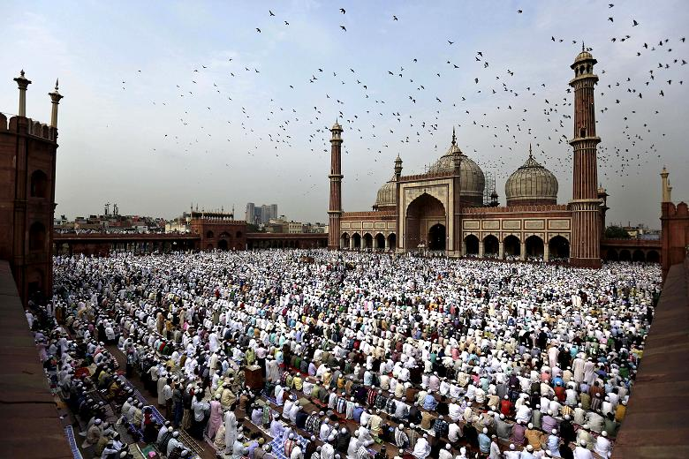
Background
The Prophet ﷺ would recite Surah Qāf in large gatherings:
Jumuʿah ṣalāh
The Friday sermon: Umm Hishām b. Ḥārithah b. Nuʿmān memorised the sūrah just by hearing it in the Prophet’s khuṭbah
The two Eid ṣalāhs
Fajr ṣalāh
Sūrah Qāf was revealed in Makkah
Main Themes of the Sūrah:
Death, Resurrection, Day of Judgement & Afterlife
Notes:
3 mins

Slide 9
The Qur’ān
Disjointed letter
Strong letter: why?
Letter repeated in the surah
Oath
Lofty status;
Glorious;
Majestic;
1. Qãf. By the glorious Quran!
Write
Complete this sentence: The Qur’an is ….
Notes:
Explanation: 3 mins
Write: 1 min
Feedback: 1 min

Slide 10
Engage with the Qur’ān
“I have not seen anything that nourishes the mind and the soul, protects the body, and guarantees success more than constantly engaging with the Book of Allah.”
Ibn Taymiyyah
Do they not then reflect on the Qur’ān? Or are there locks upon their hearts? (47:24)
Notes:
Explanation: 2 mins

Slide 11
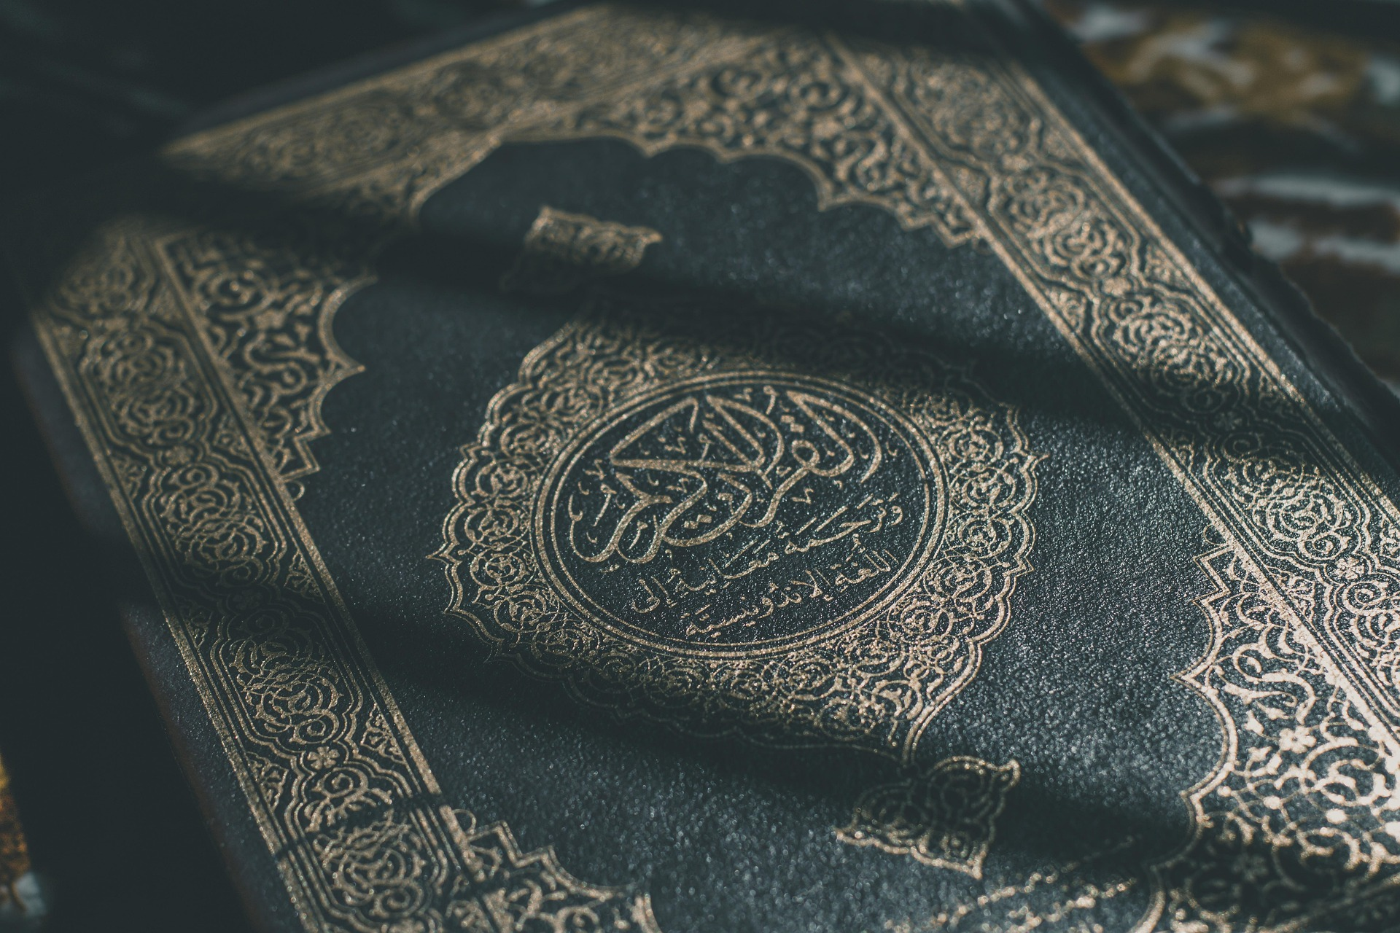
The Qur’ān is the greatest miracle Allah has sent down to us. It is the comfort to our hearts and the compass which guides us at every point in life. It is our eternal companion.
Notes:
1 min

Slide 12
Your Relationship With the Qur’ān
Reflect
How will you improve your relationship with the Qur’ān this Ramadan?
Learn how to recite the Qur’ān properly.
Have a fixed daily amount (wird) of recitation.
Try to memorise a portion of the Qur’ān.
Know and understand the meaning of what you recite.
Reflect upon the Qur’ān. Ask yourself, what is Allah saying to ME in these verses?
Increase your īmān through the Qur’ān.
Act upon the Qur’ān and behave according to it.
Notes:
Explanation: 4 mins
Reflect: 1 min

Slide 13
Denial of the Messenger
Discuss
If Allah had sent an angel instead of a human messenger, how do you think some people would have reacted?
2. ˹All will be resurrected,˺ yet the deniers are astonished that a warner has come to them from among themselves ˹warning of resurrection˺. So the disbelievers say, “This is an astonishing thing!
Notes:
4 mins

Slide 14
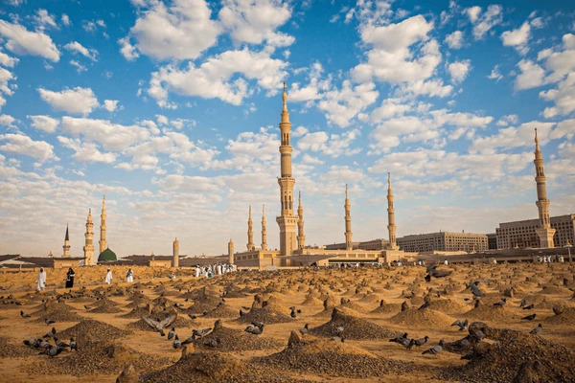
Denial of Resurrection
The Quraysh did not believe it was possible for humans to be brought back to life after they had perished and their bones decomposed.
The remainder of the sūrah is a response to this claim.
3. ˹Will we be returned to life,˺ when we are dead and reduced to dust? Such a return is impossible.”
Notes:
3 mins

Slide 15
Allah’s Absolute Knowledge
Recorded in al-Lawḥ al-Maḥfūẓ—every single thing is recorded; not one thing is missed out.
كِتَـٰبٌ حَفِيظٌ
4. We certainly know what the earth consumes of them ˹after their death˺, and with us is a well-preserved Record.
Reflect
How does this verse make you feel?
Notes:
Explanation: 3 mins
Reflect: 1 min
Feedback: 2 mins

Slide 16
Wandering in Confusion
Consequence of those who reject the message = confusion
مَّرِيجٍ - Mixed and confused (marajal baḥrayn); there will be no meaning and purpose to their life if they reject the truth
5. In fact, they reject the truth when it has come to them, so they are in a confused state.
Imagine waking up on a plane with no idea how you got there, who brought you, or where you’re headed. How would you feel if that was your life?
Notes:
5 mins

Slide 17
How Does Belief in the Hereafter Impact the Way You Live Your Life?
Reflect
Act
In which aspect of your life do you feel you are not prioritising the Ākhirah enough?
Write down one concrete action you will take starting this week to move closer to living an Ākhirah-focused life.
Notes:
It should make us view our lives and the world around us with an Ākhirah-centric lens.
Action: speakers are encouraged to prompt the audience to think about the different facets of their life: health, social, relationships, work, spirituality, leisure etc and then pick one where they feel like they don’t prioritise the akhirah
Reflect: 2 mins
Act: 2 mins
Feedback: 2 mins

Slide 18
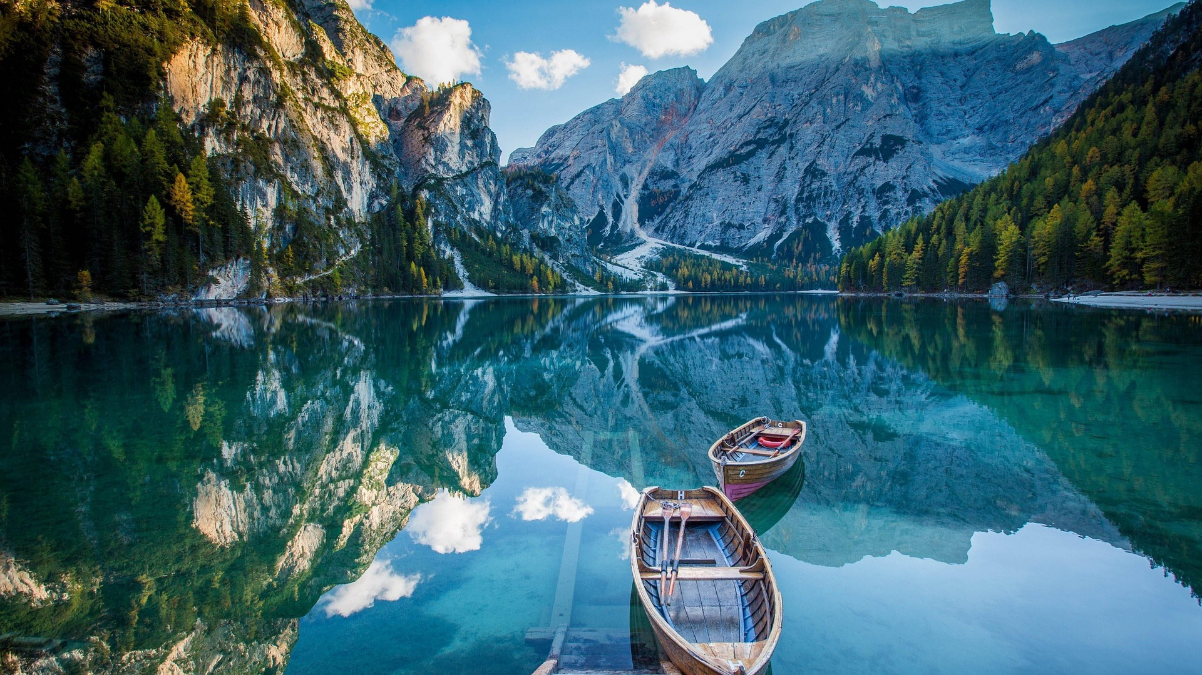
The Signs of Allah Around Us
Session 1: Part 2

Slide 19
The Flawless Sky
Allah is telling us to reflect on the signs around us: nature. This is part of fitrah.
The sky reflects Allah’s power and beauty: built, adorned, and flawless in structure. Similar to the truth.
Connect the physical to the spiritual. The Prophet ﷺ would frequently look at the sky and glorify Allah.
6. Have they not then looked at the sky above them: how We built it and adorned it ˹with stars˺, leaving it flawless?
Act
How can we put this verse into practice?
Notes:
5 mins
Revive this Sunnah—step into nature, observe the trees and sky, and reflect on the Creator.

Slide 20
The Earth
Change in order: telling us to look at the earth first.
رَوَٰسِىَ - Purpose to make the earth firm/stable. Revelation’s purpose is to make our hearts firm and stable too.
Book of revelation & Book of the universe
بَهِيجٍ - Joyous, beautiful. Look at the creation of Allah; it’s beautiful. We just need to open our eyes and hearts.
7. As for the earth, We spread it out and placed upon it firm mountains, and produced in it every type of pleasant plant.
Notes:
4 mins

Slide 21
The Chosen People
تَبْصِرَةً comes from baṣar (outer) and baṣīrah (internal).
Any knowledge that does not lead us to knowing Allah is incomplete, false or useless.
The Book of the Universe:
Readable in all languages by all methods;
Accessible to people with all abilities: literate and illiterate.
Condition: عَبْدٍ مُّنِيبٍ. The reminder will only be internalised by those who constantly return to Allah.
8. ˹all as˺ an insight and a reminder to every servant who turns ˹to Allah˺
Notes:
4 mins

Slide 22
The Source of Life
Write
5 things in nature, in your home, or in your body that depend on water to survive
Discuss
9. And We send down blessed rain from the sky, bringing forth gardens and grains for harvest
What are the similarities between water from the sky and revelation from the sky?
Notes:
Write/draw: 1 min
Discuss: 1 min
Feedback: 2 mins

Slide 23
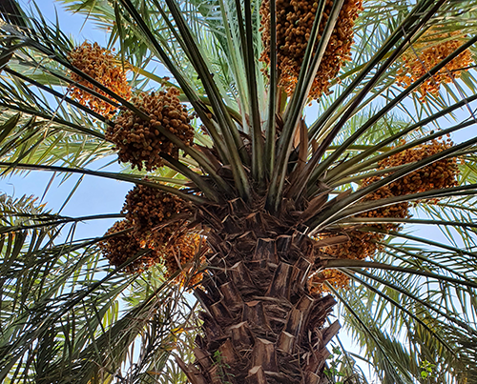
Palm Trees
Can survive in extreme heat;
Have a long life and durability;
Produce abundant fruit: variety of flavours, colours and textures.
10. and towering palm trees ˹loaded˺ with clustered fruit
Notes:
3 mins

Slide 24
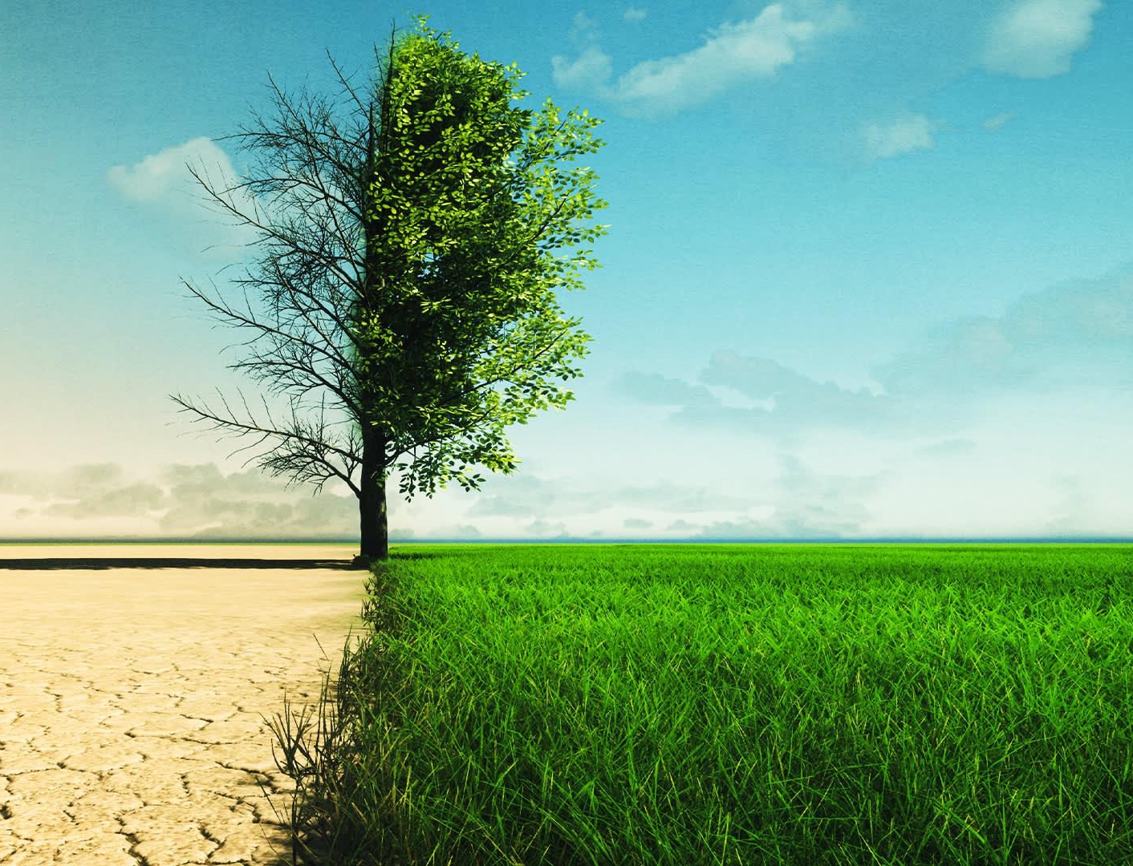
Life to the Dead
The parable Allah is giving here is regarding resurrection
Allah is telling the disbelievers: the One who can cause the dead earth to come back to life, can certainly bring you back to life again.
11. ˹as˺ a provision for ˹Our˺ servants. And with this ˹rain˺ We revive a lifeless land. Similar is the emergence ˹from the graves˺
Notes:
3 mins

Slide 25
A Glance at History
Allah is telling us to look at nations in the past who denied the truth
8 civilisations are mentioned: 4 in Arabia and 4 outside of Arabia
Water is a blessing, but can also be used as a punishment: People of Nūḥ, Aṣḥāb al-Rass, ʿĀd & Firʿawn
12. Before them, the people of Noah denied ˹the truth,˺ as did the people of the Water-pit, Thamûd, 13. ’Ȃd, Pharaoh, the kinfolk of Lot
Discuss
Why does Allah tell us to look at the signs in history?
Notes:
Discussion: 5 mins
Discuss: 1 min
Feedback: 1 min

Slide 26
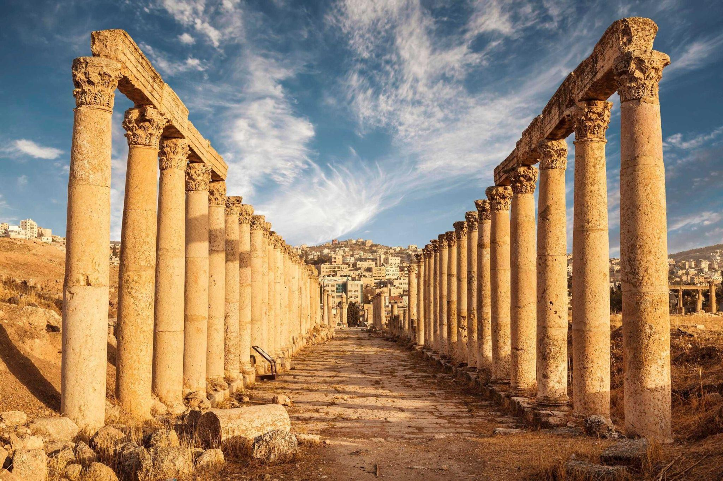
The Stark Warning
Some civilisations reached great heights. Yet, they rejected the message and were punished.
Allah is teaching us through history that no matter how advanced a civilisation has become, it is not immune to His punishment.
14. the residents of the Forest, and the people of Tubba’. Each rejected ˹their˺ messenger, so My warning was fulfilled.
Notes:
3 mins

Slide 27
Plenary
Any reflections/questions?
WRITE
Write down one new thing you learnt/felt during this session and display it visibly.
Action to take away
Notes:
The facilitator should collect all sticky notes and group them on the wall according to the main themes and then quickly do a recap of the responses.
2 mins to write down
5 mins for feedback

Slide 28
For the next session…
Homework task
Plan a nature walk/activity with your family. Look at Allah's magnificent creation, reflect on it, and jot down your thoughts. Bring these with you to the next session.
Aim High!
Memorise verses 1-14
Notes:
3 mins
All participants should be highly encouraged to memorise the verses, along with its translation.

