Slide 1
Instructions for Use
Preparation: Read the accompanying PDF, A Journey Through Surah Qaf, in advance to ensure smooth delivery.
Recitation: Recite the passage aloud and encourage attendees to repeat after you. Begin the session with the passage from Part 1 and recite the passage from Part 2 in the middle of the session.
Session Structure: Each session is divided into two parts with a short break in between.
Reflection & Discussion: Dedicate the recommended time to reflection and discussion questions—this is essential for fostering a culture of tadabbur (deep contemplation).
Timings: Suggested timings for each slide are provided in the slide descriptions for guidance.
Engagement: Display the starter question as attendees arrive and settle in.
Memorisation: Encourage all attendees to memorise both the Arabic and English translations of the verses.
Notes:
2 mins

Slide 2
Starter
When you are going through a difficult time, what strategies/techniques do you use to navigate those times?
Notes:
Play in background Surah Qāf: https://www.youtube.com/watch?v=jLQXotfD0dw&t=12s
Have the question ready on the board so learners can start thinking as they walk in/wait for the session to start.

Slide 3
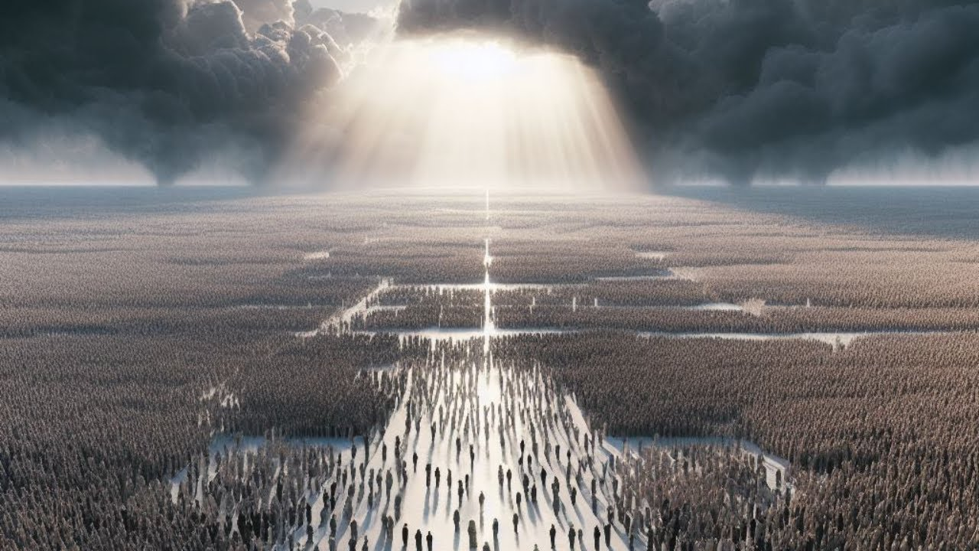
AN EASY
RESURRECTION
Surah Qāf: Session 4

Slide 4
Duʿā for opening of the heart
اَللّٰهُمَّ إِنِّيْ عَبْدُكَ ، وَابْنُ عَبْدِكَ ، وَابْنُ أَمَتِكَ ، نَاصِيَتِيْ بِيَدِكَ ، مَاضٍ فِيَّ حُكْمُكَ ، عَدْلٌ فِيَّ قَضَاؤُكَ ، أَسْأَلُكَ بِكُلِّ اسْمٍ هُوَ لَكَ ، سَمَّيْتَ بِهِ نَفْسَكَ ، أَوْ عَلَّمْتَهُ أَحَدًا مِّنْ خَلْقِكَ ، أَوْ أَنْزَلْتَهُ فِيْ كِتَابِكَ ، أَوِ اسْتَأْثَرْتَ بِهِ فِيْ عِلْمِ الْغَيْبِ عِنْدَكَ ، أَنْ تَجْعَلَ الْقُرْآنَ رَبِيْعَ قَلْبِيْ ، وَنُوْرَ صَدْرِيْ ، وَجَلَاءَ حُزْنِيْ ، وَذَهَابَ هَمِّيْ
O Allah, I am Your servant and the son of Your male servant and the son of Your female servant. My forehead is in Your Hand (i.e. you have control over me). I am subject to Your judgement and Your decree concerning me is just. I ask You – by every name that is Yours, by which You have named Yourself, or taught any one of Your creation, or revealed in Your Book, or kept unto Yourself in the knowledge of the unseen that is with You – to make the Qur’ān the spring of my heart, the light of my chest, the banisher of my grief and the reliever of my anxiety.
Notes:
1 min

Slide 5
Learning
Objectives
Explore the importance of tadabbur
01
Understand how to apply true patience to difficulties in life
02
Connect the start of the surah to the end of the surah
03
Read and reflect upon verses 36-45 of Surah Qāf
04
Notes:
1 min

Slide 6
Outcome of Rejection
They built a lot of strong and mighty buildings (a strong civilisation);
They roamed the lands to search for rizq
وَكَمْ أَهْلَكْنَا قَبْلَهُم مِّن قَرْنٍ هُمْ أَشَدُّ مِنْهُم بَطْشًا فَنَقَّبُوا۟ فِى ٱلْبِلَـٰدِ هَلْ مِن مَّحِيصٍ
فَنَقَّبُوا۟ فِى ٱلْبِلَـٰدِ
36. ˹Imagine˺ how many peoples We destroyed before them, who were far mightier than them. Then ˹when the torment came,˺ they ˹desperately˺ sought refuge in the land. ˹But˺ was there any escape?
Reflect
What is this verse saying to you? Do we subconsciously think wealth and power will protect us?
Notes:
2 mins explanation
2 mins reflect

Slide 7
The Reminder
Literal Meaning: ‘this’ Refers to: - Destruction of previous nations
- What has been discussed in the sūrah
ذَٰلِكَ
إِنَّ فِى ذَٰلِكَ لَذِكْرَىٰ لِمَن كَانَ لَهُۥ قَلْبٌ أَوْ أَلْقَى ٱلسَّمْعَ وَهُوَ شَهِيدٌ
37. Surely in this is a reminder for whoever has a ˹mindful˺ heart and lends an attentive ear.
- The Qur’ān is a reminder
- It is there for us to take lessons and benefit from. This is its purpose.
لَذِكْرَىٰ
Notes:
3 mins

Slide 8
Reminder for…
3 conditions
أَلْقَى ٱلسَّمْعَ - Direct their sense of hearing completely to the One who is speaking.
إِنَّ فِى ذَٰلِكَ لَذِكْرَىٰ لِمَن كَانَ لَهُۥ قَلْبٌ أَوْ أَلْقَى ٱلسَّمْعَ وَهُوَ شَهِيدٌ
قَلْب - Heart
شَهِيدٌ - Their hearts and minds must be present during the experience.
37. Surely in this is a reminder for whoever has a ˹mindful˺ heart and lends an attentive ear.
Reflect
We all have hearts, so why did this verse mention one with a heart?
Notes:
Everyone has a physical heart, but not everyone’s ‘spiritual’ heart is alive or healthy. In order to benefit from revelation, our hearts need to be alive.
Explanation: 3 mins
Reflect: 1 min

Slide 9
“If you want to benefit from the Qur’ān, gather your heart when it is recited, focus your hearing, and act like you are being directly addressed by Allah, as it is an address from Him to you upon the tongue of His Messenger ﷺ. Allah said, ‘Indeed there is a reminder in that for whoever has a heart or whoever listens attentively with his heart present’ (50:37)” - Ibn al-Qayyim
Notes:
1 min

Slide 10
Interacting With the Qur’ān: 4 Steps
1. Tartil Recitation
3. Tadabbur Reflecting
2. Tafsir Understanding
4. Tatbiq Applying
Notes:
4 mins
Tartil (Recitation):
- Slowly, calmly
- Pausing at the end of each ayah to absorb the words
- With tajwid
- Recite beautifully: "Allah does not listen to anything as He listens to the recitation of the Qur’ān by a Prophet who recites the Qur’ān audibly and melodiously" (Bukhari).
- Feel the verses as you recite; experience the emotion.
- Cry: It is mustaḥabb (recommended) to cry whilst reciting the Qur’ān, and when it is being recited. The way to achieve this is to evoke sadness in the heart by reflecting on the severe threats, warnings and promises; and then reflecting on one’s shortcomings regarding them. And if this does not evoke sadness and crying, as it does to the elite (worshippers), then he should cry over the lack of (being able to cry), as this is one of the greatest calamities.” (Imam al Ghazali)
(Show video; 4:25 or 3:42) https://www.youtube.com/watch?v=M1oX0b1kIb4
Tafsir (Explanation):
Tadabbur (Reflection):
Tatbiq (Application):
- Our purpose is to develop Qur'anic Character. Aisha (ra) when asked about the Prophet (saw)'s character, replied: His character was the Qur'an.

Slide 11
Tadabbur
What is Allah telling me in this verse?
How does this apply to my life now?
What action will I take based on this?
Notes:
3 mins
Instructor to provide an example of a verse illustrating how to do Tadabbur.

Slide 12
“Reciting the Quran as it should be recited means for the tongue, the mind, and the heart to all take part in the act together. The tongue’s duty is to pronounce the letters correctly and recite beautifully, the mind’s duty is to explore the meanings, and the heart’s duty is to take heed and be responsive to the words with alarm and eagerness to comply. So the tongue recites, the mind explains, and the heart internalises.” - Ibn al Qayyim

Slide 13
Connection to the Start
Reason for revelation
- Sunday to Friday
- Six stages
سِتَّةِ أَيَّامٍ
وَلَقَدْ خَلَقْنَا ٱلسَّمَـٰوَٰتِ وَٱلْأَرْضَ وَمَا بَيْنَهُمَا فِى سِتَّةِ أَيَّامٍ وَمَا مَسَّنَا مِن لُّغُوبٍ
Not even an ounce of tiredness touched Him.
لُّغُوبٍ
38. Indeed, We created the heavens and the earth and everything in between in six Days, and We were not ˹even˺ touched with fatigue.
Reflect
Why is creation mentioned here again? What is Allah proving to us?
Notes:
Explanation - 4 mins
Reflect - 2 mins

Slide 14
The Remedy I
Discuss
Why does Allah ask us to remain patient?
What is Sabr?
Why does Allah send us trials?
فَٱصْبِرْ عَلَىٰ مَا يَقُولُونَ وَسَبِّحْ بِحَمْدِ رَبِّكَ قَبْلَ طُلُوعِ ٱلشَّمْسِ وَقَبْلَ ٱلْغُرُوبِ
39. So be patient ˹O Prophet˺ with what they say. And glorify the praises of your Lord before sunrise and before sunset.
Notes:
Discussion: 3 mins to discuss and 3 mins for feedback

Slide 15
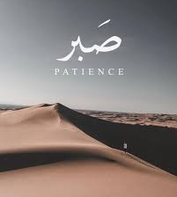
Sabr
Endurance
Contentment with Allah’s decree
Persevering towards your goals
Not losing control of yourself
Notes:
3 mins
Some resources to understand the meaning of sabr:
https://www.islam21c.com/propagation/qualities-for-success-self-control/
https://yaqeeninstitute.org/watch/series/the-true-meaning-of-patience-late-night-talk
https://muslimmatters.org/2023/07/21/when-problems-have-no-solution-making-peace-with-endless-trials/

Slide 16
“Sabr is not passive; it is perseverance in the face of obstacles, staying focused, and self-controlled during challenges. Sabr is active, deep, and essential.”

Slide 17
Activity
Think about a recent struggle you faced:
Family Disagreements Misunderstandings
Work Difficult colleagues High stress
Religion Personal struggles with faith Criticism from others
Islamophobia Discrimination Negative remarks
How did you react. Did you remain patient, or did frustration take over?
What was the outcome of your reaction? Did it improve or worsen the situation?
How could you have acted with sabr in the situation
Notes:
10 mins

Slide 18
The Remedy II
Tasbīḥ and ḥamd are our powerful weapons
Morning & Evening: connects the physical signs around us to our Creator.
When you glorify Allah, you have a direct link with Him, and one who maintains such a link is content and reassured and thus able to remain patient.
فَٱصْبِرْ عَلَىٰ مَا يَقُولُونَ وَسَبِّحْ بِحَمْدِ رَبِّكَ قَبْلَ طُلُوعِ ٱلشَّمْسِ وَقَبْلَ ٱلْغُرُوبِ
39. So be patient ˹O Prophet˺ with what they say. And glorify the praises of your Lord before sunrise and before sunset.
Commit to setting a daily adhkār routine.
How has dhikr helped you during a difficult time?
Notes:
Explanation: 2 mins
Act: 1 min
Reflect: 2 mins

Slide 19
The Remedy III
Allah emphasises the night frequently in the Qur’ān.
The night is for rest. The rest of the body is sleeping. The rest for the soul is qiyām.
ٱلسُّجُودِ - prostrating; this indicates ṣalāh. Most important part of ṣalāh is sujūd.
Adhkar after salah: Immediately after the ṣalāh, the Prophet ﷺ would say astaghfirullah.
This could also refer to the sunan ṣalāh after the farḍ.
وَمِنَ ٱلَّيْلِ فَسَبِّحْهُ وَأَدْبَـٰرَ ٱلسُّجُودِ
40. And glorify Him during part of the night and after the prayers.
Notes:
3 mins

Slide 20
The End
Session 4: Part 2

Slide 21
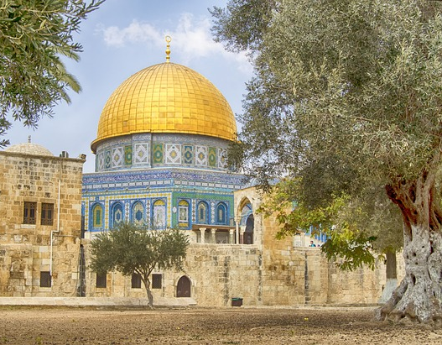
Back to the Final Day
Zamakhsharī: the rock of Al-Quds: it is the closest part of the earth to the sky and the center of the earth.
وَٱسْتَمِعْ يَوْمَ يُنَادِ ٱلْمُنَادِ مِن مَّكَانٍ قَرِيبٍ
The closest places to people so that the call reaches everyone equally, at the same time.
41. And listen! On the Day the caller will call out from a near place
Notes:
2 mins

Slide 22
The Mighty Blast
Challenge
In which verse in this surah has the blast already been mentioned?
يَوْمَ يَسْمَعُونَ ٱلصَّيْحَةَ بِٱلْحَقِّ ۚ ذَٰلِكَ يَوْمُ ٱلْخُرُوجِ
42. the Day all will hear the ˹mighty˺ Blast in ˹all˺ truth, that will be the Day of emergence ˹from the graves˺.
Notes:
Challenge: 1 min

Slide 23
The Royal We
Repetition of: we and only we.
إِنَّا نَحْنُ نُحْىِۦ وَنُمِيتُ وَإِلَيْنَا ٱلْمَصِيرُ
43. It is certainly We Who give life and cause death. And to Us is the final return.
Notes:
Explanation: 2 mins

Slide 24
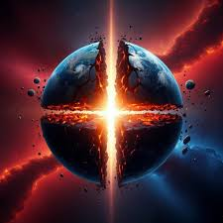
Back to the Point
Reflect
How does this verse make you feel?
يَوْمَ تَشَقَّقُ ٱلْأَرْضُ عَنْهُمْ سِرَاعًا ۚ ذَٰلِكَ حَشْرٌ عَلَيْنَا يَسِيرٌ
44. ˹Beware of˺ the Day the earth will split open, letting them rush forth. That will be an easy gathering for Us.
Notes:
Reflect: 3 mins

Slide 25
The All-Aware
Comforting the Messenger
Prophet’s role is only to convey the message, not to force belief.
Guidance comes from Allah alone. Our role is to share the truth, trusting that the outcome is in His hands.
نَّحْنُ أَعْلَمُ بِمَا يَقُولُونَ ۖ وَمَآ أَنتَ عَلَيْهِم بِجَبَّارٍ ۖ فَذَكِّرْ بِٱلْقُرْءَانِ مَن يَخَافُ وَعِيدِ
45. We know best what they say. And you ˹O Prophet˺ are not ˹there˺ to compel them ˹to believe˺. So remind with the Qur’ān ˹only˺ those who fear My warning.
Reflect
How are we conveying the message of Allah? Are we giving it its due right?
Notes:
Explanation: 3 mins
Reflect: 3 mins

Slide 26
The Best Reminder
The Qur’ān is the best reminder; that is why we need to constantly turn to it and reflect on it.
The Qur’ān is our methodology, it is our fuel and thus we need it to navigate all of life’s challenges.
نَّحْنُ أَعْلَمُ بِمَا يَقُولُونَ ۖ وَمَآ أَنتَ عَلَيْهِم بِجَبَّارٍ ۖ فَذَكِّرْ بِٱلْقُرْءَانِ مَن يَخَافُ وَعِيدِ
45. We know best what they say. And you ˹O Prophet˺ are not ˹there˺ to compel them ˹to believe˺. So remind with the Qur’ān ˹only˺ those who fear My warning.
Discuss
Who benefits from the reminder?
Notes:
Explanation: 4 mins

Slide 27
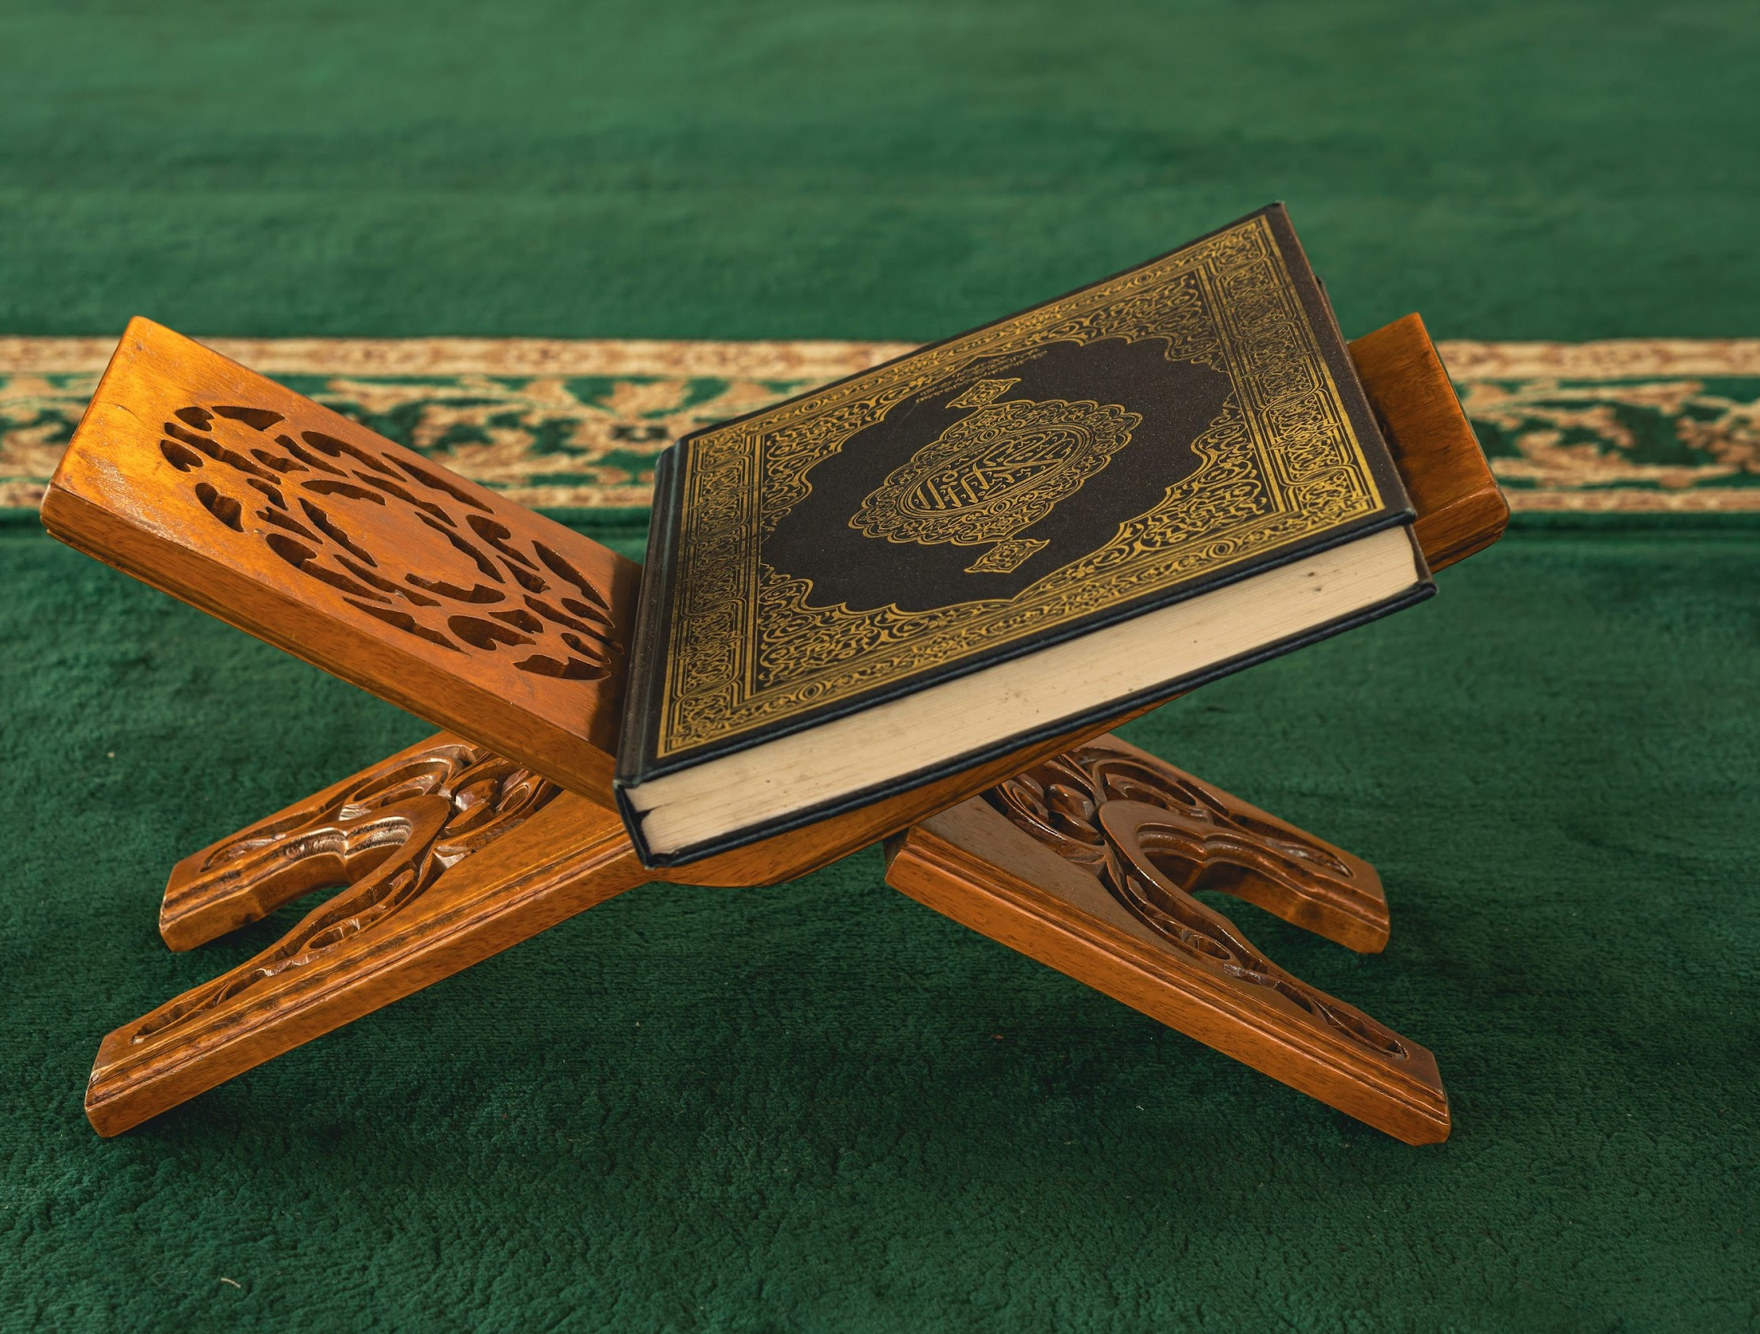
Reflect
How has your relationship with the Qur’ān changed over the last 4 weeks?
What do you want your relationship with the Qur’ān to look like going forwards?
Notes:
5 mins

Slide 28
Plenary
Any reflections/questions?
WRITE
Write down one thing that changed your perspective/transformed you from this surah.
Action to take away
Notes:
The facilitator should collect all sticky notes and group them on the wall according to the main themes.

Slide 29
Until Next Ramadan
Homework task
Commit to one new action you will take to strengthen your relationship with the Qur’ān.
Aim High!
Recite Surah Qāf in your salah

