Slide 1
Instructions for Use
Preparation: Read the accompanying PDF, A Journey Through Surah Qaf, in advance to ensure smooth delivery.
Recitation: Recite the passage aloud and encourage attendees to repeat after you. Begin the session with the passage from Part 1 and recite the passage from Part 2 in the middle of the session.
Session Structure: Each session is divided into two parts with a short break in between.
Reflection & Discussion: Dedicate the recommended time to reflection and discussion questions—this is essential for fostering a culture of tadabbur (deep contemplation).
Timings: Suggested timings for each slide are provided in the slide descriptions for guidance.
Engagement: Display the starter question as attendees arrive and settle in.
Memorisation: Encourage all attendees to memorise both the Arabic and English translations of the verses.
Notes:
2 mins

Slide 2
Starter
“You have been granted entry into Jannah, the eternal Paradise of peace and eternal bliss, where no sorrow, no pain, will ever touch you again.”
Imagine your outcome
Imagine you are standing on the Day of Judgement, waiting for the outcome of your test and you hear one of these scenarios. On a post-it note, write down how you would feel in each of the scenarios.
“You have been condemned to the Hell-fire, where you will dwell in agony forever, with no escape, no relief.”
Notes:
Play in background Surah Qāf: https://www.youtube.com/watch?v=jLQXotfD0dw&t=12s
Have the question ready on the board so learners can start thinking as they walk in/wait for the session to start.
Feedback: 4 mins

Slide 3
HEAVEN &
HELL
Surah Qāf: Session 3

Slide 4
Duʿā for opening of the heart
اَللّٰهُمَّ إِنِّيْ عَبْدُكَ ، وَابْنُ عَبْدِكَ ، وَابْنُ أَمَتِكَ ، نَاصِيَتِيْ بِيَدِكَ ، مَاضٍ فِيَّ حُكْمُكَ ، عَدْلٌ فِيَّ قَضَاؤُكَ ، أَسْأَلُكَ بِكُلِّ اسْمٍ هُوَ لَكَ ، سَمَّيْتَ بِهِ نَفْسَكَ ، أَوْ عَلَّمْتَهُ أَحَدًا مِّنْ خَلْقِكَ ، أَوْ أَنْزَلْتَهُ فِيْ كِتَابِكَ ، أَوِ اسْتَأْثَرْتَ بِهِ فِيْ عِلْمِ الْغَيْبِ عِنْدَكَ ، أَنْ تَجْعَلَ الْقُرْآنَ رَبِيْعَ قَلْبِيْ ، وَنُوْرَ صَدْرِيْ ، وَجَلَاءَ حُزْنِيْ ، وَذَهَابَ هَمِّيْ
O Allah, I am Your servant and the son of Your male servant and the son of Your female servant. My forehead is in Your Hand (i.e. you have control over me). I am subject to Your judgement and Your decree concerning me is just. I ask You – by every name that is Yours, by which You have named Yourself, or taught any one of Your creation, or revealed in Your Book, or kept unto Yourself in the knowledge of the unseen that is with You – to make the Qur’ān the spring of my heart, the light of my chest, the banisher of my grief and the reliever of my anxiety.
Notes:
1 min

Slide 5
Learning
Objectives
Reflect on the importance of the heart
01
Learn how to develop a heart that always turns to Allah
02
Explore the characteristics of the People of Jannah
03
Read and reflect upon verses 30-35 of Surah Qāf
04
Notes:
1 min

Slide 6
Shiver-inducing
Horrifying & frightening scene:
Hell will become full to the extent that no more can be added to it.
There will always be room for more in Hell: current people will get squashed and constricted even further.
Hell is so huge that despite the huge numbers of people entering it, there will be room for more.
يَوْمَ نَقُولُ لِجَهَنَّمَ هَلِ ٱمْتَلَأْتِ وَتَقُولُ هَلْ مِن مَّزِيدٍ
30. ˹Beware of˺ the Day We will ask Hell, “Are you full ˹yet˺?” And it will respond, “Are there any more?”
Notes:
4 mins

Slide 7
The Contrast
Pleasant, calm and friendly scene.
أُزْلِفَتِ - brought close. They won’t go to Jannah, it will be brought close to them.
Honour is shown with every word in these scenes; Paradise is brought near so they don’t have to trouble themselves by going to it.
وَأُزْلِفَتِ ٱلْجَنَّةُ لِلْمُتَّقِينَ غَيْرَ بَعِيدٍ
31. And Paradise will be brought near to the righteous, not far off.
Notes:
3 mins

Slide 8
The People of Paradise I
The one who constantly returns to his Lord. The one who always repents to Allah.
أَوَّابٍ
هَـٰذَا مَا تُوعَدُونَ لِكُلِّ أَوَّابٍ حَفِيظٍ
32. ˹And it will be said to them,˺ “This is what you were promised, for whoever ˹constantly˺ turned ˹to Allah˺ and kept up ˹His commandments˺—
Protector; the one who protects their eyes, ears etc from anything ḥarām and from crossing Allah’s boundaries.
حَفِيظٍ
Notes:
4 mins

Slide 9
The People of Paradise II
+
Fear
خَشِىَ
Glorification
Sincere heart
Heart that is always turning to Allah
A heart that remembers its sins in private and seeks repentance for it
بِقَلْبٍ مُّنِيبٍ
مَّنْ خَشِىَ ٱلرَّحْمَـٰنَ بِٱلْغَيْبِ وَجَآءَ بِقَلْبٍ مُّنِيبٍ
Reflect
33. who were in awe of the Most Compassionate without seeing ˹Him˺, and have come with a heart turning ˹only to Him˺.
Do you sometimes feel unworthy of Jannah because of your sins? How does this verse shift your perspective on the characteristics of the People of Jannah?
Notes:
Discussion: 5 mins
Reflect: 2 mins
Feedback: 2 mins

Slide 10
Repentance & The Heart
Challenge
In which other verse in this surah does the word ‘munīb’ come?
Which Prophet was described as ‘munīb’?
Allah mentions the people of Jannah: He starts with repentance (‘awwāb’) and ends with repentance (‘munīb’).
Every act of worship has an outer and inner aspect.
Focus on the inner and the outer will follow in course.
Notes:
Discussion: 5 mins
Reflect: 2 mins
Feedback: 2 mins

Slide 11
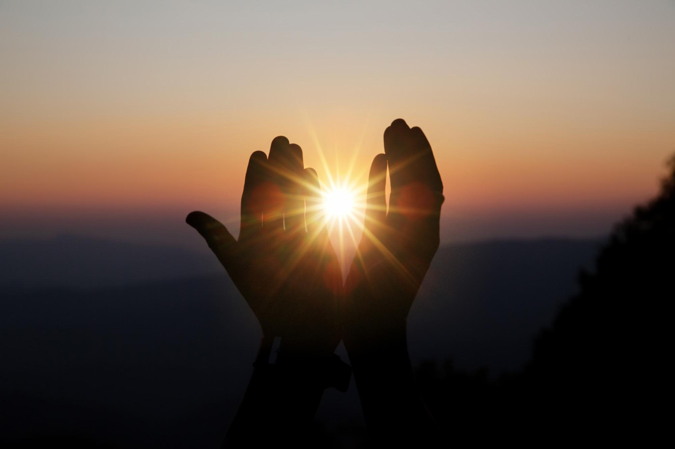
One of our key life goals and duʿā’ should be to reach the level of inābah. Inābah consists of repeatedly turning to Allah with love and humility; and to turn away from other than Him.
Notes:
1 min

Slide 12
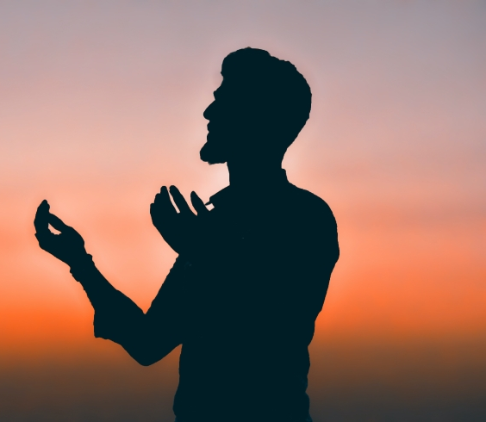
Write a Letter
Think of a recent sin you have committed
Write down a letter to Allah begging Him to forgive you
Reflect
Acknowledge your lowly status
How did the activity make you feel?
What stops you from turning to Allah in repentance?
What steps can you take to ensure you are always turning to Allah and focused on Him?
BEG
Promise to try your best to never go back to the sin
Ask Allah to help you stay away from the sin
Notes:
https://productivemuslim.com/tawbah-to-do-list/
https://productivemuslim.com/doodle-tawbah-to-do-list/ - Can print this out for attendees
10 mins

Slide 13
Eternal Bliss
Session 3: Part 2

Slide 14
The Best Welcome
Salām has two meanings: peace and greetings. Both are intended here.
Salām; eternal peace and serenity is the ultimate goal; this dunyā is not a place of peace.
The best greeting we will inshā’Allāh hear is: سَلَامٌ قَوْلًا مِّن رَّبٍّ رَّحِيمٍ
ٱدْخُلُوهَا بِسَلَـٰمٍ ۖ ذَٰلِكَ يَوْمُ ٱلْخُلُودِ
34. Enter it in peace. This is the Day of eternal life!”
Challenge
Which surah is the ayah above in?
Notes:
Discussion: 4 mins
Challenge: 1 min
Answer: Surah Yasin, Ayah 58

Slide 15
Everything You’ve Ever Wished
In Jannah there are two types of naʿīm
لَهُم مَّا يَشَآءُونَ فِيهَا وَلَدَيْنَا مَزِيدٌ
Physical
Spiritual
35. There they will have whatever they desire, and with Us is ˹even˺ more.
Reflect
How does this verse make you feel?
Notes:
Discussion: 2 mins
Reflect: 1 min
Feedback: 1 min

Slide 16
Notes:
Video: 6 mins

Slide 17
What More?
‘More’ refers to the gift of seeing Allah.
لَهُم مَّا يَشَآءُونَ فِيهَا وَلَدَيْنَا مَزِيدٌ
35. There they will have whatever they desire, and with Us is ˹even˺ more.
Notes:
Discussion: 2 min

Slide 18
The greatest joy a believer will enjoy in the hereafter will be the joy of seeing Allah and meeting Him. There are no words which can describe how phenomenal this experience will be. When the people of Jannah will see Allah ﷻ with their very own eyes, they will forget all the previous blessings given to them in Paradise.
Notes:
1 min

Slide 19
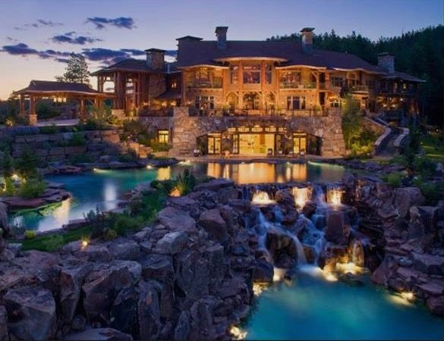
Your Jannah
The Companions felt like the Hereafter was very real and this motivated them and kept them on track.
As humans we need a reminder of Jannah to motivate us.
Draw/Describe your ideal Jannah; don’t forget to engage all of your senses
Notes:
15 mins
Put a calm nasheed in the background or you can also play this spoken word:
https://www.youtube.com/watch?v=_gGmqpulygw

Slide 20
Using Your Jannah Vision
Allah gives us tribulations and trials to help us wake up and turn to Him; this is done out of His mercy as He wants eternal happiness and bliss for us.
Next time you go through a trial
Wear Your Akhirah Glasses 👓 – Shift your perspective
Take Action – Identify the steps you need to take to stay on the right path (patience, du‘ā, steadfastness, repentance etc)
Take out your Vision Board
Refocus on the Goal
Notes:
3 mins

Slide 21
Plenary
Any reflections/questions?
WRITE
What one action will you start from today to develop one of the 4 characteristics of the People of Jannah mentioned in the session?
Write it on the post-it note.
Action to take away
Notes:
The facilitator should collect all sticky notes and group them on the wall according to the main themes.
5 mins

Slide 22
For the next session…
Homework task
When you face a challenge during the next week, take out your Jannah vision board/written piece and use it to help put your akhirah glasses on.
Aim High!
Memorise verses 30-35
Notes:
2 mins

