Slide 1
Instructions for Use
Preparation: Read the accompanying PDF, A Journey Through Surah Qaf, in advance to ensure smooth delivery.
Recitation: Recite the passage aloud and encourage attendees to repeat after you. Begin the session with the passage from Part 1 and recite the passage from Part 2 in the middle of the session.
Session Structure: Each session is divided into two parts with a short break in between.
Reflection & Discussion: Dedicate the recommended time to reflection and discussion questions—this is essential for fostering a culture of tadabbur (deep contemplation).
Timings: Suggested timings for each slide are provided in the slide descriptions for guidance.
Engagement: Display the starter question as attendees arrive and settle in.
Memorisation: Encourage all attendees to memorise both the Arabic and English translations of the verses.
Notes:
2 mins

Slide 2
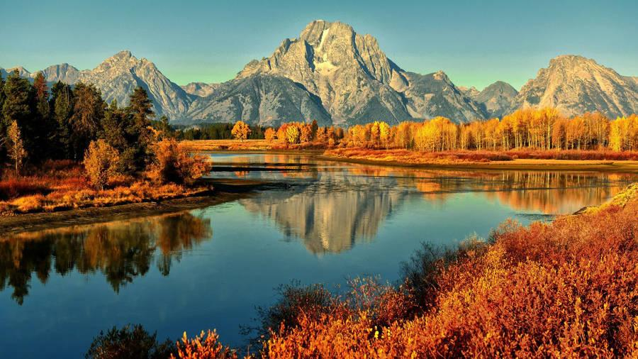
Starter
On your walk, what thoughts did you have of Allah?
Notes:
Play in background Surah Qāf: https://www.youtube.com/watch?v=jLQXotfD0dw&t=12s
Have the question ready on the board so learners can start thinking as they walk in/wait for the session to start.

Slide 3
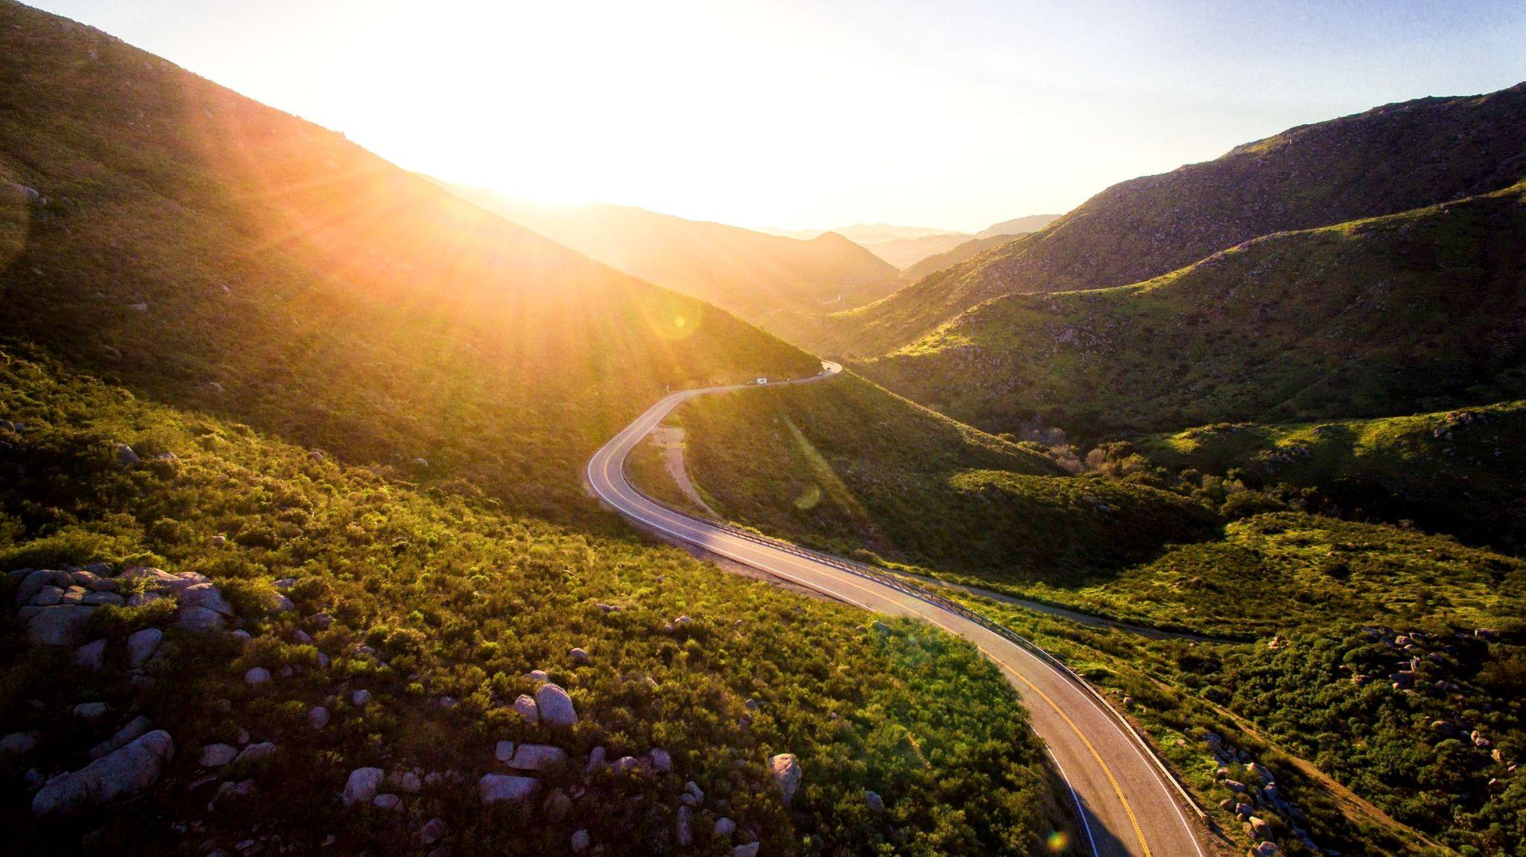
JOURNEY
THROUGH LIFE
Surah Qāf: Session 2

Slide 4
Duʿā for opening of the heart
اَللّٰهُمَّ إِنِّيْ عَبْدُكَ ، وَابْنُ عَبْدِكَ ، وَابْنُ أَمَتِكَ ، نَاصِيَتِيْ بِيَدِكَ ، مَاضٍ فِيَّ حُكْمُكَ ، عَدْلٌ فِيَّ قَضَاؤُكَ ، أَسْأَلُكَ بِكُلِّ اسْمٍ هُوَ لَكَ ، سَمَّيْتَ بِهِ نَفْسَكَ ، أَوْ عَلَّمْتَهُ أَحَدًا مِّنْ خَلْقِكَ ، أَوْ أَنْزَلْتَهُ فِيْ كِتَابِكَ ، أَوِ اسْتَأْثَرْتَ بِهِ فِيْ عِلْمِ الْغَيْبِ عِنْدَكَ ، أَنْ تَجْعَلَ الْقُرْآنَ رَبِيْعَ قَلْبِيْ ، وَنُوْرَ صَدْرِيْ ، وَجَلَاءَ حُزْنِيْ ، وَذَهَابَ هَمِّيْ
O Allah, I am Your servant and the son of Your male servant and the son of Your female servant. My forehead is in Your Hand (i.e. you have control over me). I am subject to Your judgement and Your decree concerning me is just. I ask You – by every name that is Yours, by which You have named Yourself, or taught any one of Your creation, or revealed in Your Book, or kept unto Yourself in the knowledge of the unseen that is with You – to make the Qur’ān the spring of my heart, the light of my chest, the banisher of my grief and the reliever of my anxiety.
Notes:
1 min

Slide 5
Learning
Objectives
Reflect on the impact of being aware of Allah’s closeness to us
01
Practise taking an ‘audit’ of your actions
02
Explore the characteristics of the People of Hell and develop strategies to avoid them
03
Read and reflect upon verses 15-29 of Surah Qāf
04
Notes:
1 min

Slide 6
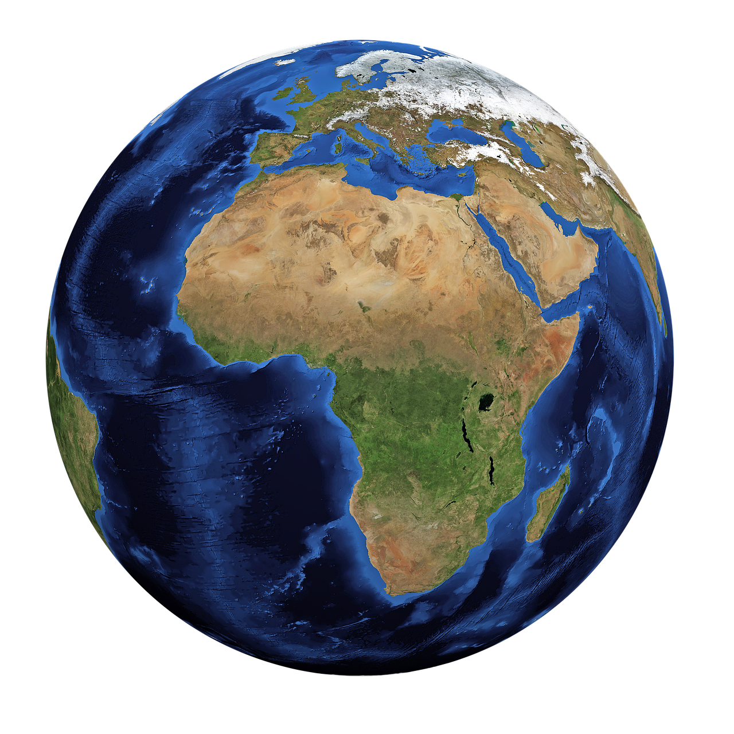
The 4 Stages of Life
On the ground
Under the ground
The Day of Judgement
The eternal abode: Paradise or Hell-Fire
The first, shortest and most important stage is on the ground.
Our status in all of the other stages is dependent on how we behave in the first stage of life.
Notes:
3 mins

Slide 7
Allah’s Might
لَبْسٍ - confusion. يَلْبِسُ means to mix something; confusion arises when things are mixed up and are unclear.
أَفَعَيِينَا بِٱلْخَلْقِ ٱلْأَوَّلِ ۚ بَلْ هُمْ فِى لَبْسٍ مِّنْ خَلْقٍ جَدِيدٍ
15. Were We incapable of creating ˹them˺ the first time? In fact, they are in doubt about ˹their˺ re-creation.
Reflect
Is it easier to create something from scratch or to re-create something?
Notes:
Explanation: 3 mins
Reflect: 1 min

Slide 8
The Human Being
وَلَقَدْ خَلَقْنَا ٱلْإِنسَـٰنَ وَنَعْلَمُ مَا تُوَسْوِسُ بِهِۦ نَفْسُهُۥ ۖ وَنَحْنُ أَقْرَبُ إِلَيْهِ مِنْ حَبْلِ ٱلْوَرِيدِ
The biggest proof of Allah’s existence, power and might: creation of the human being
16. Indeed, ˹it is˺ We ˹Who˺ created humankind and ˹fully˺ know what their souls whisper to them, and We are closer to them than ˹their˺ jugular vein.
Discuss
Share one amazing fact you know about the human being with the person next to you.
Notes:
Explanation: 2 mins
Discuss: 1 min
Feedback: 1 min

Slide 9
Every Little Secret
Verse 4 mentions the grand things Allah knows; now He mentions the minutiae = absolute knowledge
We would not dare say a single word that does not please Allah. We wouldn’t even dwell on a bad thought = Taqwa
He doesn’t record our thoughts out of His mercy (verse 18)
وَلَقَدْ خَلَقْنَا ٱلْإِنسَـٰنَ وَنَعْلَمُ مَا تُوَسْوِسُ بِهِۦ نَفْسُهُۥ ۖ وَنَحْنُ أَقْرَبُ إِلَيْهِ مِنْ حَبْلِ ٱلْوَرِيدِ
16. Indeed, ˹it is˺ We ˹Who˺ created humankind and ˹fully˺ know what their souls whisper to them, and We are closer to them than ˹their˺ jugular vein.
Notes:
Explanation: 3 mins

Slide 10
Closer than we think
Just as the jugular vein is close yet can go unnoticed, Allah’s presence is near even if not always perceived.
وَلَقَدْ خَلَقْنَا ٱلْإِنسَـٰنَ وَنَعْلَمُ مَا تُوَسْوِسُ بِهِۦ نَفْسُهُۥ ۖ وَنَحْنُ أَقْرَبُ إِلَيْهِ مِنْ حَبْلِ ٱلْوَرِيدِ
16. Indeed, ˹it is˺ We ˹Who˺ created humankind and ˹fully˺ know what their souls whisper to them, and We are closer to them than ˹their˺ jugular vein.
Reflect
How does this verse make you feel?
Notes:
Explanation: 3 mins
Reflect: 1 min
Feedback: 1 min

Slide 11
“In this verse, there is awe, dread, and fear for one group; and comfort, solace, and peace of heart for another group.”
Imam Qushayrī
Notes:
1 min

Slide 12
The Two Angels
The Prophet ﷺ said, “The scribe (angel) on the left delays registering the sin of a Muslim for six hours. If he repents (within these six hours), and seeks Allah’s forgiveness, they drop it off. If he doesn’t, they write it down as a single sin” (Ṭabarānī).
إِذْ يَتَلَقَّى ٱلْمُتَلَقِّيَانِ عَنِ ٱلْيَمِينِ وَعَنِ ٱلشِّمَالِ قَعِيدٌ
17. As the two recording-angels—˹one˺ sitting to the right, and ˹the other to˺ the left—note ˹everything˺
Notes:
2 mins

Slide 13
Every Utterance
Watching carefully
رَقِيبٌ
Writing everything diligently
عَتِيدٌ
مَّا يَلْفِظُ مِن قَوْلٍ إِلَّا لَدَيْهِ رَقِيبٌ عَتِيدٌ
18. not a word does a person utter without having a ˹vigilant˺ observer ready ˹to write it down˺.
Reflect
Why is the recording of ‘uttering’/speech emphasised here in this verse?
Notes:
A man may say a word that is pleasing to God, without a thought of how far it can reach. God will credit him with His pleasure for it until the Day when he meets Him. Another man may say a word that is displeasing to God, without a thought of how far it can reach. God will record against him His displeasure for it until the Day when he meets Him.
Discussion: 4 mins
Reflect: 1 min
Feedback: 2 mins

Slide 14
Daily Audit Challenge
Positive/kind things I said/did in the last 24 hours
Think of the last 24 hours and write down the good and bad things you said.
Negative/hurtful things I said/did in the last 24 hours
Notes:
Explain the importance of Muhāsabah to the audience: take account of your actions on a daily basis to ensure you are living a life in alignment to what Allah wants from you.
5 mins

Slide 15
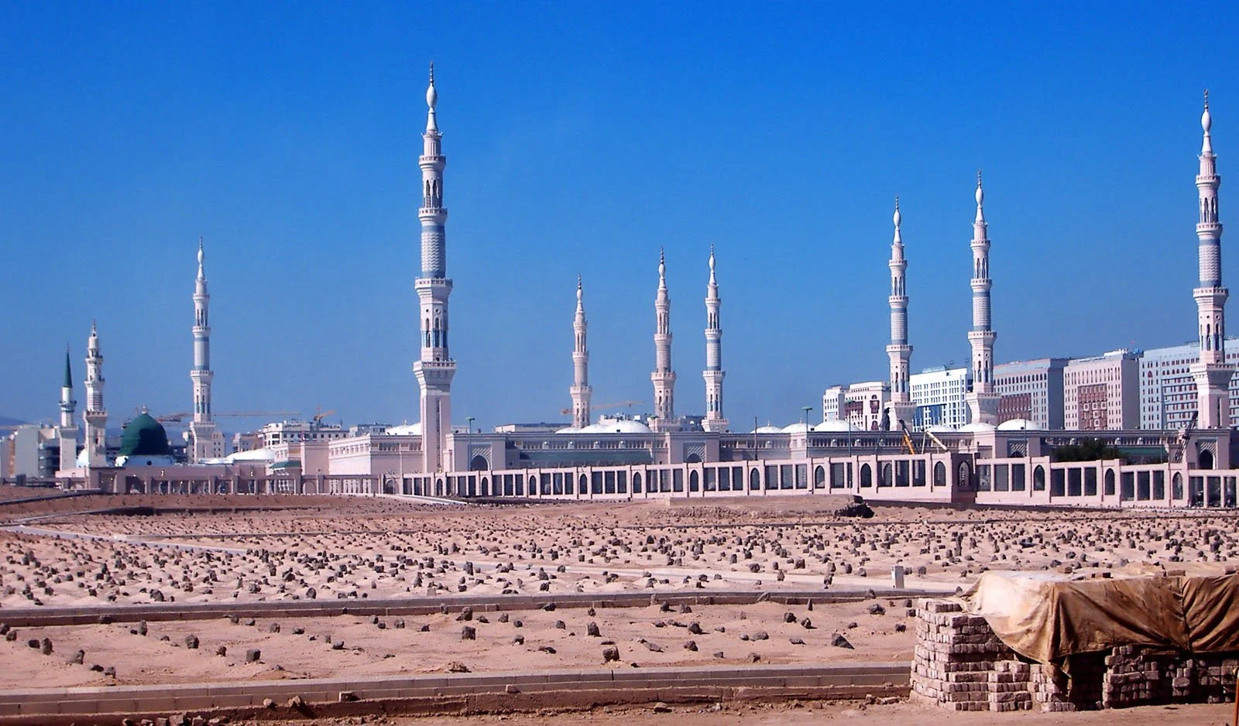
Death & Resurrection

Slide 16
The Only Guarantee
Death brings an overwhelming, almost drunken state. Even the Prophet ﷻ felt its intensity.
سَكْرَةُ ٱلْمَوْتِ
وَجَآءَتْ سَكْرَةُ ٱلْمَوْتِ بِٱلْحَقِّ ۖ ذَٰلِكَ مَا كُنتَ مِنْهُ تَحِيدُ
At the moment of death, reality becomes clear—there is no denial.
بِٱلْحَقِّ
19. ˹Ultimately,˺ with the throes of death will come the truth. This is what you were trying to escape!
We all know death is certain, yet delay preparing for it.
تَحِيدُ
Notes:
3 mins

Slide 17
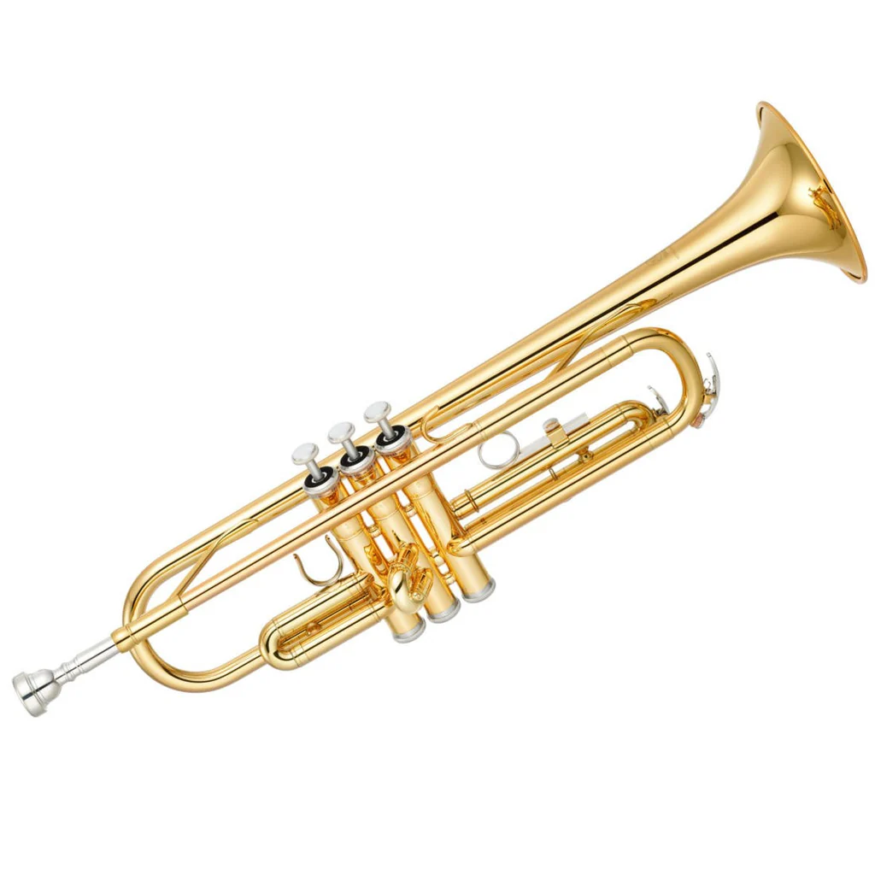
The Trumpet
Loud sounds are used for important announcements
The angel has already placed the trumpet on his lips, awaiting the command to blow.
وَنُفِخَ فِى ٱلصُّورِ ۚ ذَٰلِكَ يَوْمُ ٱلْوَعِيدِ
20. And the Trumpet will be blown. This is the Day ˹you were˺ warned of.
Write
If you knew the trumpet was going to be blown tomorrow, how would you spend your day today?
Notes:
Write:
Provide further prompts to the audience including:
How would they earn their money? (job choice)
How would they raise their children?
How would they spend their time?
What relationships would they focus on?
How would they spend their wealth?
Discussion: 3 mins
Write: 2 mins
Feedback: 2 mins

Slide 18
The Companions
سَآئِقٌ - Someone who drives/pushes forward.
شَهِيدٌ - One to bear witness for or against the person.
In a court, the police arrive with the criminal.
وَجَآءَتْ كُلُّ نَفْسٍ مَّعَهَا سَآئِقٌ وَشَهِيدٌ
21. Each soul will come forth with an angel to drive it and another to testify.
Notes:
3 mins

Slide 19
The Truth is Now Clear
The veil of sleep that is lifted (resurrection); compared to the veil of heedlessness being lifted.
لَّقَدْ كُنتَ فِى غَفْلَةٍ مِّنْ هَـٰذَا فَكَشَفْنَا عَنكَ غِطَآءَكَ فَبَصَرُكَ ٱلْيَوْمَ حَدِيدٌ
22. ˹It will be said to the denier,˺ “You were totally heedless of this. Now We have lifted this veil of yours, so Today your sight is sharp!”
Notes:
4 mins

Slide 20
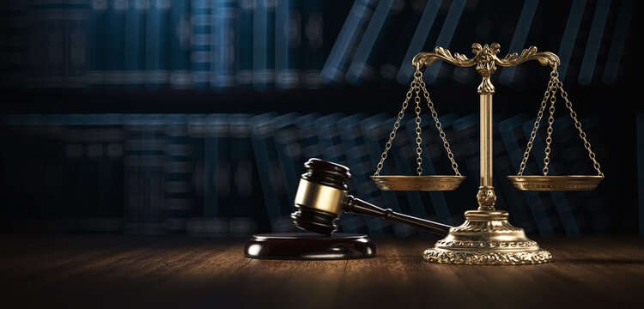
The Divine Court
Session 2: Part 2

Slide 21
Secrets Unveiled
قَرِينُ - Close companion, the one who is always with you.
Witness statement in Divine court: many witnesses
وَقَالَ قَرِينُهُۥ هَـٰذَا مَا لَدَىَّ عَتِيدٌ
Reflect
23. And one’s accompanying-angel will say, “Here is the record ready with me.”
What sin is Allah concealing for you today? How would you feel if it were to be unveiled? Take a moment to sincerely repent and seek forgiveness.
Notes:
Discussion: 4 mins
Reflect: 2 mins

Slide 22
The Verdict
Verses 24-26 reason for revelation: Walīd b. Mughīrah
Strong verse; direct command
كَفَّارٍ - exaggeration of Kāfir. Allah gave them chance upon chance, but they were extremely stubborn and denied the truth.
أَلْقِيَا فِى جَهَنَّمَ كُلَّ كَفَّارٍ عَنِيدٍ
24. ˹It will be said to both angels,˺ “Throw into Hell every stubborn disbeliever
Reflect
Is there a truth you’ve been stubborn in accepting, even though deep down you know it’s right?
Notes:
Discussion: 3 min
Reflect: 2 mins

Slide 23
Attributes of People of Hell
مَّنَّاع
Always prevented goodness for himself and others.
مُّرِيب
مُعْتَد
مَّنَّاعٍ لِّلْخَيْرِ مُعْتَدٍ مُّرِيبٍ
Aggressive and crossing the boundaries.
Doubter and spreading doubts amongst others.
25. withholder of good, transgressor, and doubter,
Discuss
How many attributes in total are there across the two verses?
Notes:
Explanation: 4-5 mins
Discuss: 1 min

Slide 24
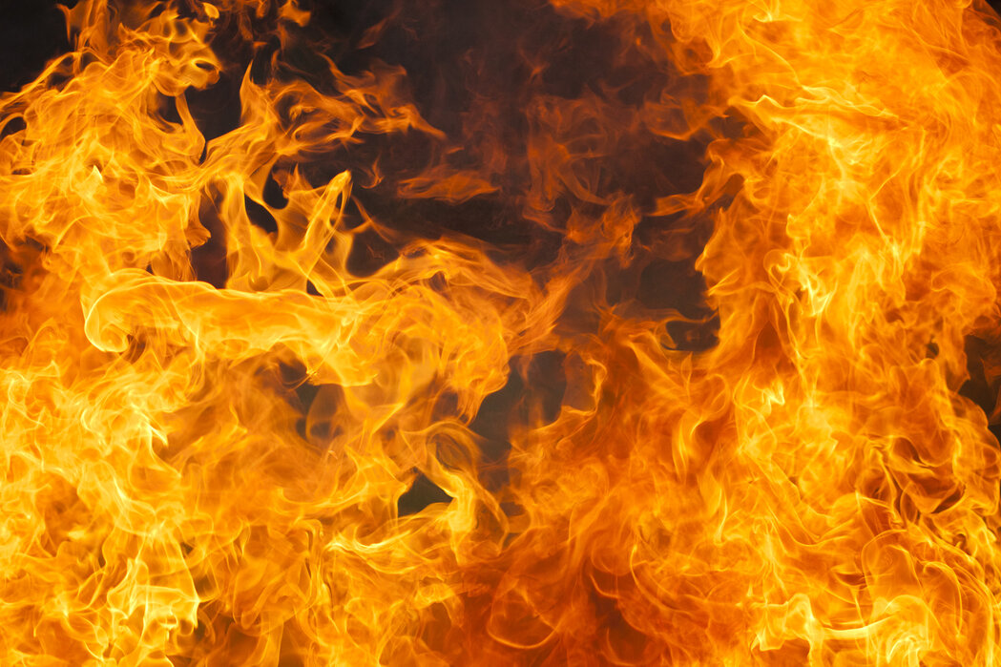
Cast Into the Fire
Discuss
How does this verse and the two verses prior make you feel?
ٱلَّذِى جَعَلَ مَعَ ٱللَّهِ إِلَـٰهًا ءَاخَرَ فَأَلْقِيَاهُ فِى ٱلْعَذَابِ ٱلشَّدِيدِ
26. who set up another god with Allah. So cast them into the severe punishment.”
Notes:
Discuss: 2 mins
Feedback: 2 mins

Slide 25
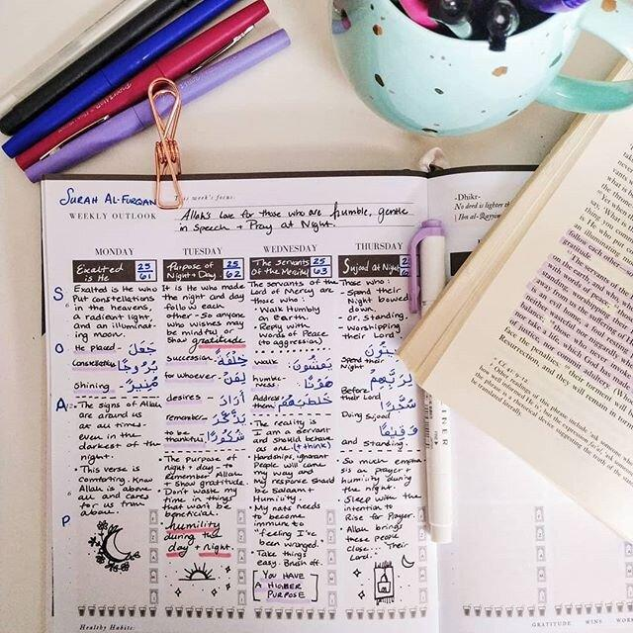
Journalling Activity
Use the prompts below to help you think and journal
1. Stubbornness (Kaffār) Is there a truth you’ve rejected, even though deep down you know it’s right?
2. Withholding Good (Mannāʿ) Have you refrained from helping someone or giving charity when you could?
3. Transgression (Muʿtad) Have you crossed boundaries in your behavior, spoken out of anger, or acted unjustly?
4. Doubt (Murīb) Are there areas of your faith that you question, or have spread doubt in others?
Seek forgiveness and ask Allah to remove these traits from you
Notes:
Just as we need to know the characteristics of the people of Jannah, we also need to learn the characteristics of the People of the Hell-Fire so we don’t fall in the trap.
10 mins

Slide 26
The Debate
قَالَ قَرِينُهُۥ رَبَّنَا مَآ أَطْغَيْتُهُۥ وَلَـٰكِن كَانَ فِى ضَلَـٰلٍۭ بَعِيدٍ
Debate between
Leaders & Followers
Individual & the Devil
27. One’s ˹devilish˺ associate will say, “Our Lord! I did not make them transgress. Rather, they were far astray ˹on their own˺.”
Notes:
3 mins

Slide 27
It’s Too Late
الْوَعِيدِ refers to:
The Qur’ān;
Messengers’ bringing the message of warning to their people
قَالَ لَا تَخْتَصِمُوا۟ لَدَىَّ وَقَدْ قَدَّمْتُ إِلَيْكُم بِٱلْوَعِيدِ
28. Allah will respond, “Do not dispute in My presence, since I had already given you a warning.
Notes:
3 mins

Slide 28
The Verdict Is Final
Allah is describing Himself in two ways in this verse:
His perfect knowledge prevents any statement being altered in front of Him
His perfect justice and fairness ensures that He never wrongs His servants.
مَا يُبَدَّلُ ٱلْقَوْلُ لَدَىَّ وَمَآ أَنَا۠ بِظَلَّـٰمٍ لِّلْعَبِيدِ
29. My Word cannot be changed, nor am I unjust to ˹My˺ creation.”
Reflect
How does this verse make you feel?
Notes:
How do you respond to Allah’s warnings when they come to you?
How would it feel to stand before Allah and have no excuse for our actions?
Discussion: 4 mins
Reflect: 2 mins
Feedback: 2 mins

Slide 29
Plenary
Any reflections/questions?
WRITE
What one specific action can you do to protect yourself from having the characteristics of the People of Hell.
You can use the journalling activity to help you.
Action to take away
Notes:
The facilitator should collect all sticky notes and group them on the wall according to the main themes.
The facilitator should give a specific example e.g. the next time my neighbour is unwell, I will send them some food.

Slide 30
For the next session…
Homework task
Spend 5 minutes every day doing a daily audit of your actions/words. Write down whether it is driving you closer to Paradise or the Hell-Fire.
Bring this with you next week.
Please also bring any artistic supplies with you next week for an activity.
Aim High!
Memorise verses 15-29

