Slide 1
Important Notes for the Educator
The PowerPoints are animated so please use the PPT version if possible.
Keep the competition active throughout the four sessions. There is a slide in the first session with instructions.
Recite the passage/ayah aloud and encourage learners to recite after you OR ask learners to recite an ayah each.
Encourage learners to memorise Surah Qaf and its translation. Reward them for successful completion.
There are speaker notes under each slide. Read the notes before delivering the session.
Please thoroughly read the free PDF ‘A Journey through Surah Qaf’ in addition to reading tafsir books and lectures of this surah.
Feel free to adjust this PPT to your learners’ needs.
[A] in the PPT = Active learning. This can be done orally, in writing, on mini-whiteboards (MWB), classroom board, through discussion; alone, in pairs, groups etc, and through other methods. Try to use a variety of methods within each session. These can all contribute to the competition score.
LWA is not responsible for external links.
If you benefit from this resource, please remember the project in your duʿas. Your feedback to improve the resources is highly appreciated.

Slide 2

بِسۡمِ ٱللَّهِ ٱلرَّحۡمَـٰنِ ٱلرَّحِیمِ
Welcome Back!
What is one thing you cannot live without?
Notes:
Start with bismillah, hamd and salawat. Greet learners, welcome them and thank them for attending.
Have the question ready on the board so learners can start thinking as they walk in/wait for the session to start.
Ask for some responses/mini-whiteboards to be raised.

Slide 3



سورة
سورة ق
The Final Clue:
Heart First
Surah Qaf: Session 4
Notes:
Today is our last session on Surah Qaf.

Slide 4

Session
Objectives
Identify the requirements of connecting to the Qur’ān
01
Apply sabr to real-life scenarios
02
03
Explore how the Qur’ān is the best reminder
Recite and reflect upon verses 36-45 of Surah Qāf
04
Notes:
Today we will…

Slide 5
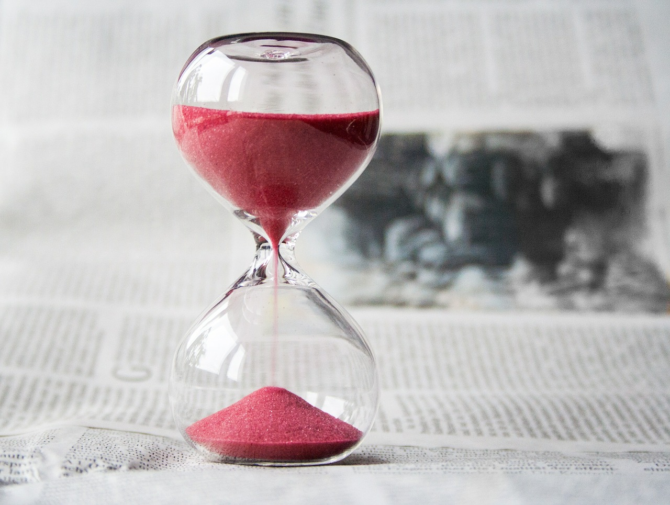
Articulate
One pass allowed
30 seconds
Can’t say ‘begins with/rhymes with’
One pass allowed
30 seconds
Can’t say ‘begins with/rhymes with’
Notes:
Use the words prepared (cut out from the attached handout with this lesson)/prepare your own list of words/phrases.
Cut them out and put them in a box/on the table.
In class, divide the students into two, three, or four teams of at least two players.
Game
The teams take turns playing.
One student from the team stands at the front of the class, so only they can see the vocabulary words. This student describes the word on the screen/paper, without using that word or any gestures.
The rest of the students in their team try to guess the word they are describing.
The teams have thirty seconds to correctly guess as many words as possible, with each correct guess scoring one point. Depending on the level of your students, and how many words you have available, you may want to allow zero, or one pass per turn.
Do the same with the other team(s), then repeat with other students describing for future rounds. The team with the most points at the end of the game wins (and gets rewarded ☺)
Find the words on the document attached to this lesson.

Slide 6
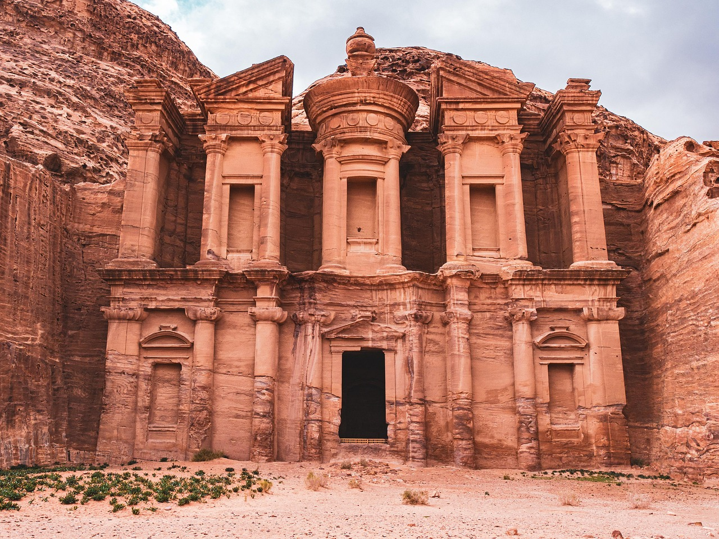
Learn From
The Past
وَكَمْ أَهْلَكْنَا قَبْلَهُم مِّن قَرْنٍ هُمْ أَشَدُّ مِنْهُم بَطْشًا فَنَقَّبُوا۟ فِى ٱلْبِلَـٰدِ هَلْ مِن مَّحِيصٍ ‎﴿٣٦﴾
Tall and physically very powerful + built many lofty strong and mighty buildings They roamed the lands to search for rizq
Message to the polytheists + anyone who comes after and thinks their wealth/power will protect them.
[A] Which āyah in this sūrah contained a similar message?
We have destroyed even mightier generations before these disbelievers, who travelled through [many] lands- was there any escape?
Notes:
Allah is reminding us that many nations before them who were mightier and more prosperous were destroyed because they disbelieved and rejected the message. They travelled far to seek livelihood and riches but when the punishment came, nothing could protect them. They had no escape or way out.
Ayah 14

Slide 7
If You Want to
Benefit…
إِنَّ فِى ذَٰلِكَ لَذِكْرَىٰ لِمَن كَانَ لَهُۥ قَلْبٌ أَوْ أَلْقَى ٱلسَّمْعَ وَهُوَ شَهِيدٌ ‎﴿٣٧﴾‏
‘This’:
      (1) Destruction of previous nations
      (2) Previous āyāt of this sūrah
[A] What are the 3 conditions of benefitting from this reminder?
There truly is a reminder in this for whoever has a heart, whoever listens attentively.
1. Their hearts are alive and healthy
2. They direct their sense of hearing completely to the One who is speaking (أَلْقَى ٱلسَّمْعَ)
3. Their hearts and minds must be present (شَهِيدٌۭ) during the experience
Notes:
Allah’s words are a reminder (ذِكْرَىٰ), but only those who meet the requirements actually benefit from it:
Firstly, they must have hearts that are alive and attentive (قَلْبٌ ) We all have hearts, so why does this verse mention ‘heart’? Everyone has a physical heart, but not everyone’s ‘spiritual’ heart is alive or healthy. In order to benefit from revelation, our spiritual hearts need to be alive. Remember we learnt qalb munīb. [A] Who remembers the meaning of qalb munīb?
Then they must direct their sense of hearing completely to the One who is speaking (أَلْقَى ٱلسَّمْع)
After that their hearts and minds must be present (شَهِيدٌ) during the experience.

Slide 8
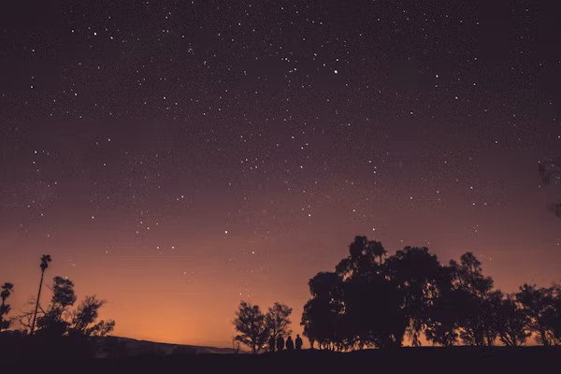
“
Reciting the Qur’an properly means engaging the tongue, mind, and heart together. The tongue recites with precision, the mind reflects on the meaning, and the heart responds with sincerity and eagerness to act upon it.”

Slide 9
The
All-Powerful
وَلَقَدْ خَلَقْنَا ٱلسَّمَـٰوَٰتِ وَٱلْأَرْضَ وَمَا بَيْنَهُمَا فِى سِتَّةِ أَيَّامٍ وَمَا مَسَّنَا مِن لُّغُوبٍ ‎﴿٣٨﴾
Not even an ounce of fatigue.
Rejects the belief of the people of the book who believe that God took a day of rest.
The creation of the universe posed no difficulty to Allah. Re-doing something is even easier than doing it the first time.
We created the heavens, the earth, and everything between, in six Days without tiring.
Notes:
This rejects the belief of the people of the book who believe that God took a day of rest (Saturday).
At the start of the sūrah, verses 6-7 mention the creation of the earth and this is now repeated again. This emphasises that the creation of the universe posed no difficulty to Allah and compared to this, bringing the dead back to life is much easier for Him. This reaffirms and re-emphasises Allah’s absolute power over all things.

Slide 10
The
Remedy
فَٱصْبِرْ عَلَىٰ مَا يَقُولُونَ وَسَبِّحْ بِحَمْدِ رَبِّكَ قَبْلَ طُلُوعِ ٱلشَّمْسِ وَقَبْلَ ٱلْغُرُوبِ ‎﴿٣٩﴾‏ وَمِنَ ٱلَّيْلِ فَسَبِّحْهُ وَأَدْبَـٰرَ ٱلسُّجُودِ ‎﴿٤٠﴾‏
Sabr is crucial in the believer’s life.
Sabr is active: steadfastness, self-control, patience.
Dhikr is another powerful weapon.
Remember Allah and pray ṣalah at these times.
So [Prophet], bear everything they say with patience; celebrate the praise of your Lord before the rising and setting of the sun; proclaim His praise in the night and at the end of every prayer;
Notes:
Allah is now telling the Prophet ﷺ to be patient on what they (i.e. the disbelievers) are saying. The Prophet ﷺ was treated very badly in Makkah. [A] Can you think of an example?
Allah is telling Him to be patient and gives him the source of this strength: tasbīḥ and ḥamd. Dhikr is one of the most powerful weapons we have in dealing with life’s difficulties. Why?
When you glorify and praise Allah, you have a direct link with Him, and whoever maintains such a link is content and reassured and thus able to remain patient. This is because you know that, with Allah’s help, you are safe and secure.
We learn from this that we should have a strong dhikr routine so that it protects us from difficulties.
Ibn ʿAbbās: the times mentioned above refer to the prescribed prayer times: Fajr (before the rising of the sun), Ẓuhr and ʿAṣr (before the setting of the sun), and ʿIshāʾ (during a part of the night).

Slide 11
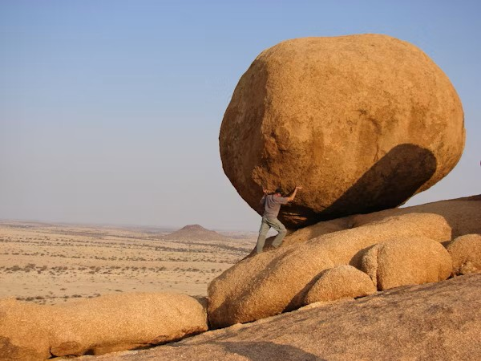
Do You Know What Sabr Is?
There are 3 types of ṣabr:
1) Ṣabr in obeying Allah.
Your alarm goes off for Fajr, but you're exhausted.
(2) Ṣabr in staying away from sins.
You fail an important exam despite studying hard.
(3) Ṣabr in regards to the trials Allah has decreed.
Your friends are pressuring you to gossip.

Slide 12
1. It’s 9 AM and you’re finally enjoying your sleep-in. Suddenly, your mum calls from the kitchen: “Wake up, I need your help with cleaning today!”
You’re annoyed, thinking, But it’s my holiday!
2. You’re walking to the shop. A passerby walks past and sniggeringly says, ‘Paki!’
3. You’re getting ready to go out when you realise your sibling took your favourite shoes without asking—and now they’re dirty!
4. You’re scrolling through your feed when you come across a post from someone in your friend group clearly talking bad about you.
How Can You
Practise Sabr?
How can you respond?
Notes:
Assign a scenario to each group.

Slide 13
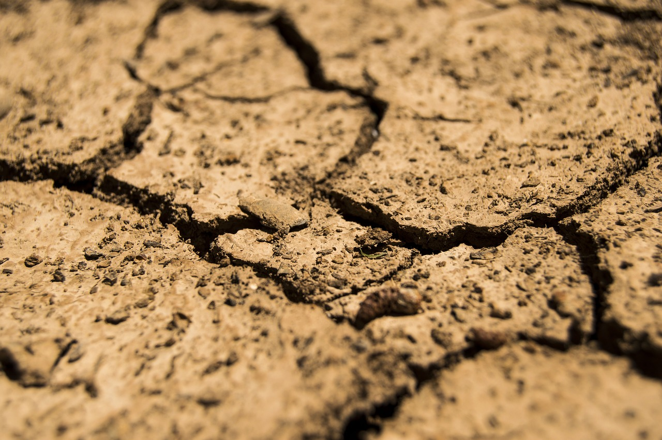
The Mighty
Blast
وَٱسْتَمِعْ يَوْمَ يُنَادِ ٱلْمُنَادِ مِن مَّكَانٍ قَرِيبٍ ‎﴿٤١﴾ يَوْمَ يَسْمَعُونَ ٱلصَّيْحَةَ بِٱلْحَقِّ ذَٰلِكَ يَوْمُ ٱلْخُرُوجِ ‎﴿٤٢﴾
The closest places to people so that the call reaches everyone equally, at the same time.
[A] In which verse in this surah has the blast already been mentioned?
listen out for the Day when the caller will call from a nearby place. They will come out [from their graves] on that Day, the Day when they hear the mighty blast in reality.
Notes:
Zamakhsharī says that the place will be the rock of al-Quds: it is the closest part of the earth to the sky and the center of the earth.
It could also refer to the closest places to people so that the call reaches everyone equally, at the same time.
Ṣayḥah: creaming; everything important has an announcement. The Day of Judgement will also have an announcement. We have already discussed how loud and terrifying this blast will be.
Verse 20.

Slide 14
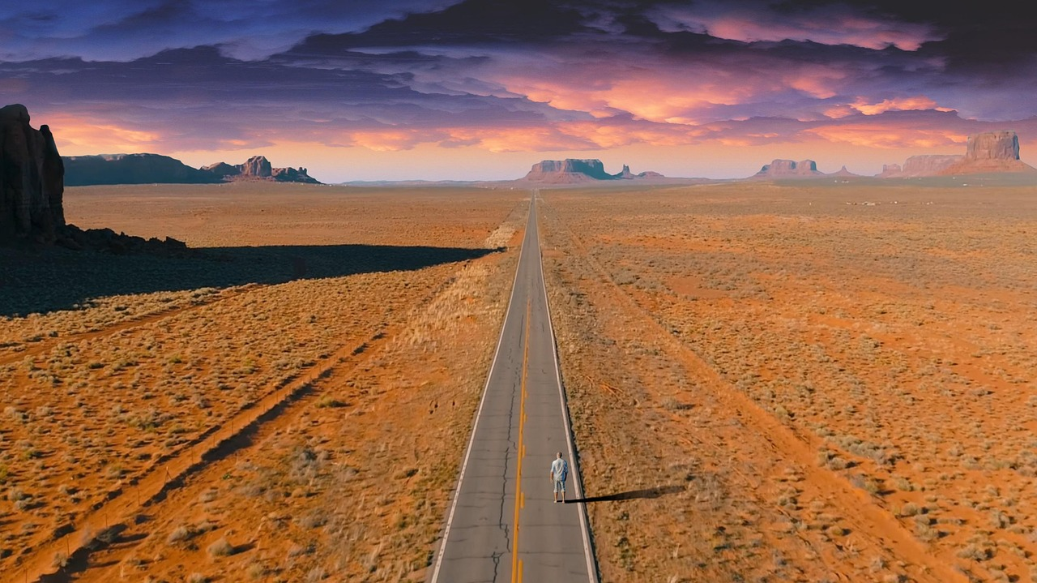
An Easy
Gathering
‏ إِنَّا نَحْنُ نُحْىِۦ وَنُمِيتُ وَإِلَيْنَا ٱلْمَصِيرُ ‎﴿٤٣﴾ يَوْمَ تَشَقَّقُ ٱلْأَرْضُ عَنْهُمْ سِرَاعًا ذَٰلِكَ حَشْرٌ عَلَيْنَا يَسِيرٌ ‎﴿٤٤﴾
Repeated emphasis: ‘we’
Never forget your ultimate destination
Everything is easy for Allah
It is We who give life and death; the final return will be to Us on the Day when the earth will be torn apart, letting them rush out- that gathering will be easy for Us.
Notes:
The verse contains repeated emphasis: Indeed, we are, only we, we are the one who give life, we are the one who cause death and only to us is the final return. [A] who remembers the issue this sūrah is addressing?
تَشَقَّقُ: the earth will split open and we will all come out on the Day of Judgement.
ذَٰلِكَ حَشْرٌ عَلَيْنَا يَسِيرٌ :everything is easy for Allah.
As believers, we should NEVER ever forget that this life is short and a place to cultivate our hereafter. We will ALL return to Allah. Let us prepare it from today.

Slide 15
“
Life is a journey to Allah—every step takes you closer to the Final Day. Stay on the right path.

Slide 16
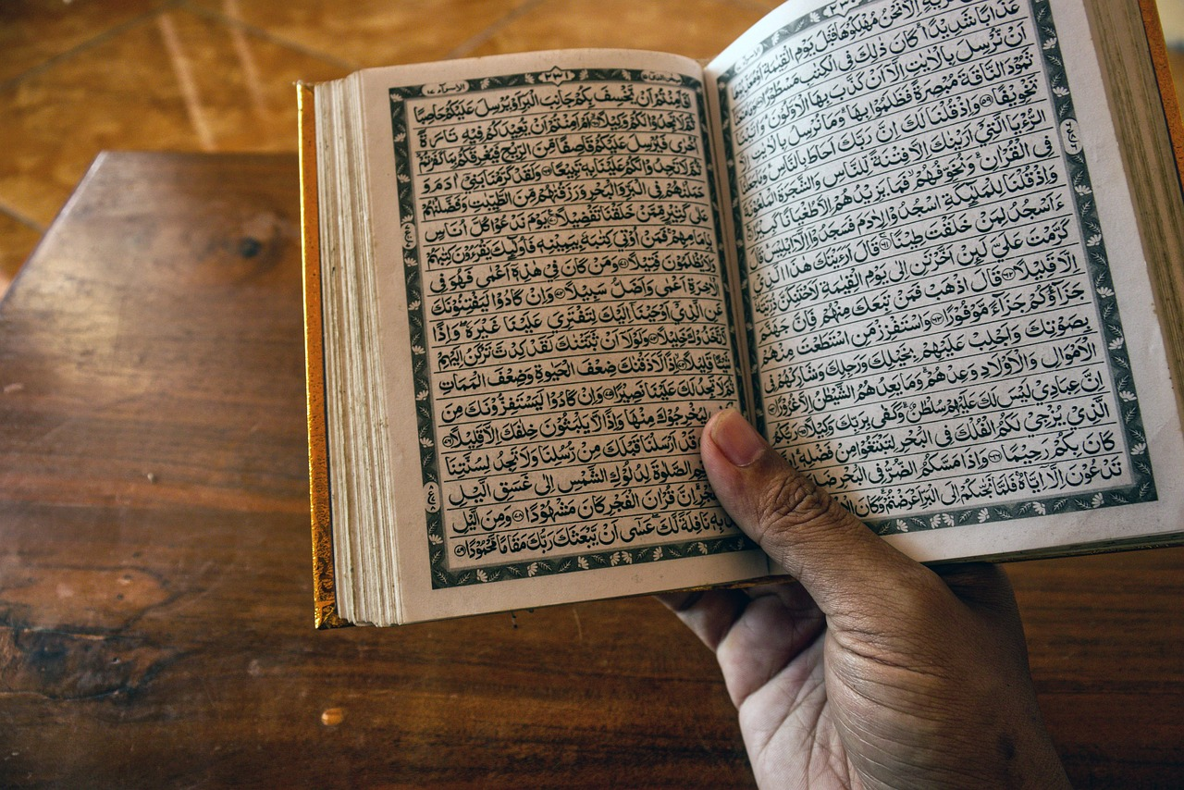
The Best Reminder
نَّحْنُ أَعْلَمُ بِمَا يَقُولُونَ وَمَآ أَنتَ عَلَيْهِم بِجَبَّارٍ فَذَكِّرْ بِٱلْقُرْءَانِ مَن يَخَافُ وَعِيدِ ‎﴿٤٥﴾
Comforting the Messenger
Prophet’s role is only to convey the message, not to force belief.
Guidance comes from Allah Alone. Our role is to share the truth.
The Qur’ān is the best reminder – constantly turn to it and reflect on it.
[A] What do you notice about the beginning and ending of this sūrah?
We know best what the disbelievers say. You [Prophet] are not there to force them, so remind, with this Quran, those who fear My warning.
Notes:
Allah is saying that He knows everything. Your job (O Prophet) is just to convey the message.
Allah is comforting the Prophet ﷺ that his job is not to force the people; it’s just to convey the message. The only one who can open their hearts is Allah.
Message for us: Our job is to convey, not force. Guidance is not in the hands of humans. If we do our best, we don’t need to worry about the outcome as that will come from Allah.
The Qur’ān is the best reminder; that is why we need to constantly turn to it and reflect on it.
Who really benefits from the Quran? Only those who fear Allah truly benefit from His message. The greater our mindfulness, fear, and humility, the more we can benefit from the Qur’an. Remember khashyah? مَّنْ خَشِىَ ٱلرَّحْمَـٰنَ بِٱلْغَيْبِ وَجَآءَ بِقَلْبٍ مُّنِيبٍ ‎﴿٣٣﴾
[A] Who remembers the definition of khashyah?
The beginning of the sūrah – وَٱلْقُرْءَانِ ٱلْمَجِيدِ
The ending of the sūrah - فَذَكِّرْ بِٱلْقُرْءَانِ
Each sūrah is a masterpiece, an ocean of treasures and endless wisdom.

Slide 17
Recite
Learn the meanings
Reflect
Act
Remind others

Slide 18
How Will You
Convey?
In your groups, design an advert for why everyone (Muslims and non-Muslim) needs the Qur’an.
You will be assessed on both the design and content.
Less is more!
Notes:
Give

Slide 19
Plenary
What did Sūrah Qāf teach you about what you need to do different in your life?
Notes:
Does anyone have any questions?

Slide 20
For Next Ramadan inshaAllah
سُبْحَانَكَ اللّٰهُمَّ وَبِحَمْدِكَ ، أَشْهَدُ أَنْ لَّا إِلٰهَ إِلَّا أَنْتَ ، أَسْتَغْفِرُكَ وأَتُوْبُ إِلَيْكَ
Stay connected to Surah Qāf by reciting it in your ṣalāh.
Recite calmly, beautifully and reflect on it.
Notes:
Jazakumullah Khayra for attending. May Allah reward and bless each and every minute which we spent in drawing closer to His Book. May The Most Generous accept us from ahlul-Qur’ān: the People of the Qur’ān, His chosen special servants.
Anything wrong was from ourselves and shayṭān. Anything correct was from Allah ﷻ.

Slide 21
The End

Slide 22
Additional Activities
Quiz based on lessons from Sūrah Qāf
Vocabulary quiz
Notes:
If you have additional time, give learners time to memorise the Arabic and the meanings. Then use these activities to consolidate the vocabulary.

