Slide 1
Important Notes for the Educator
The PowerPoints are animated so please use the PPT version if possible.
Keep the competition active throughout the four sessions. There is a slide in the first session with instructions.
Recite the passage/ayah aloud and encourage learners to recite after you OR ask learners to recite an ayah each.
Encourage learners to memorise Surah Qaf and its translation. Reward them for successful completion.
There are speaker notes under each slide. Read the notes before delivering the session.
Please thoroughly read the free PDF ‘A Journey through Surah Qaf’ in addition to reading tafsir books and lectures of this surah.
Feel free to adjust this PPT to your learners’ needs.
[A] in the PPT = Active learning. This can be done orally, in writing, on mini-whiteboards (MWB), classroom board, through discussion; alone, in pairs, groups etc, and through other methods. Try to use a variety of methods within each session. These can all contribute to the competition score.
LWA is not responsible for external links.
If you benefit from this resource, please remember the project in your duʿas. Your feedback to improve the resources is highly appreciated.

Slide 2
بِسۡمِ ٱللَّهِ ٱلرَّحۡمَـٰنِ ٱلرَّحِیمِ
Welcome Back!
What aspect of Jahannam sends shivers down your spine the most?
Notes:
Start with bismillah, hamd and salawat. Greet learners, welcome them and thank them for attending.
Have the question ready on the board so learners can start thinking as they walk in/wait for the session to start.
Ask for some responses/mini-whiteboards to be raised.

Slide 3
سورة
سورة ق
Dreams
Come True
Surah Qaf: Session 3
Notes:
Today is the 3rd^{nd} of a four-part series on Surah Qaaf. The next session will be on…. Inshallah.
Resources required: Projector/screen, post-it notes, speaker
Optional: Mini-whiteboards, art supplies

Slide 4
Session
Objectives
Identify the size of Jahannam
01
Explore the characteristics of the people of Paradise
02
Reflect on the blessings and bliss of Paradise
03
Recite and reflect upon verses 30-35 of Surah Qāf
04
Notes:
Today we will…

Slide 5
Starter
Noughts & Crosses
Taqwa
غَفْلَةٍ
ٱلْمَجِيدِ
عَبْدٍ
حَبْلِ ٱلْوَرِيدِ
ٱلْحَقِّ
رّزْقًا
مَآءً
مُبَـٰرَكًا
Crosses: Click on the left side of the square
Noughts: Click on the right side of the square
Click again to remove
Press your ‘Esc’ key to exit
Notes:
Starter for Surah Qaaf Session 3:
Ask two pupils/two groups of 3-4 learners to come to the front. They have to successfully define the terms in order to be able to click successfully. Winner(s) to be rewarded/points added to the collective team scores.
Majeed – Glorious, Noble
Hablil-Wareed – Jugular vein
Ghaflah - Heedlessness
Taqwa – Allah-consciousness/God-consciousness/Fear of Allah
Haqq - Truth
Abd – Servant, slave
Maa’ - Water
Mubarak - Blessed
Rizq - Sustenance

Slide 6
Extremely
Terrifying
يَوْمَ نَقُولُ لِجَهَنَّمَ هَلِ ٱمْتَلَأْتِ وَتَقُولُ هَلْ مِن مَّزِيدٍ ‎﴿٣٠﴾
Very powerful image and language
Jahannam is HUGE!
There will always be room for more in Hell: existing inhabitants will get squashed and constricted even further.
We shall say to Hell on that day, ‘Are you full?’ and it will reply, ‘Are there no more?’
Notes:
This is a very scary ayah. This ayah draws a very powerful image and the wording is very powerful. Instead of merely ‘Jannah is huge’ there is this dialogue.
We see every disbeliever and aggressor being thrown into Hell where they pile up, and then Hell is being questioned whether it’s full—it’s a truly horrifying and frightening scene!
Hell is so huge that despite the huge numbers of people entering it, there will be room for more.
There will always be room for more as it will just mean that the existing inhabitants will get squashed and constricted even further.

Slide 7
“
Jahannam is surrounded by desires, while Jannah is surrounded by hardships. If you surrender to desires, you march towards Jahannam with a smile.

Slide 8
Jannah for the
Righteous
وَأُزْلِفَتِ ٱلْجَنَّةُ لِلْمُتَّقِينَ غَيْرَ بَعِيدٍ ‎﴿٣١﴾
Pleasant, calm and friendly scene.
The people of Jannah will be honoured: Jannah will be brought close
But Paradise will be brought close to the righteous and will no longer be distant:
Notes:
The next set of verses is in contrast to the verses above. This is the perfect balance of the Din; the balance between hope and fear that we, as believers, should always have.
The image in this āyah is of a pleasant, calm and friendly scene.
أُزْلِفَتِ : brought close. They won’t go to Jannah—it will be brought close to them.
Every word and action in this scene is indicative of the honour that will be shown to the people of Paradise; Paradise is brought near so they don’t have to trouble themselves by going close to it.

Slide 9
The People of Paradise
هَـٰذَا مَا تُوعَدُونَ لِكُلِّ أَوَّابٍ حَفِيظٍ ‎﴿٣٢﴾
أَوَّابٍ
The one who constantly returns to his Lord. The one who always repents to Allah.
حَفِيظٍ
Protector; the one who protects their eyes, ears etc from anything ḥarām and from crossing Allah’s boundaries.
‘This is what you were promised––this is for everyone who turned often to God and kept Him in mind,
Notes:
This āyah describes two key characteristics of the people of Jannah:
أَوَّابٍ : the one who constantly returns to his Lord, he one who always repents to Allah. Allah knows we are human and we sin continuously. He is so Kind and just wants us to return to Him and repent. The 5 prayers are a chance for repentance and for us to turn to Allah.
Tawbah (repentance) is the hallmark of the believer: truly turning with one’s heart to Allah, and humbly apologising to Him.
It is inevitable that we are going to sin; but each time we sin, we should rush to make tawbah, so that the sins do not corrode our hearts.
2. حَفِيظٍۢ : protector; the one who protects their eyes, ears etc from anything ḥarām. Someone who does not exceed/cross the boundaries of Allah.

Slide 10
Hearts Connected to the Creator
مَّنْ خَشِىَ ٱلرَّحْمَـٰنَ بِٱلْغَيْبِ وَجَآءَ بِقَلْبٍ مُّنِيبٍ ‎﴿٣٣﴾‏
خَشِىَ
بِقَلْبٍ مُّنِيبٍ
- Heart that is always turning to Allah.
- Munīb is from inābah.
Khashyah (awe) = fear + respect.
[A] Which āyah was this word previously mentioned in?
- Importance of the heart in our dīn
who held the Most Gracious in awe, though He is unseen, who comes before Him with a heart turned to Him in devotion-
Notes:
This āyah further describes two more characteristics of the people of Jannah:
خَشِىَ ٱلرَّحْمَـٰنَ بِٱلْغَيْبِ : Khashyah is a type of fear (translated as ‘awe’) = fear + respect. When a believer is alone and can commit a sin, the only thing that stops them is knowing that Allah is watching them. This is the essence of taqwa.
بِقَلْبٍۢ مُّنِيبٍ : A sincere heart, one that is always turning to Allah. A heart that remembers its sins in private and seeks repentance for it
This gives us hope. Don’t think Jannah is exclusive to those who don’t commit sins—it is for those who return to Allah.
- Munīb is from inābah: repeatedly turning to Allah.
The heart is very important in our dīn. Every act has an outer and an inner element. The inner is the essence. We must focus on purifying our hearts and bringing our hearts to our outer physical acts of worship.

Slide 11
Time to
Dig Deep
Think of a recent sin you have committed. Write down a letter to Allah begging Him to forgive you
Acknowledge your lowly status
BEG
Promise to try your best to never go back to the sin
Ask Allah to help you stay away from the sin
The Crumpled
Paper Heart
Notes:
[Practical Activity: The Crumpled Paper Heart
Have each teen crumple their paper tightly. This represents the effect of sins on the heart.
Now, ask them to carefully smooth it out. It won’t be perfect, showing how sins leave marks.
But then, give each one a brand-new, clean sheet. That represents tawbah!]
Lesson: Even if we feel broken, Allah gives us a fresh start when we repent sincerely.
No matter what you’ve done, always do tawbah and repent to Allah. Allah loves His servants who repent and sincerely turn back to Him.
[Then ask learners to write this personal letter. Tell them to not peep at others’ letters and keep theirs to themselves too. Scatter them across the room if possible.]

Slide 12
The Best
Welcome
ٱدْخُلُوهَا بِسَلَـٰمٍ ذَٰلِكَ يَوْمُ ٱلْخُلُودِ ‎﴿٣٤﴾
Eternal peace and serenity.
The best greeting we will inshaAllah hear is: سَلَامٌ قَوْلًا مِّن رَّبٍّ رَّحِيمٍ
[A] Which sūrah is this āyah in?
so enter it in peace. This is the Day of everlasting Life.’
Notes:
Enter with peace because this is Dār as-Salām; the angels will be waiting at the doors of Jannah to greet us.
The best greeting we will inshā’Allāh hear is: سَلَامٌ قَوْلًا مِّن رَّبٍّ رَّحِيمٍ (Yasin: 58)
Jannah is forever and forever!
The Prophet ﷺ said: “When the people of Paradise go to Paradise and the people of Hell go to Hell, death will be brought and placed between Paradise and Hell. Then it will be slaughtered, and a caller will call out: ‘O people of Paradise, there is no death; O people of Hell, there is no death.’ Then the joy of the people of Paradise will increase, and the sorrow of the people of Hell will increase.

Slide 13
Everything You’ve Ever Dreamed of
لَهُم مَّا يَشَآءُونَ فِيهَا وَلَدَيْنَا مَزِيدٌ ‎﴿٣٥﴾
Literally ANYTHING you wish for.
Mazīd: the Ultimate Gift.
[A] What do you think this refers to?
They will have all that they wish for there, and We have more for them.

Slide 14
Notes:
Make learners watch from 6:11- end of video

Slide 15
“
The greatest joy a believer will enjoy in the hereafter will be the joy of seeing Allah and meeting Him. There are no words which can describe how phenomenal this experience will be.

Slide 16
It’s Competition Time
Imagine your ideal Jannah. Choose one of the below:
1) Draw/sketch
2) Write a poem/spoken word
3) Write a descriptive piece
The top 3 will earn points for their team inshaAllah!
Don’t forget to engage all of your senses.

Slide 17
Jannah-Focused
Always stay focused on your goal.
[A] What is your purpose in life?
[A] Why do we need to always keep this in mind?
Taqwa = Jannah
Jannah
Notes:
Worshipping Allah.
We should always keep this in mind as there are SO many shayāṭīn, both jinn and human, who are trying to distract us and divert us. Today, everything around us is pushing us away from Allah ﷻ and Jannah—entertainment, social media, societal ideas and notions of success; and other ideologies. There are so many distractions. As young people especially, we need to have a clear focus and direction. We don’t want to be regretting on our deathbeds or on the Day of Judgement.
We know the truth. We know the reality. We are people of Surah Qaaf. We are people of the Qur’an. Allah is giving us these reminders NOW so we don’t regret it tomorrow bi’idhnillah. No matter what difficulties and trials we face in life, our vision and focus should always be clear: the pleasure of Allah and Jannah al-Firdaws. And the way we’re going to work hard to attain this is taqwa: constant awareness, obedience and consciousness of Allah ﷺ.

Slide 18
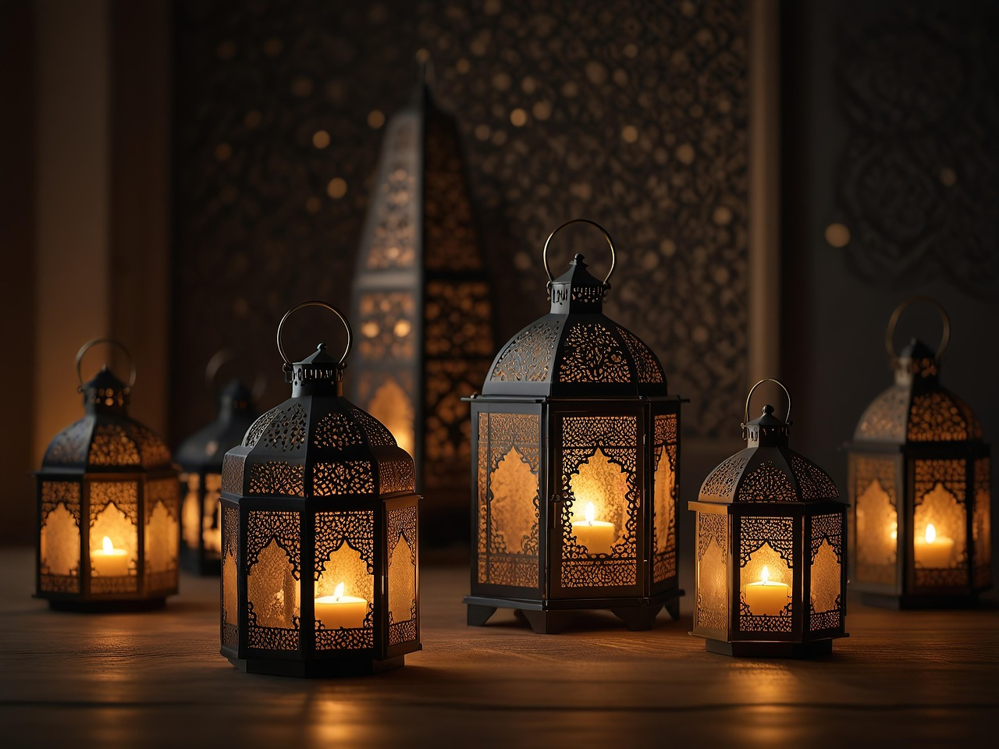
Plenary
What one action will you start from today to develop one of the 4 characteristics of the People of Jannah mentioned in the session?
Notes:
What does ‘mazīd’ (more) refer to?

Slide 19
For Next Week
سُبْحَانَكَ اللّٰهُمَّ وَبِحَمْدِكَ ، أَشْهَدُ أَنْ لَّا إِلٰهَ إِلَّا أَنْتَ ، أَسْتَغْفِرُكَ وأَتُوْبُ إِلَيْكَ
1) Memorise Ayahs 30-35
2) Bonus: Memorise the translation

Slide 20
The End

Slide 21
Additional Activities
Guess the word
Vocabulary crossword

