Slide 1
Important Notes for the Educator
The PowerPoints are animated so please use the PPT version if possible.
Keep the competition active throughout the four sessions. There is a slide in the first session with instructions.
Recite the passage/ayah aloud and encourage learners to recite after you OR ask learners to recite an ayah each.
Encourage learners to memorise Surah Qaf and its translation. Reward them for successful completion.
There are speaker notes under each slide. Read the notes before delivering the session.
Please thoroughly read the free PDF ‘A Journey through Surah Qaf’ in addition to reading tafsir books and lectures of this surah.
Feel free to adjust this PPT to your learners’ needs.
[A] in the PPT = Active learning. This can be done orally, in writing, on mini-whiteboards (MWB), classroom board, through discussion; alone, in pairs, groups etc, and through other methods. Try to use a variety of methods within each session. These can all contribute to the competition score.
LWA is not responsible for external links.
If you benefit from this resource, please remember the project in your duʿas. Your feedback to improve the resources is highly appreciated.

Slide 2
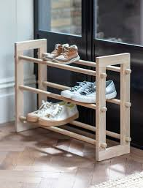
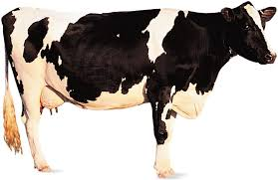
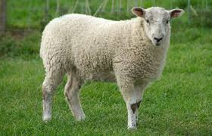
بِسۡمِ ٱللَّهِ ٱلرَّحۡمَـٰنِ ٱلرَّحِیمِ
Welcome Back!
Can you guess the word?
+
+
Notes:
Start with bismillah, hamd and salawat. Greet learners, welcome them and thank them for attending.
Have the question ready on the board so learners can start thinking as they walk in/wait for the session to start.
Ask for some responses/mini-whiteboards to be raised.
Pictionary
As a hint if they are struggling, tell them it is an Arabic word from the previous session’s passage
Answer: Moo + Baa + Rack = Mubarak
Mubaraka = blessed.

Slide 3
سورة
سورة ق
Every Step
Counts
Surah Qaf: Session 2
Notes:
Today is the 2nd of a four-part series on Surah Qaaf. The next session will be on…. Inshallah.

Slide 4
Session
Objectives
Reflect on the impact of being aware of Allah’s closeness to us
01
Practise taking an ‘audit’ of your actions
02
Explore the characteristics of the People of Hell and develop strategies to avoid them
03
Recite and reflect upon verses 15-29 of Surah Qāf
04
Notes:
Today we will…

Slide 5
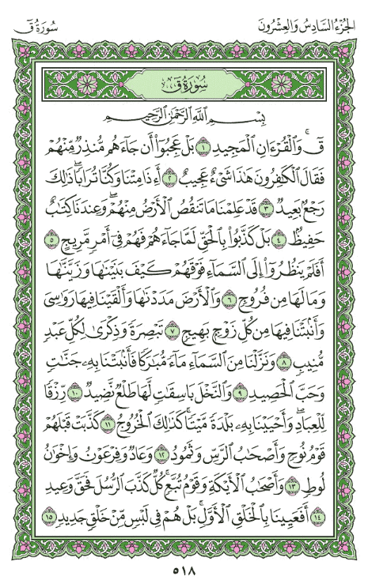
Quick Recap
[A] What did we learn in the previous āyāt of Surah Qāf?
1 point = Ok-ish point
3 points = Amazing point!
2 points = Good point
Notes:
We often talk about how great the Qur’an is, but do we truly believe it? These questions will help us and inshaAllah motivate us to strengthen our connection with the Greatest Book.
[Ask learners to (privately) jot down the answers to these questions and give them some time to reflect. Then go round eliciting ideas for how they can become closer to the Qur’an].

Slide 6
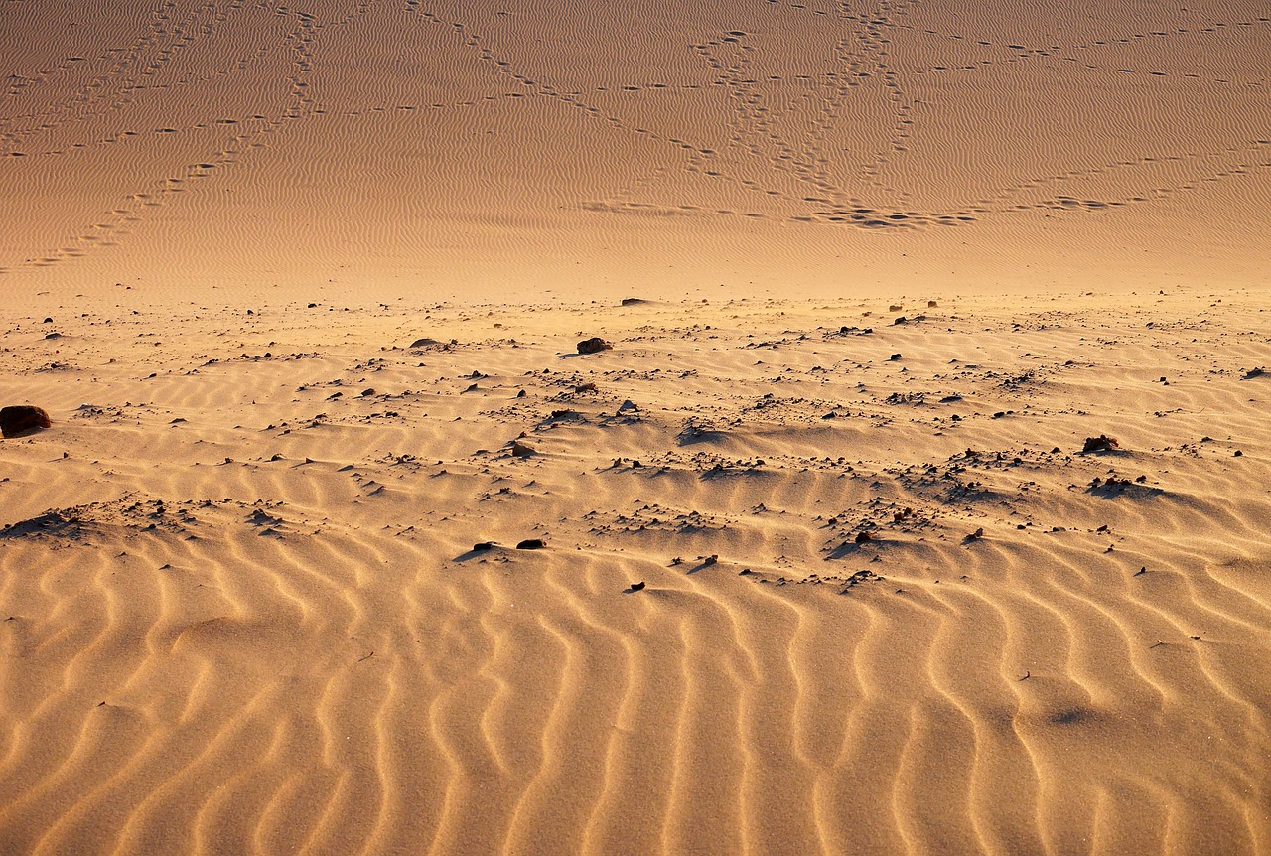
Allah’s
Might
أَفَعَيِينَا بِٱلْخَلْقِ ٱلْأَوَّلِ بَلْ هُمْ فِى لَبْسٍ مِّنْ خَلْقٍ جَدِيدٍ ‎﴿١٥﴾‏
Who created you the first time round?
Is it easier to create something from scratch or to re-create something?
So, were We incapable of the first creation? No indeed! Yet they doubt a second creation.
Notes:
The theme of resurrection continues but now from a new angle: the journey that we will all go on.
It is a single journey which begins with birth, goes through death and ends with resurrection and deed reckoning. Throughout the journey, we are under Allah’s watchful gaze. We cannot escape. When we realise this, our hearts are filled with awe and worry. Only Allah knows our innermost thoughts.
In this āyah, Allah is asking: Who created you the first time round? This āyah is about Allah’s power once again.
Repeating something is easier than creating it from scratch.
The disbelievers are confused and doubtful about resurrection.

Slide 7
The Human
Being
وَلَقَدْ خَلَقْنَا ٱلْإِنسَـٰنَ وَنَعْلَمُ مَا تُوَسْوِسُ بِهِۦ نَفْسُهُۥ وَنَحْنُ أَقْرَبُ إِلَيْهِ مِنْ حَبْلِ ٱلْوَرِيدِ ‎﴿١٦﴾
Reflect on one of Allah’s greatest signs: YOU!
[A] Allah knows your every single thought. How should this belief affect us?
Just as the jugular vein is close yet can go unnoticed, Allah’s presence is near even if not always perceived.
We created man––We know what his soul whispers to him: We are closer to him than his jugular vein––
Notes:
Allah will now take us on a journey: everything we do in this life will be written, we will die, and we will be resurrected.
Allah draws our attention to one of the biggest proofs of His power, existence, Oneness and resurrection: the creation of the human being. Always think about the human body and reflect on it. When you study biology in school, don’t just study it to pass the exam. Think of the incredible ways Allah has made us and reflect on it to become closer to Him.
Next, Allah says that He knows every single of our thoughts. When we imagine this fact, we are bound to experience a shiver down our spine. If we really understood this statement, we would not dare say a single word that does not please Allah. We wouldn’t even think of a bad thought. This statement is sufficient to make us careful, always alert. This is the essence of taqwa. [Remember as we are fasting, taqwa is the objective of fasting. Allah wants us to cultivate taqwa through fasting].
This analogy is beautiful because the jugular vein, despite its closeness, is not felt by a person due to its hidden nature. Similarly, a person does not always perceive Allah’s closeness to them, even though it is a reality.

Slide 8
The Two
Angels
إِذْ يَتَلَقَّى ٱلْمُتَلَقِّيَانِ عَنِ ٱلْيَمِينِ وَعَنِ ٱلشِّمَالِ قَعِيدٌ ‎﴿١٧﴾‏
The angel on the left delays registering the sin of a Muslim for six hours. If he repents (within these six hours), and seeks Allah’s forgiveness, they drop it off. If he doesn’t, they write it down as a single sin.
[A] What does this teach you about Allah ﷻ?
with two receptors set to record, one on his right side and one on his left:
Notes:
It’s difficult sometimes as we cannot see them, but always try to think of the angels who are recording everything.
The Prophet ﷺ said, “The scribe (angel) on the left delays registering the sin of a Muslim for six hours. If he repents (within these six hours), and seeks Allah’s forgiveness, they drop it off. If he doesn’t, they write it down as a single sin” (Ṭabarānī).
[A] What does this teach you about Allah ﷻ?
Allah’s immense mercy and forgiveness. He is al-Ghafur ar-Rahim.

Slide 9
Every Single
Word
مَّا يَلْفِظُ مِن قَوْلٍ إِلَّا لَدَيْهِ رَقِيبٌ عَتِيدٌ ‎﴿١٨﴾
Angels who carefully watch and write everything down.
[A] How can we act upon this verse?
he does not utter a single word without an ever-present watcher.
Notes:
We have to be very very careful with our speech.
The Prophet ﷺ said, “Indeed, one of you utters a statement which pleases Allah, thinking it does not amount to much; yet Allah decrees His pleasure with him because of it, until the day he will meet Him. And indeed, one of you utters a statement which angers Allah, thinking it does not amount to much; yet Allah decrees His anger with him because of it, until the day he will meet Him” (Tirmidhī).

Slide 10
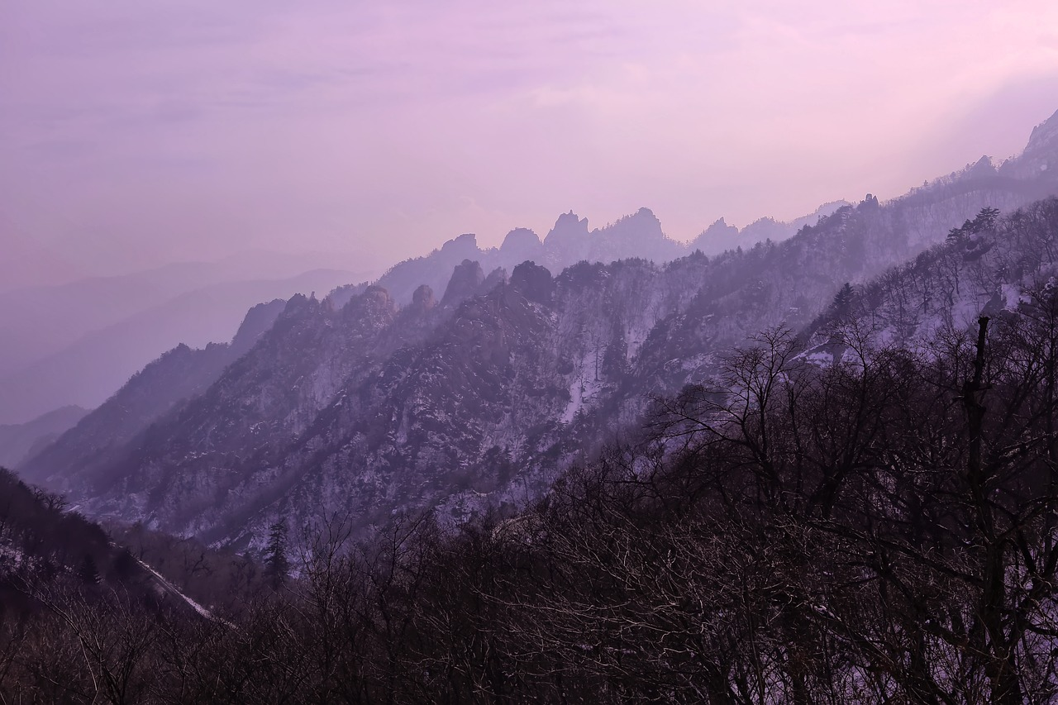
“
You can hide your thoughts from the world, but never from Allah—His knowledge is absolute.

Slide 11
The 24-Hour Playback Challenge
Imagine your last 24 hours were recorded. Would you be happy to hit replay?
Write positive/kind things you said/did in the last 24 hours
Write negative/hurtful things you said/did in the last 24 hours
Notes:
We should do an ‘audit’/hold ourselves accountable (muḥasabah) daily/weekly etc before we are held to account by Allah on the Day of Judgement.

Slide 12
No Escape!
وَجَآءَتْ سَكْرَةُ ٱلْمَوْتِ بِٱلْحَقِّ ذَٰلِكَ مَا كُنتَ مِنْهُ تَحِيدُ ‎﴿١٩﴾
سَكْرَةُ ٱلْمَوْتِ
Death brings an overwhelming, almost drunken state. Even the Prophet ﷺ felt its intensity.
بِٱلْحَقِّ
At the moment of death, reality becomes clear—there is no denial.
We all know death is certain, yet delay preparing for it.
تَحِيدُ
The trance of death will bring the Truth with it: ‘This is what you tried to escape.’
Notes:
After explaining their rejection of resurrection, Allah highlights the time when truth will prevail: the small qiyāmah (death).
[Play the sound of the dying heartbeat]
There is nothing we seek to escape more than death.
سَكْرَةُ ٱلْمَوْتِ : Literally means a drunken state. When death was approaching the Prophet ﷺ he wiped sweat off his face and said: “There is no god worthy of worship except Allah! Death has its stupor!” He said this, even though he had chosen to be in Allah’s company, longing to see Him. So how about us? May Allah protect us and give us a beautiful ending.
بِٱلْحَقِّ : In that moment, we will see everything. No one can deny anything at that moment.
تَحِيدُ: Escape. We know we’re going to die but we don’t want to prepare for death or for the hereafter.

Slide 13
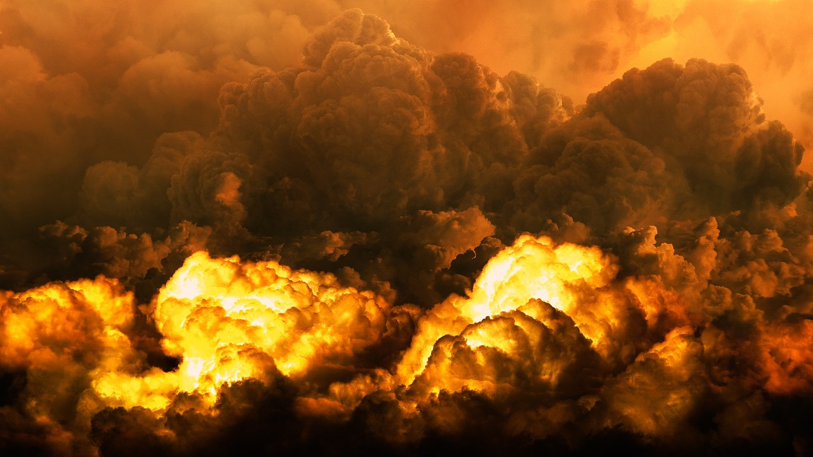
A Petrifying
Sound
وَنُفِخَ فِى ٱلصُّورِ ذَٰلِكَ يَوْمُ ٱلْوَعِيدِ ‎﴿٢٠﴾
The angel has already placed the trumpet on his lips, awaiting the command to blow.
[A] What is this angel called?
The Trumpet will be sounded: ‘This is the Day [you were] warned of.’
Notes:
Hve you ever heard a really loud scary sound? Imagine the whole world being rocked by a deafening, extremely terrifying LOUD sound!
The trumpet will be blown. The Prophet (saw) mentioned that the angel responsible for blowing the trumpet has already placed it on his lips, waiting for the command to blow it.
[A] What is this angel called?
Israfil (as)
Qiyāmah will start with a large sound. When important announcements are made, they are usually preceded by a loud sound/distinct sound to alert people and wake them up.
يَوْمُ ٱلْوَعِيدِ - : Allah wants to warn us out of His mercy. He wants us to succeed eternally.

Slide 14
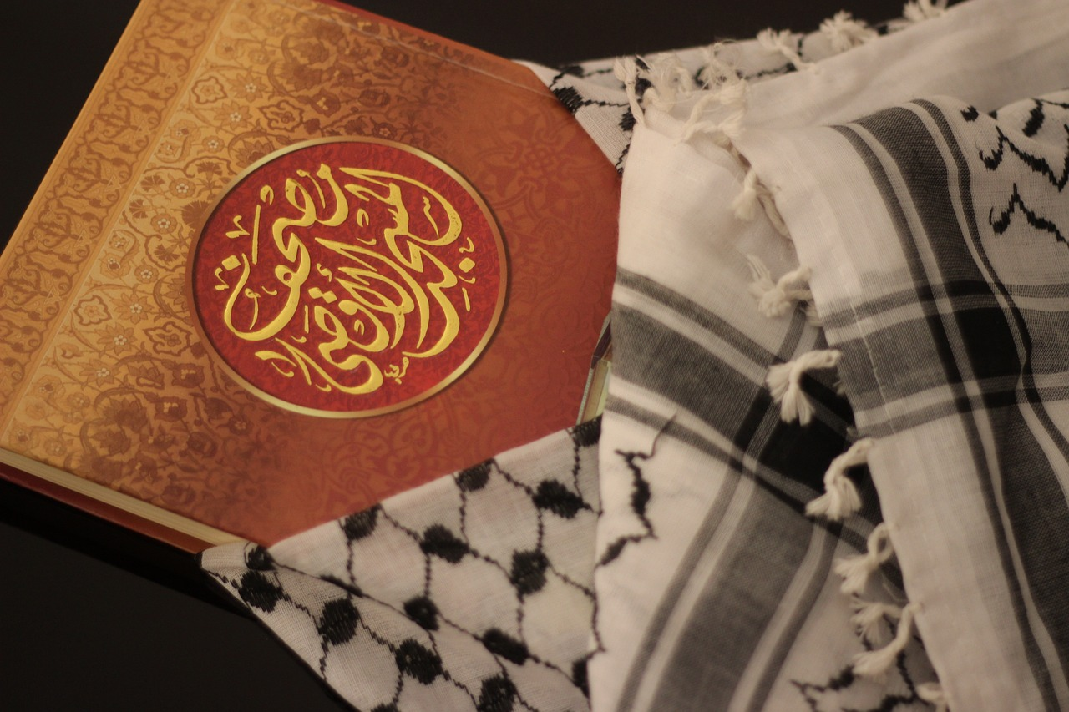
To the Divine Court
وَجَآءَتْ كُلُّ نَفْسٍ مَّعَهَا سَآئِقٌ وَشَهِيدٌ ‎﴿٢١﴾
سَآئِق
Someone who drives/pushes forward.
شَهِيدٌ
One to bear witness for or against the person.
Each person will arrive attended by an [angel] to drive him on and another to bear witness:
Notes:
This is the divine court.
In a court, the police comes with the criminal.
Imagine the scene: a person being dragged and pushed forward, flanked by the angels.
The two that are with us our whole lives will now come to report on our actions.
سَآئِقٌ : Someone who drives. In this context, it means push forward to the place of gathering.
شَهِيدٌ : One to bear witness for or against the person.
On that Day, will our angels testify FOR us or AGAINST us?

Slide 15
The Veil
Is Lifted
لَّقَدْ كُنتَ فِى غَفْلَةٍ مِّنْ هَـٰذَا فَكَشَفْنَا عَنكَ غِطَآءَكَ فَبَصَرُكَ ٱلْيَوْمَ حَدِيدٌ ‎﴿٢٢﴾
You were heedless and denied the Day of Judgement.
Today, you will see everything.
We still have time. We need to remove the ghaflah.
‘You paid no attention to this [Day]; but today We have removed your veil and your sight is sharp.’
Notes:
You were heedless, denied the Day of Judgement and didn’t prepare for it. Now the veil over your heart is lifted. Today, you will see everything: all sorts of terrifying punishments.
We still have time. We need to remove the ghaflah (heedlessness). We can’t let the dunya and its deceptions make us forgetful of Allah, His Messenger ﷺ and our eternal journey.

Slide 16
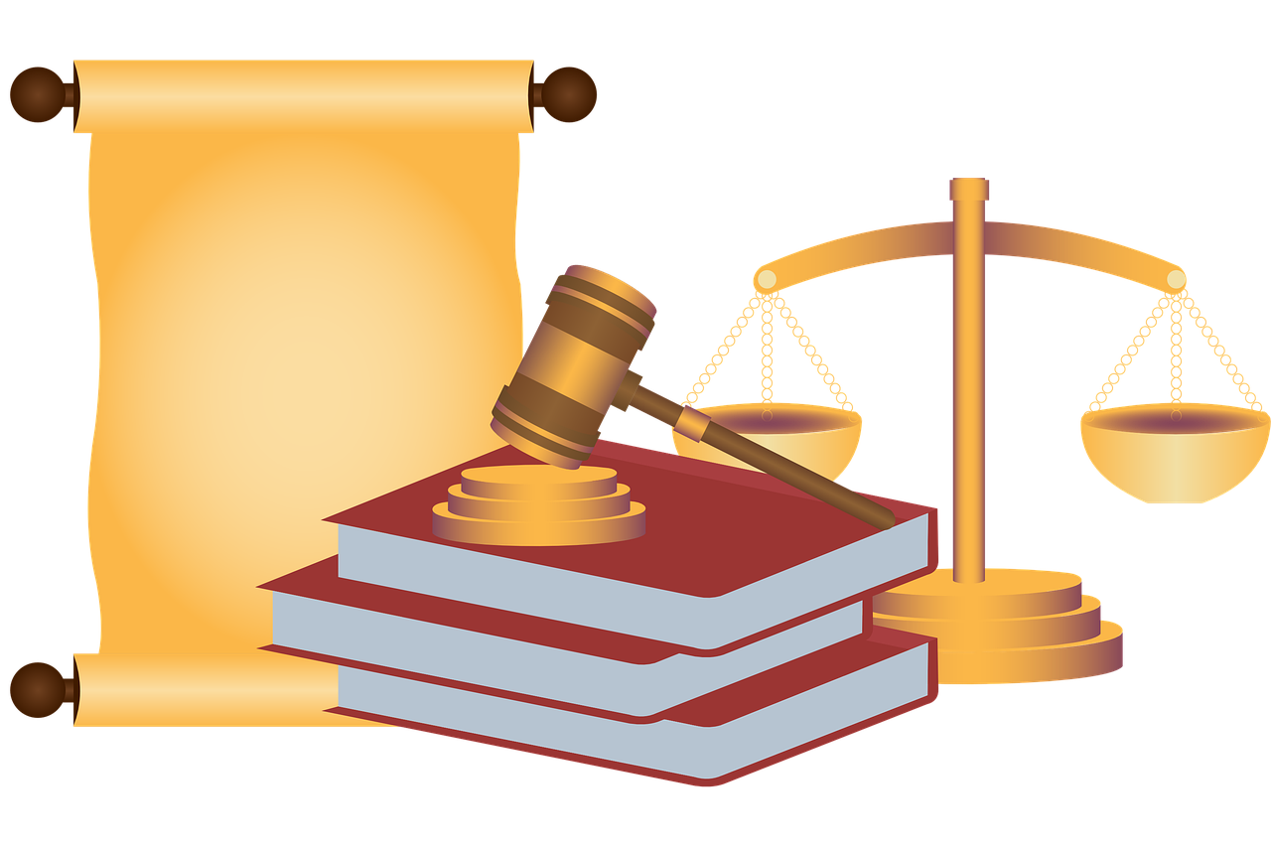
Secrets
Unveiled
وَقَالَ قَرِينُهُۥ هَـٰذَا مَا لَدَىَّ عَتِيدٌ ‎﴿٢٣﴾
قَرِينُه: Close companion, the one who is always with you.
Witness statement in Divine court
[A] What/who else will testify for/against you on the Day of Judgement?
The person’s attendant will say, ‘Here is what I have prepared’-
Notes:
Qarīn: Close companion, the one who is always with you. The plural is Quranā’.
This word is mentioned twice in this sūrah; one with و and one without و.
The qarīn mentioned here is the angel and the next qarīn is the devil. There are two qarīn with us in our lives: angel & shayṭān.
This is now the witness statement in the Divine court.
The witnesses are many: angel, earth (on that Day the earth will recount everything, 99:4), limbs, hands, legs etc.

Slide 17
The
Verdict
أَلْقِيَا فِى جَهَنَّمَ كُلَّ كَفَّارٍ عَنِيدٍ ‎﴿٢٤﴾‏
Verses 24-26 reason for revelation: Walīd b. Mughīrah.
Strong verse; direct command.
كَفَّارٍ : noun of intensity of kāfir. Allah gave them chance upon chance, but they were extremely stubborn and denied the truth.
‘Hurl every stubborn disbeliever into Hell,
Notes:
Verses 24-26 were revealed because of Walīd b. Mughīrah (a staunch enemy of Prophet Muhammad ﷺ) who prevented his cousin from accepting Islam.
This sūrah is very strong. Everything is clear. A very powerful command: أَلْقِيَا

Slide 18
The Qualities of the People of Hell
مَّنَّاعٍ لِّلْخَيْرِ مُعْتَدٍ مُّرِيبٍ ‎﴿٢٥﴾ ٱلَّذِى جَعَلَ مَعَ ٱللَّهِ إِلَـٰهًا ءَاخَرَ فَأَلْقِيَاهُ فِى ٱلْعَذَابِ ٱلشَّدِيدِ ‎﴿٢٦﴾
مَّنَّاعٍ لِّلْخَيْرِ
Noun of intensity again. He always prevented goodness for himself and others.
مُعْتَدٍ
Aggressive and crossing the boundaries.
Doubter and spreading doubts amongst others.
مُّرِيب
everyone who hindered good, was aggressive, caused others to doubt, and set up other gods alongside God. Hurl him into severe punishment!’-

Slide 19
Characteristics of the People of the Fire
كَفَّارٍ
مَّنَّاعٍۢ لِّلْخَيْرِ
مُعْتَدٍۢ
مُّرِيبٍ
عَنِيدٍۢ
Disbeliever
Very stubborn
Prevents good/doesn’t share wealth
Aggressive, crosses boundaries
Causes others to doubt
Role Play
You will be given one of the following words. Prepare a short role play which outlines the specific characteristic.
The rest of the teams will guess which word was allocated to you.
Your teacher will guide you.
Notes:
Role play in groups of 4
The team to guess the word first will receive points

Slide 20
Your Devil Will Disown You
قَالَ قَرِينُهُۥ رَبَّنَا مَآ أَطْغَيْتُهُۥ وَلَـٰكِن كَانَ فِى ضَلَـٰلٍ بَعِيدٍ ‎﴿٢٧﴾
It wasn’t me! It’s not my fault!
and his [evil] companion will say, ‘Lord, I did not make him transgress; he had already gone far astray himself.’
Notes:
Allah now mentions the debate between the leaders and followers.
This could also refer to the debate with the devil, who throughout the person’s life, tried to tempt him away from the truth.
ʿAbdullāh b. Masʿūd reported: The Messenger of Allah ﷺ said, “Each one of you has a devil-companion from the jinn over him.” They said, “Even you, O Messenger of Allah?” The Prophet said, “Even me, except that Allah helped me against him until he surrendered/embraced Islam. He only orders me to do good.

Slide 21
A Powerful Beginning
قَالَ لَا تَخْتَصِمُوا۟ لَدَىَّ وَقَدْ قَدَّمْتُ إِلَيْكُم بِٱلْوَعِيدِ ‎﴿٢٨﴾ مَا يُبَدَّلُ ٱلْقَوْلُ لَدَىَّ وَمَآ أَنَا۠ بِظَلَّـٰمٍ لِّلْعَبِيدِ ‎﴿٢٩﴾
Warning: (1) The Qur’ān; (2) Warning of the Messengers
Allah’s perfect knowledge prevents any statement being altered in front of Him
Allah’s perfect justice prevents Him from wronging His servants
God will say, ‘Do not argue in My presence. I sent you a warning. and My word cannot be changed: I am not unjust to any creature.’
Notes:
Allah is describing Himself in two ways in this verse:
His perfect knowledge prevents any statement being altered in front of Him
His perfect justice and fairness prevents Him from wronging His servants
Allah is Just and Fair—He sent sufficient warnings before resorting to punishing those who denied the truth.

Slide 22
“
Allah never wrongs anyone—even the weight of a speck. His justice is perfect, even when it seems unfair.
Notes:
Some civilisations reached great heights, building towering structures and strong buildings. However, this didn’t stop them from rejecting the truth and thus didn’t protect them from punishment. Allah is teaching a lesson through history: كُلٌّۭ كَذَّبَ ٱلرُّسُلَ فَحَقَّ وَعِيد.

Slide 23
The Defendant’s
Chair
Notes:
HOW TO PLAY
⿡ Each round, the teacher (Prosecutor) calls one player to the Defendant’s Chair (Hot Seat).
⿢ The teacher challenges them with one of the questions below.
⿣ The Defendant has 10 seconds to answer.
⿤ If they answer correctly, they escape judgment and earn points for their team!
⿥ If they hesitate or get it wrong, their team must “bail them out” by answering within 5 seconds—or they lose a point!
⿦ After each round, the next student is put on trial.
How close is Allah to us?
Why/How does Allah prove resurrection through the creation of the human?
How can we act upon the āyāt of the angels writing down everything we do and say?
What does Allah say about death in today’s passage?
Why will the trumpet be blown?
Why were verses 24-6 revealed about Walīd ibn al-Mughīrah? What did he do?
What are 3 characteristics of the people of Hell-fire mentioned in this sūrah?
What will the qarin (devil companion) say on the Day of Judgement?

Slide 24
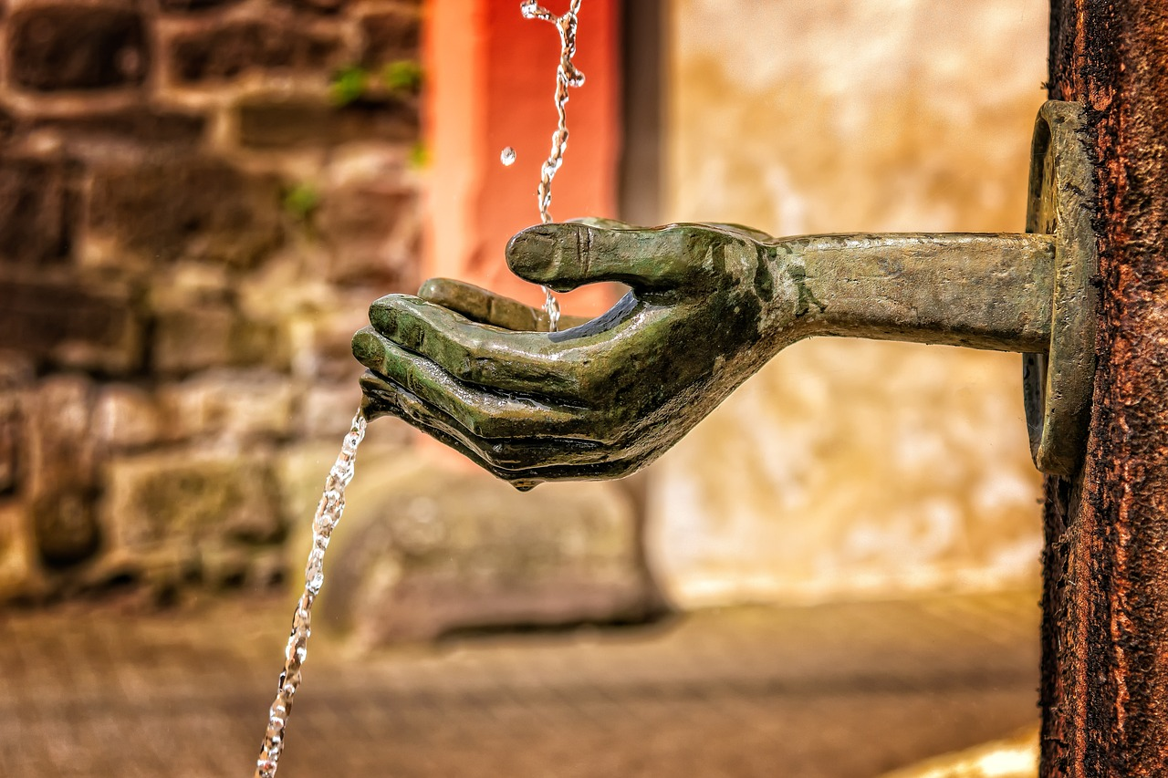
Plenary
What one specific action can you do to protect yourself from having the characteristics of the People of Hell?

Slide 25
For Next Week
سُبْحَانَكَ اللّٰهُمَّ وَبِحَمْدِكَ ، أَشْهَدُ أَنْ لَّا إِلٰهَ إِلَّا أَنْتَ ، أَسْتَغْفِرُكَ وأَتُوْبُ إِلَيْكَ
1) Memorise Ayahs 13-29
2) Bonus: Memorise the translation

Slide 26
The End

Slide 27
Additional Activities
Guess the word
Charades
Notes:
If you have additional time, give learners time to memorise the Arabic and the meanings. Then use these activities to consolidate the vocabulary.
Guess the word
I’m thinking of a word. You can only ask me X number of questions, otherwise the question gets passed to the next team.
Charades
Choose words from the surah which can be acted out.
Ask chosen person from the team to act it out. Add a restriction it make it more challenging e.g. eyes closes/turning your back to the audience.
The team that answers first is allocated points.
Classroom Charades – Instructions for Educators
Preparation:
Write words or phrases on slips of paper (or use a word list).
Divide the class into teams.
How to Play:
One student from a team picks a word and acts it out without speaking or using props.
Their team tries to guess within a time limit (e.g., 30–60 seconds).
If they guess correctly, they earn a point.
Rotate players and teams each round.
Rules:
No talking, writing, or spelling out words.
Only gestures and movements are allowed.
Encourage creativity and teamwork.
Winning:
The team with the most points after a set number of rounds wins!

