Slide 1
Important Notes for the Educator
The PowerPoints are animated so please use the PPT version if possible.
Keep the competition active throughout the four sessions. There is a slide in the first session with instructions.
Recite the passage/ayah aloud and encourage learners to recite after you OR ask learners to recite an ayah each.
Encourage learners to memorise Surah Qaf and its translation. Reward them for successful completion.
There are speaker notes under each slide. Read the notes before delivering the session.
Please thoroughly read the free PDF ‘A Journey through Surah Qaf’ in addition to reading tafsir books and lectures of this surah.
Feel free to adjust this PPT to your learners’ needs.
[A] in the PPT = Active learning. This can be done orally, in writing, on mini-whiteboards (MWB), classroom board, through discussion; alone, in pairs, groups etc, and through other methods. Try to use a variety of methods within each session. These can all contribute to the competition score.
LWA is not responsible for external links.
If you benefit from this resource, please remember the project in your duʿas. Your feedback to improve the resources is highly appreciated.

Slide 2
بِسۡمِ ٱللَّهِ ٱلرَّحۡمَـٰنِ ٱلرَّحِیمِ
Welcome!
Draw an aspect of nature that reminds you most of Allah.
Notes:
Start with bismillah, hamd and salawat. Greet learners, welcome them and thank them for attending.
Have the question ready on the board so learners can start thinking as they walk in/wait for the session to start.
Ask for some responses/mini-whiteboards to be raised.

Slide 3
سورة
سورة ق
A Wake-Up
Call
Surah Qaf: Session 1
Notes:
Today is the 1st of a four-part series on Surah Qaaf. The next session will be on…. Inshallah.

Slide 4
Session
Objectives
Reflect on the centrality of the Qur’an in our lives
01
Outline the two key issues this sūrah addresses
02
Explain why Allah asks us to reflect on His signs
03
Recite and reflect upon verses 1-14 of Surah Qāf
04
Notes:
Today we will…

Slide 5
Are You Ready
to Win?
Notes:
Before we start, you will all be put into groups. Throughout the four sessions, you will be in the same group, so make sure you attend all four sessions. Don’t let your teammates down!
Each question and activity will contribute towards your group points. The group with the most points at the end will receive a prize inshaAllah.
[Divide learners into 3-4 groups, depending on the number and what is physically feasible].

Slide 6
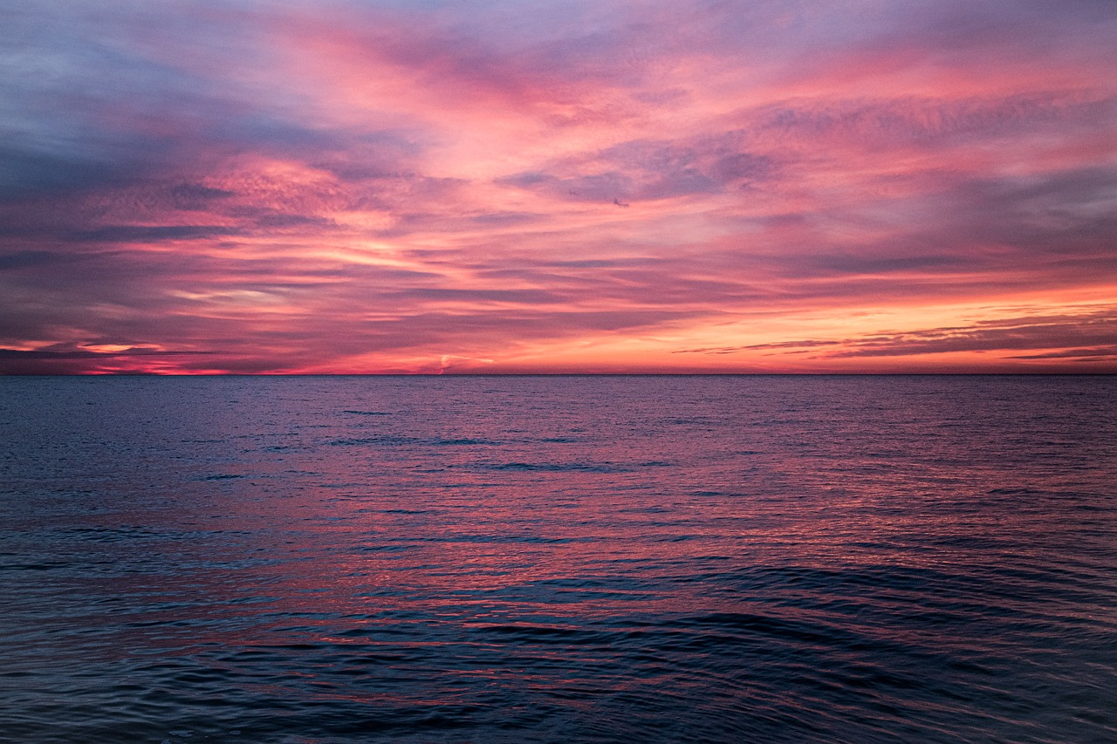
A Special Surah
The Prophetﷺ would recite Surah Qāf in large gatherings:
Jumuʿah ṣalāh
The Friday sermon: Umm Hishām b. Ḥārithah
Fajr ṣalāh
The two Eid ṣalāhs
Notes:
Surah Qāf is a very special surah. It is a Makki surah (i.e. revealed before hijrah).
The Prophet ﷺ used to recite it in large audiences:
Jumuʿah ṣalāh;
The Friday sermon: Umm Hishām b. Ḥārithah b. Nuʿmān (a female Companion) mentions that she memorised the sūrah just by hearing it in the khuṭbah of the Prophet ﷺ;
The two Eid ṣalāhs. It was a reminder not to forget the Day of Judgement; and not to commit sins or act arrogantly on this day of celebration.
Fajr ṣalāh.

Slide 7
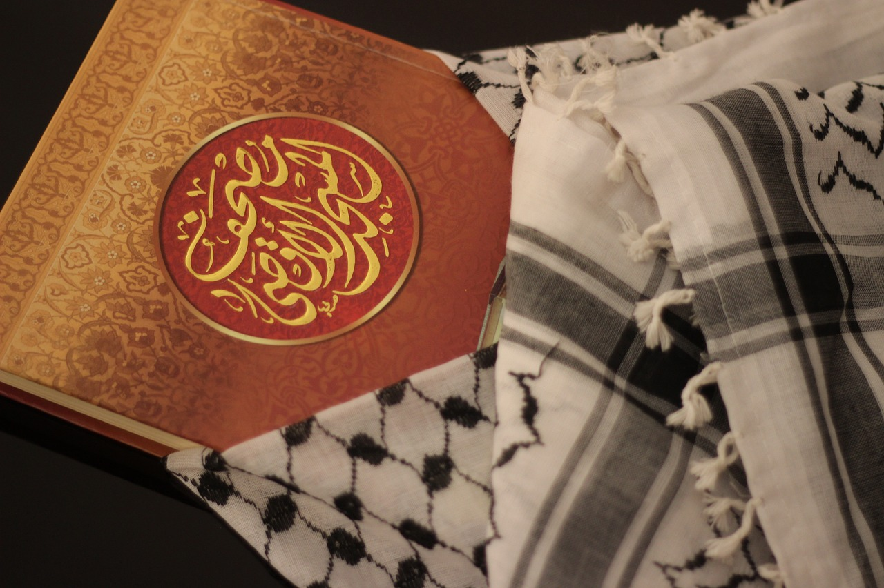
A Powerful Beginning
قٓ وَٱلْقُرْءَانِ ٱلْمَجِيدِ ‎﴿١﴾‏
ق: Strong letter: why?
Letter repeated in the surah
[A] What is the function of an oath?
ٱلْمَجِيدِ : Lofty, glorious, majestic
Qaf - By the glorious Quran!
Notes:
Let’s now dive straight into the sūrah.
We don’t know what Qaaf means. It is from the miracles of the Qur’an. Can you think of any other surahs which also start with one letter?
The letter Qāf is a strong letter. The purpose is to wake up the heedlessness of the Quraysh and send a message of warning; it is to force them to pay attention to what is coming next.
The letter Qāf will be repeated many times in this sūrah too.
Then Allah takes an oath.
The function of an oath is to alert the listener to the importance of what is going to be mentioned next.
Allah takes an oath by the Qur’an and describes it as majīd: majestic, glorious, lofty. The Qur’ān is the greatest miracle Allah has sent down to us. Its words are majestic. Its meanings are majestic. Its sounds are majestic. Its impact on hearts and lives is majestic.
The Qur’an is the anchor which guides us at every point in life, the ‘food’ for our hearts and our eternal companion.

Slide 8
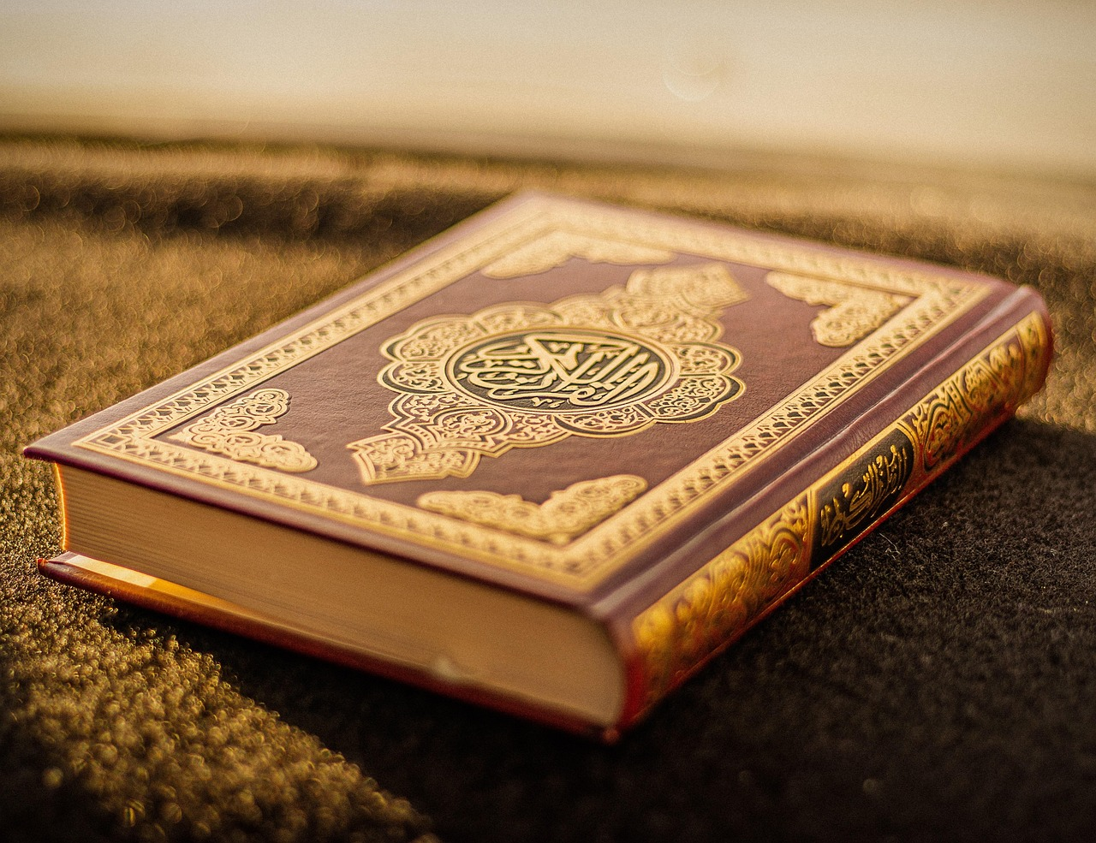
Time to Reflect
Be honest with yourself! I’m not going to ask for feedback.
Can I explain in 2 minutes *why* the Qur’an is majestic?
Do I feel connected to the Qur’an?
How important is the Qur’an in my life (on a scale from 1-10)?
Notes:
We often talk about how great the Qur’an is, but do we truly believe it? These questions will help us and inshaAllah motivate us to strengthen our connection with the Greatest Book.
[Ask learners to (privately) jot down the answers to these questions and give them some time to reflect. Then go round eliciting ideas for how they can become closer to the Qur’an].

Slide 9
How Strange!
بَلْ عَجِبُوٓا۟ أَن جَآءَهُم مُّنذِرٌ مِّنْهُمْ فَقَالَ ٱلْكَـٰفِرُونَ هَـٰذَا شَىْءٌ عَجِيبٌ ‎﴿٢﴾
1st issue raised by the Quraysh.
Disbelievers: “Why did Allah send a human and not an angel?”
[A] If Allah had sent an angel instead of a human messenger, how do you think some people would have reacted?
But the disbelievers are amazed that a warner has come from among them and they say, ‘How strange!
Notes:
This āyah mentions the first issue raised by the mushrikīn of Makkah: “Why did Allah send a human and not an angel as a messenger?”
[Ask question: If Allah had sent an angel instead of a human messenger, how do you think some people would have reacted?]
If the angels were the residents of the earth, then it would have made sense to send angels as Prophets. There are many wisdoms in why Allah sent humans and not angels.

Slide 10
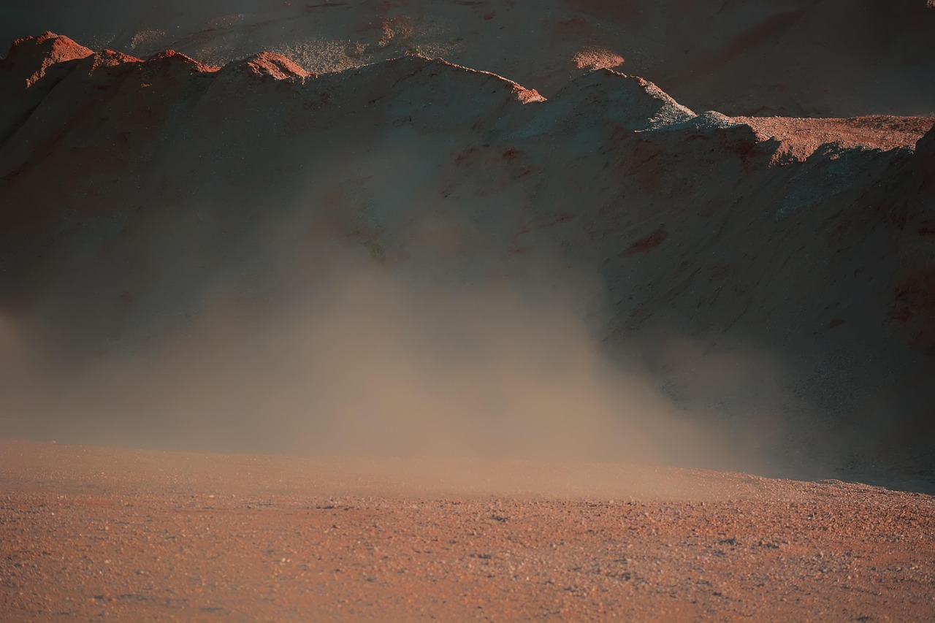
As If!!
أَءِذَا مِتْنَا وَكُنَّا تُرَابًا ذَٰلِكَ رَجْعٌ بَعِيدٌ ‎﴿٣﴾
2nd issue raised by the Quraysh.
The Quraysh did not believe it was possible for humans to be brought back to life after their bones had decomposed.
The remainder of the sūrah is a response to this issue.
To come back [to life] after we have died and become dust? That is too farfetched.’
Notes:
This is the second issue that the Quraysh raised. The Quraysh did not believe it was possible for humans to be brought back to life after their bones had decomposed.
There’s no way this is going to happen! ذَٰلِكَ رَجْعٌ بَعِيدٌ
The rest of the sūrah is a response to this issue.
Resurrection or life after death is a central belief of ours. It is one of the 3 key themes of the Qur’an revealed in Makkah. Allah will prove, again and again, how this will most certainly happen.

Slide 11
Allah’s Absolute Knowledge
قَدْ عَلِمْنَا مَا تَنقُصُ ٱلْأَرْضُ مِنْهُمْ وَعِندَنَا كِتَـٰبٌ حَفِيظٌ ‎﴿٤﴾
كِتَـٰبٌ حَفِيظ: Recorded in al-Lawḥ al-Maḥfūẓ—every single thing is recorded; not one thing is missed out.
[A] How does this verse make you feel?
We know very well what the earth takes away from them: We keep a comprehensive record.
Notes:
Allah knows what the earth consumes of their dead bodies.
From verses 4 to 14, Allah mentions three key responses to the Quraysh’s issue of resurrection. The first key proof is: Allah’s complete, absolute and ultimate knowledge.
If Allah has absolute knowledge of what the earth has consumed of dead bodies AND everything is recorded in al-Lawḥ al-Maḥfūẓ—then He is surely Capable of raising them back to life.
[A] How does this verse make you feel?

Slide 12
Lost &
Confused
بَلْ كَذَّبُوا۟ بِٱلْحَقِّ لَمَّا جَآءَهُمْ فَهُمْ فِىٓ أَمْرٍ مَّرِيجٍ ‎﴿٥﴾
Consequence of those who reject the message = confusion.
Mixed and confused - there will be no meaning and purpose to their life if they reject the truth.
But the disbelievers deny the truth when it comes to them; they are in a state of confusion.
Notes:
Those who reject the truth are confused.
Think: Imagine waking up one day randomly on an aeroplane. Your mind would race with questions: How did I get here? Who brought me here? Where am I going? Why am I here? You wouldn’t feel at ease until you understood the answers.
Similarly, imagine not knowing the answers of key questions in life: Why am I here? Where am I going?
We can’t appreciate the importance of having a purpose and direction in life as born Muslims; ask those who accepted Islam or those who don’t believe in Allah and you will see their confusion.

Slide 13
The Outcomes of Belief in the Next Life
Akhirah
[A] What impact does this have on their lives? How are their lives different?
Amy, 14
Does NOT believe in the hereafter
Iman ,14
Does NOT believe in the hereafter
Notes:
Ask learners to discuss and write down responses in their groups.
How does
Challenge: How does it impact society and those around them?

Slide 14
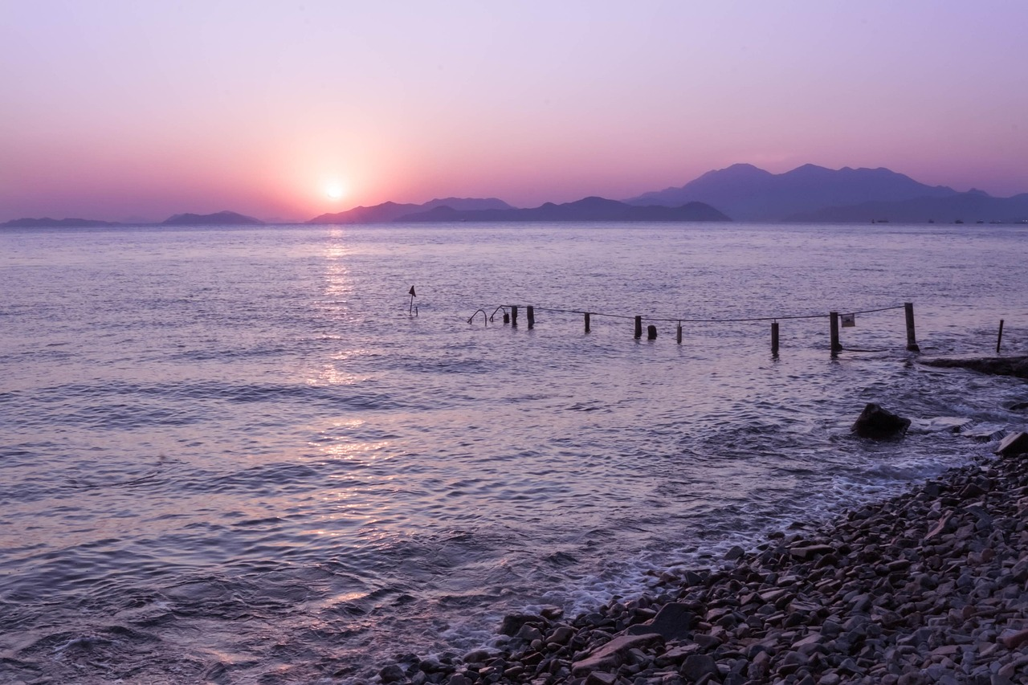
The Flawless Sky
أَفَلَمْ يَنظُرُوٓا۟ إِلَى ٱلسَّمَآءِ فَوْقَهُمْ كَيْفَ بَنَيْنَـٰهَا وَزَيَّنَّـٰهَا وَمَا لَهَا مِن فُرُوجٍ ‎﴿٦﴾‏
Reflect on the signs around us: nature. This is part of fitrah.
The sky reflects Allah’s power and beauty: built, adorned, and flawless in structure. Similar to the truth.
Connect the physical to the spiritual.
Do they not see the sky above them––how We have built and adorned it, with no rifts in it;
Did You Know?
It’s a sunnah to look at the sky. The Prophet ﷺ would frequently look at the sky and glorify Allah.
Notes:
The second key proof of resurrection that Allah presents is: The Perfect Creation of Allah.
This is an invitation from Allah to open our eyes and look at the signs around us:
There are 3 dimensions of this verse: built it, adorned it, flawless. Stability, beauty and perfection (no holes or cracks in its structure), along with clear features are common to both the sky and the truth. How can there not be a Creator of this flawless beauty?
We should always reflect on nature and strive to find the spiritual within the physical. Many aḥādīth describe how the Prophet (ﷺ) would reflect on the signs around him—such as the sky—and recite specific verses or duʿās.

Slide 15
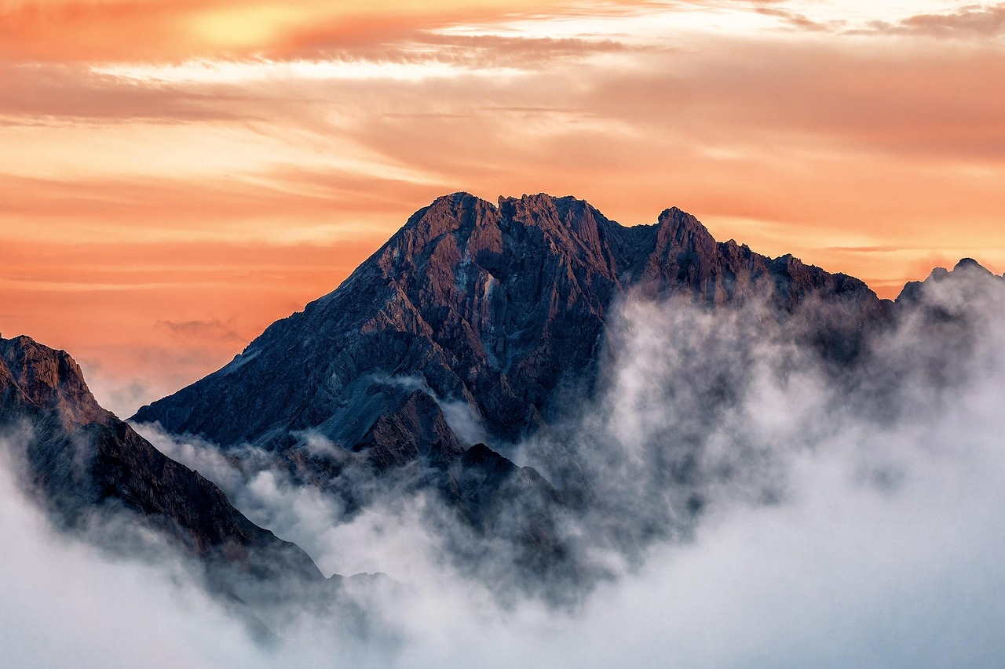
The Earth
وَٱلْأَرْضَ مَدَدْنَـٰهَا وَأَلْقَيْنَا فِيهَا رَوَٰسِىَ وَأَنبَتْنَا فِيهَا مِن كُلِّ زَوْجٍ بَهِيجٍ ‎﴿٧﴾‏
بَهِيجٍ
Joyous, beautiful.
رَوَٰسِىَ
[A] What is the function of mountains?
We just need to open our eyes and hearts.
Revelation’s purpose is to make our hearts firm and stable too.
how We spread out the earth and put solid mountains on it, and caused every kind of joyous plant to grow in it,
Notes:
رَوَٰسِىَ - : This is the adjective of mountains and the noun hasn’t been mentioned but it is implied as this is specific to mountains.
[A] What is the function of mountain?
The purpose of mountains is to make the earth firm. Revelation came in mountains; the purpose of revelation is to make the human firm, straight on the path to Allah.
بَهِيجٍۢ - : Joyous, beautiful. Look at the creation of Allah; it’s beautiful. We just need to open our eyes and hearts.

Slide 16
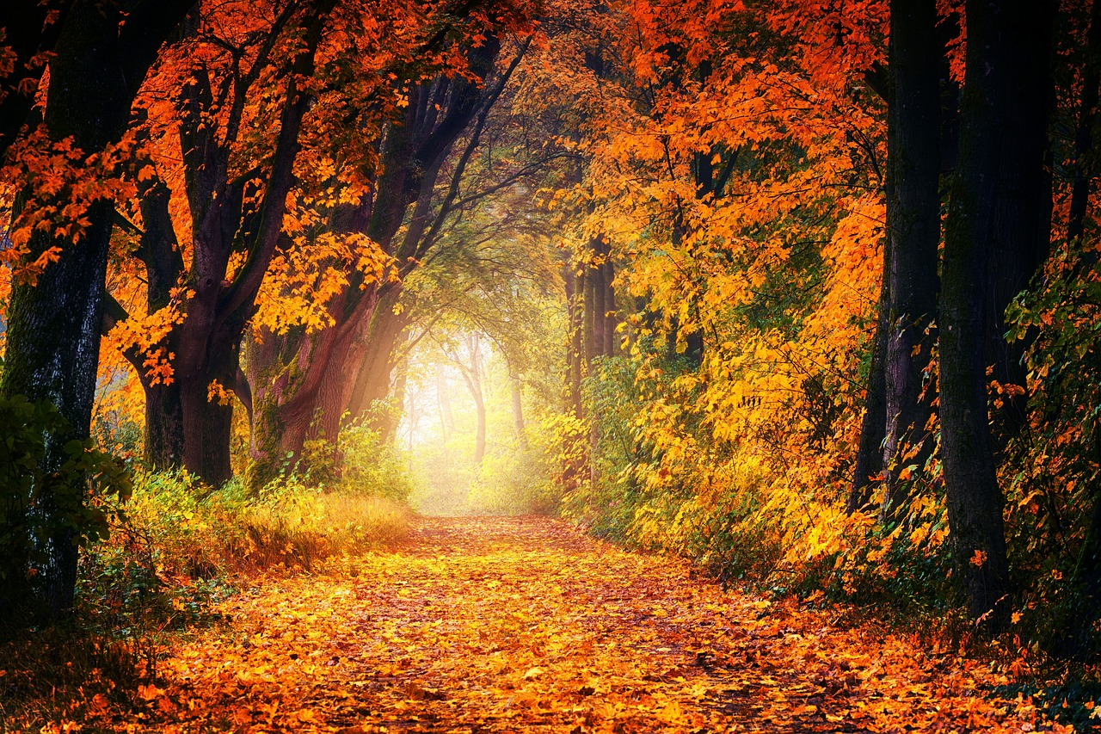
Who Will Benefit?
تَبْصِرَةً وَذِكْرَىٰ لِكُلِّ عَبْدٍ مُّنِيبٍ ‎﴿٨﴾
Any knowledge that does not lead us to knowing Allah is incomplete, false or useless.
The Book of the Universe: accessible to all.
The reminder will only be internalised by those who constantly return to Allah.
as a lesson and reminder for every servant who turns to God;
Notes:
Now that the universal image has been drawn, the sūrah touches our hearts directing us to reflect on the purpose of creation:
The purpose of all knowledge is to remind us of Allah. Every piece of new knowledge about a star, planet, and humans should be transformed into a message to our hearts. This inevitably emphasises the oneness of God as the Creator of the universe. Any knowledge that does not lead to this objective is incomplete, false or useless.
The ‘book of the universe’ is readable in all languages by all methods. It is accessible to people with all abilities: literate and illiterate people. A person living in a rural area can access it as easily as someone living in a palace.
Allah says that only the servant who is ‘munib’ (someone who constantly returns to Allah) will benefit from this reminder.

Slide 17
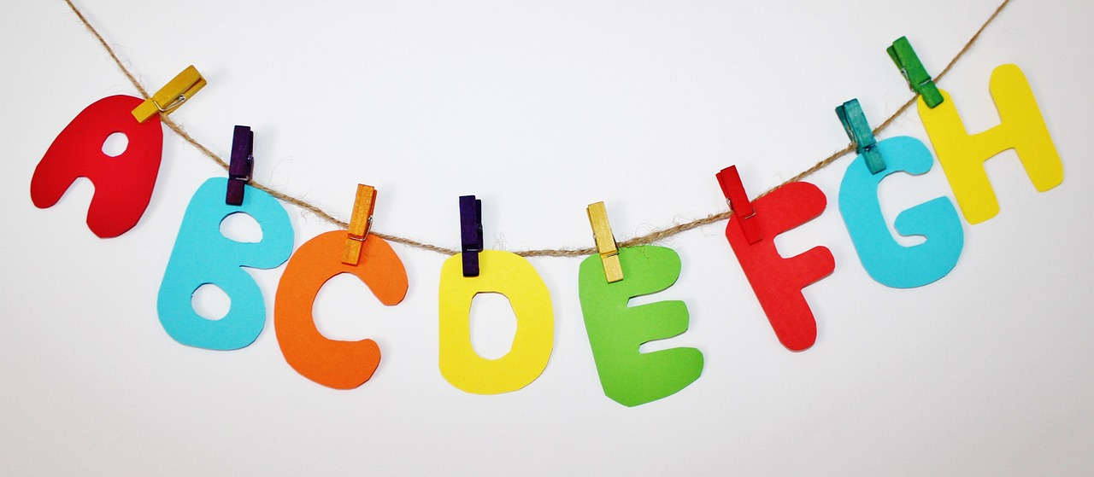
The ABC Game
In your groups, write a list of fruits and vegetables for each letter of the alphabet – 1 per letter. The group first to finish/with the most words wins!

Slide 18
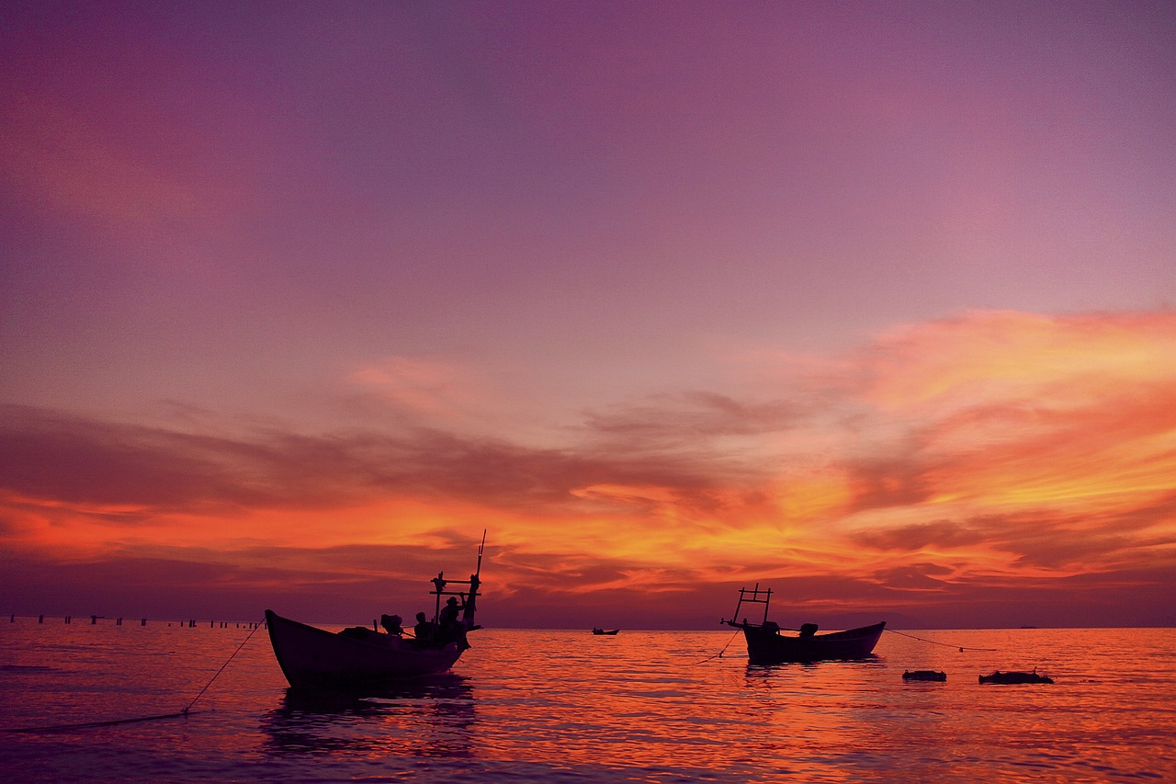
“
The signs around us make it clear that Allah exists, is All-Powerful, and One!

Slide 19
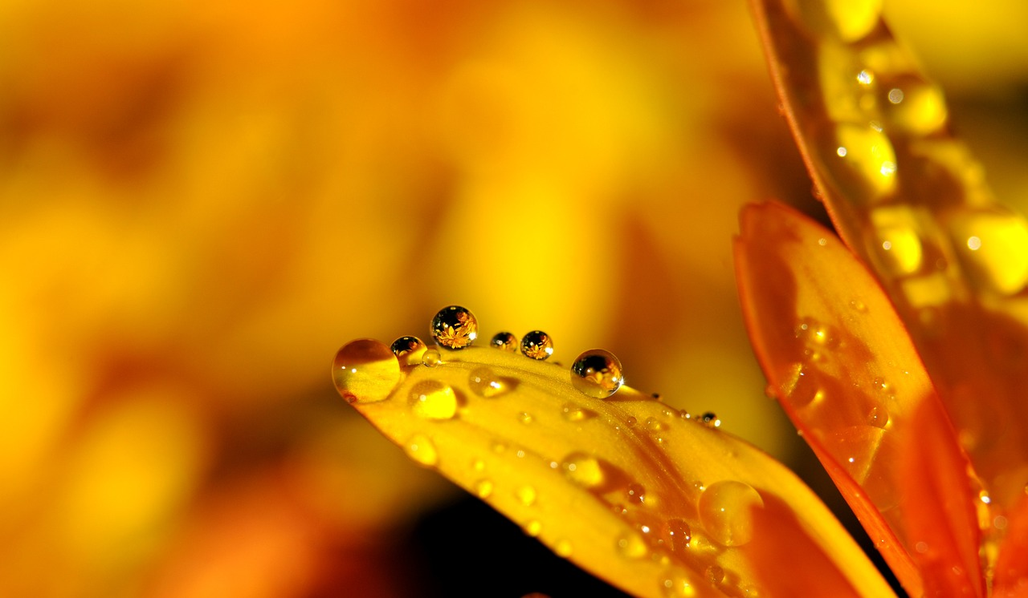
The Source
of Life
وَنَزَّلْنَا مِنَ ٱلسَّمَآءِ مَآءً مُّبَـٰرَكًا فَأَنبَتْنَا بِهِۦ جَنَّـٰتٍ وَحَبَّ ٱلْحَصِيدِ ‎﴿٩﴾‏
[A] What are the similarities between water from the sky and revelation from the sky?
and how We send blessed water down from the sky and grow with it gardens, the harvest grain,
Notes:
Allah now wants us to reflect on the source of life and sustenance: water. Through it, countless fruits and vegetables grow—with a stunning variety of colours, textures, and tastes.
[A] What are the similarities between water from the sky and revelation from the sky?
- Allah sent water to a dead earth, and when water is sent, the earth is brought back to life. Similarly, our hearts were dead, and the Qur’ān was sent to bring them back to life.
Both are described as ‘mubarak’ – blessed in the Qur’an.

Slide 20
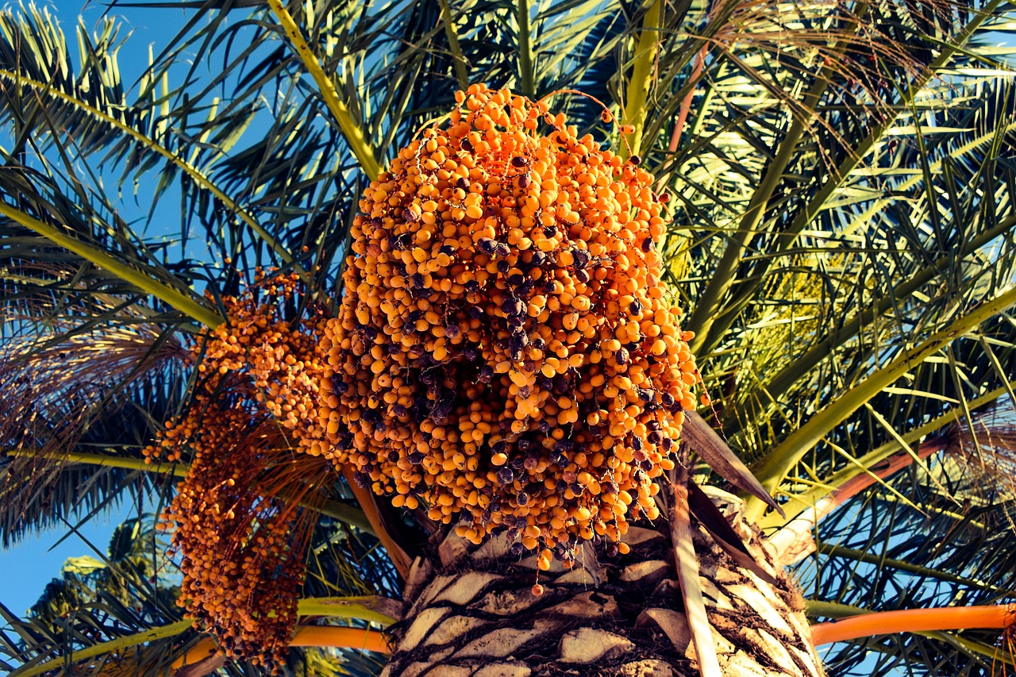
Palm
Trees
وَٱلنَّخْلَ بَاسِقَـٰتٍ لَّهَا طَلْعٌ نَّضِيدٌ ‎﴿١٠﴾‏
[A] What is unique about the palm tree?
Can survive in extreme heat;
Have a long life and durability;
Produce abundant fruit: variety of flavours, colours and textures.
and tall palm trees laden with clusters of dates,
Notes:
From these, Allah specified the palm tree due to its unique qualities:
Can survive in extreme heat;
Have a long life and durability;
Produce abundant fruit: variety of flavours, colours and textures.

Slide 21
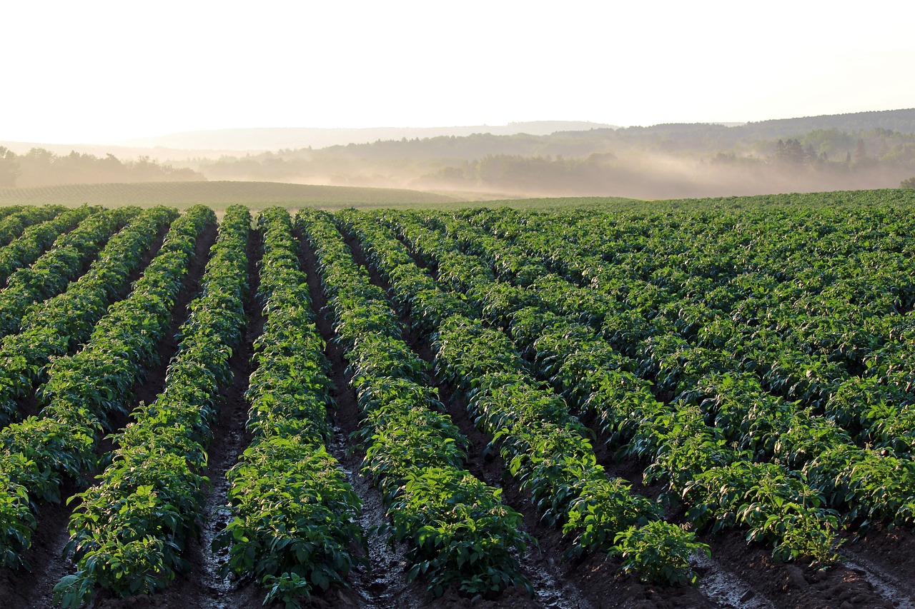
Allah: the Giver of Life
رِّزْقًا لِّلْعِبَادِ وَأَحْيَيْنَا بِهِۦ بَلْدَةً مَّيْتًا كَذَٰلِكَ ٱلْخُرُوجُ ‎﴿١١﴾
Allah is telling the disbelievers: the One who can cause the dead earth to come back to life, can certainly bring you back to life again.
[A] Which ayah mentioned their denial of resurrection?
as a provision for everyone; how with water We give [new] life to a land that is dead? This is how the dead will emerge [from their graves].
Notes:
This is the main point Allah is proving to the disbelievers: the One who can cause the dead earth to come back to life, can certainly bring you back to life again; He can bring your soul back to life once more.
[A] Which ayah mentioned their denial of resurrection?
Ayah 3: أَءِذَا مِتْنَا وَكُنَّا تُرَابًا ذَٰلِكَ رَجْعٌ بَعِيدٌ ‎﴿٣﴾

Slide 22
Learn from History
كَذَّبَتْ قَبْلَهُمْ قَوْمُ نُوحٍ وَأَصْحَـٰبُ ٱلرَّسِّ وَثَمُودُ ‎﴿١٢﴾ وَعَادٌ وَفِرْعَوْنُ وَإِخْوَٰنُ لُوطٍ ‎﴿١٣﴾‏
وَأَصْحَـٰبُ ٱلْأَيْكَةِ وَقَوْمُ تُبَّعٍ كُلٌّ كَذَّبَ ٱلرُّسُلَ فَحَقَّ وَعِيدِ ‎﴿١٤﴾‏
[A] Why does Allah tell us to look at the signs in history?
Look at nations in the past who denied the truth
Water: a blessing, but can also be a punishment. For e.g. ?
The people of Noah disbelieved long before these disbelievers, as did the people of Rass, Thamud, Ad, Pharaoh, Lot, the Forest-Dwellers, Tubba: all of these people disbelieved their messengers, and so My warning was realized.
Notes:
The previous ayāt prove Allah’s might and power. Similarly, the Most Powerful can certainly bring you back to life.
Allah now mentions the third key proof of resurrection: learning from history.
These verses are a consolation to the Prophet ﷻ and a warning to the disbelievers. The examples from history prove that those who rejected the Divine message will surely be punished and destroyed.
Water is a huge blessing, but can also be a punishment. For e.g. ? [People of Nūḥ ʿalayhis-salām; Firʿawn]
[A] Why does Allah tell us to look at the signs in history?
History repeats itself. There are patterns.
To avoid doing what they did and not to become arrogant or comfortable with material gains.
Their destruction is a sign of Allah’s ultimate power

Slide 23
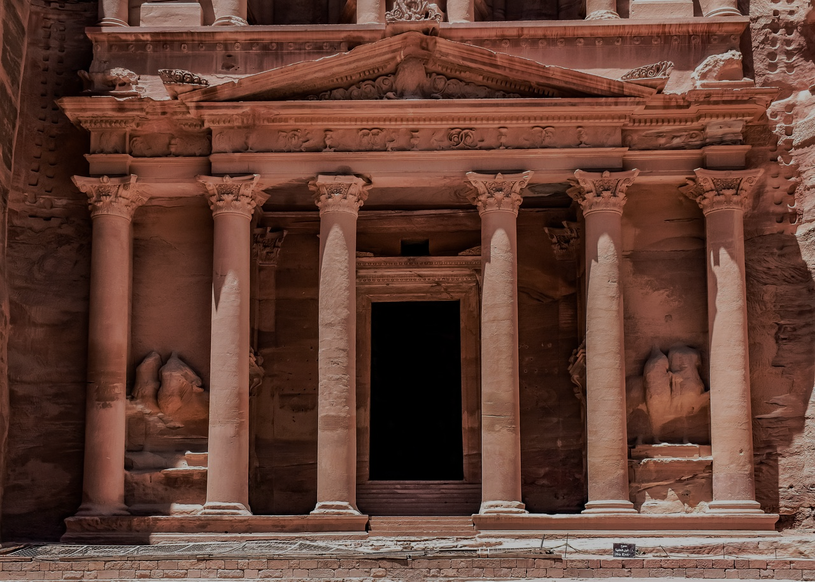
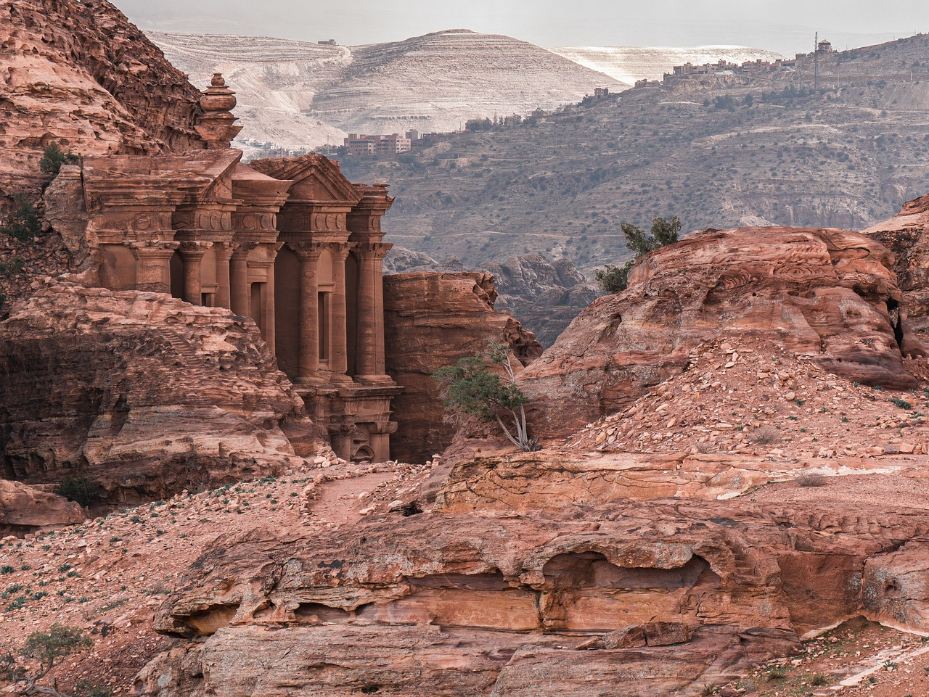
“
No matter how advanced a civilisation gets, it’s never too great for Allah’s punishment.
Notes:
Some civilisations reached great heights, building towering structures and strong buildings. However, this didn’t stop them from rejecting the truth and thus didn’t protect them from punishment. Allah is teaching a lesson through history: كُلٌّۭ كَذَّبَ ٱلرُّسُلَ فَحَقَّ وَعِيد.

Slide 24
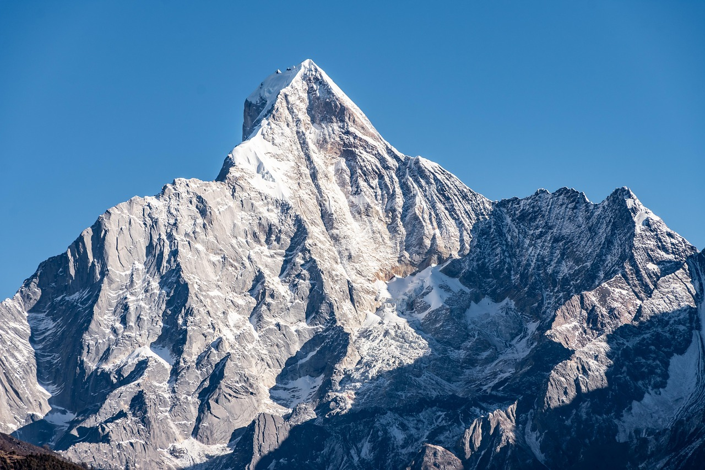
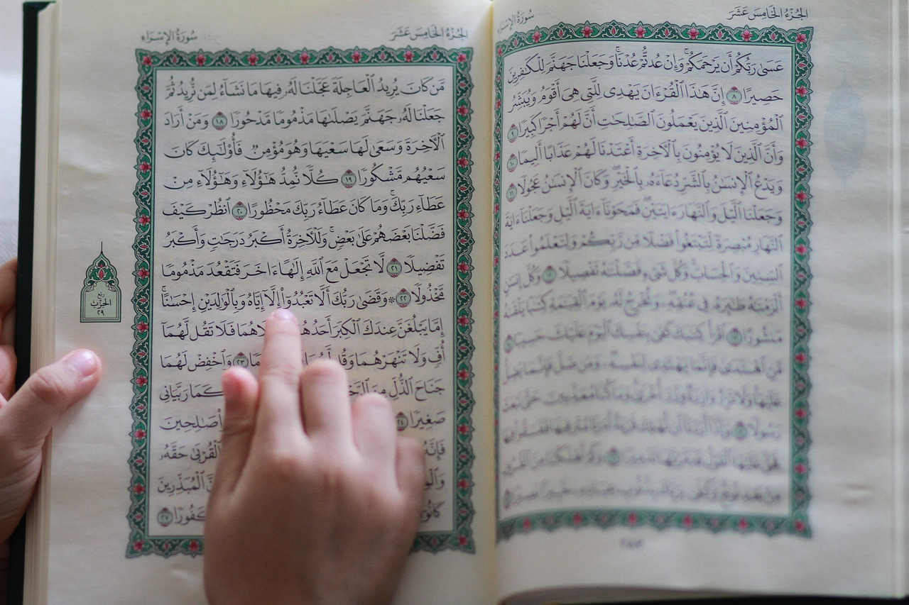
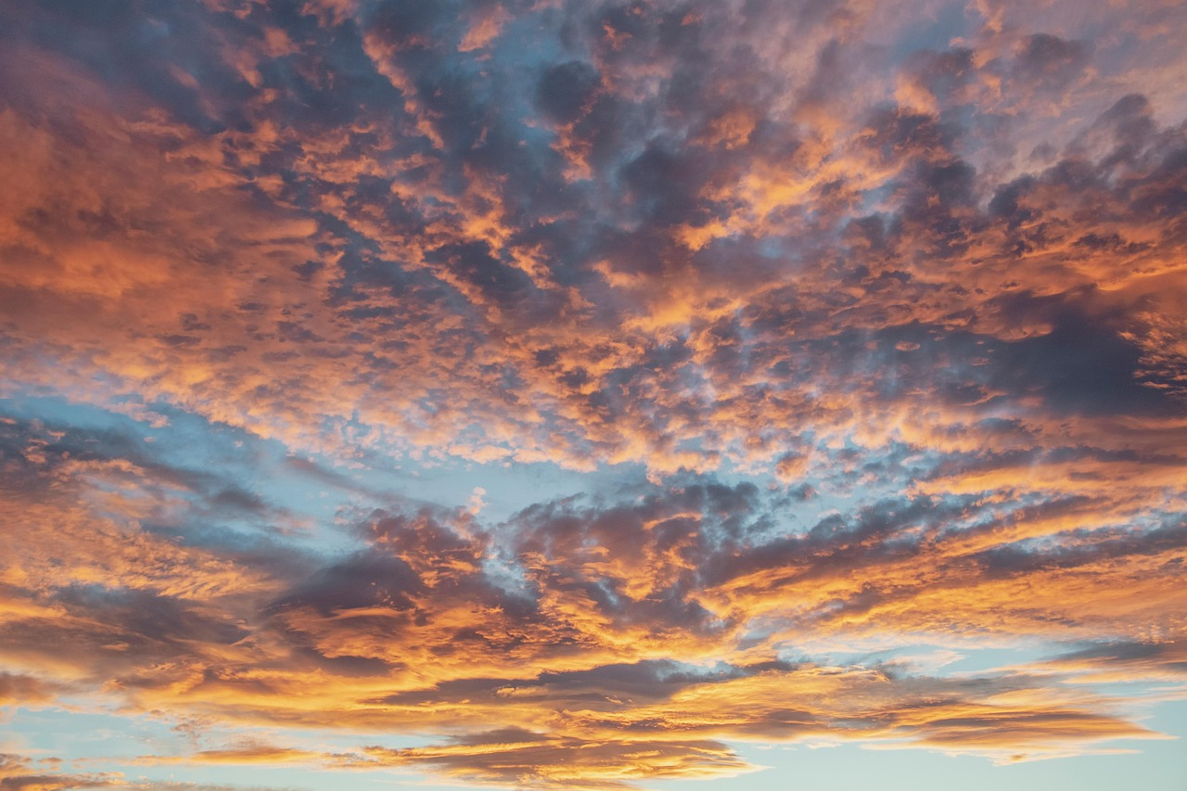
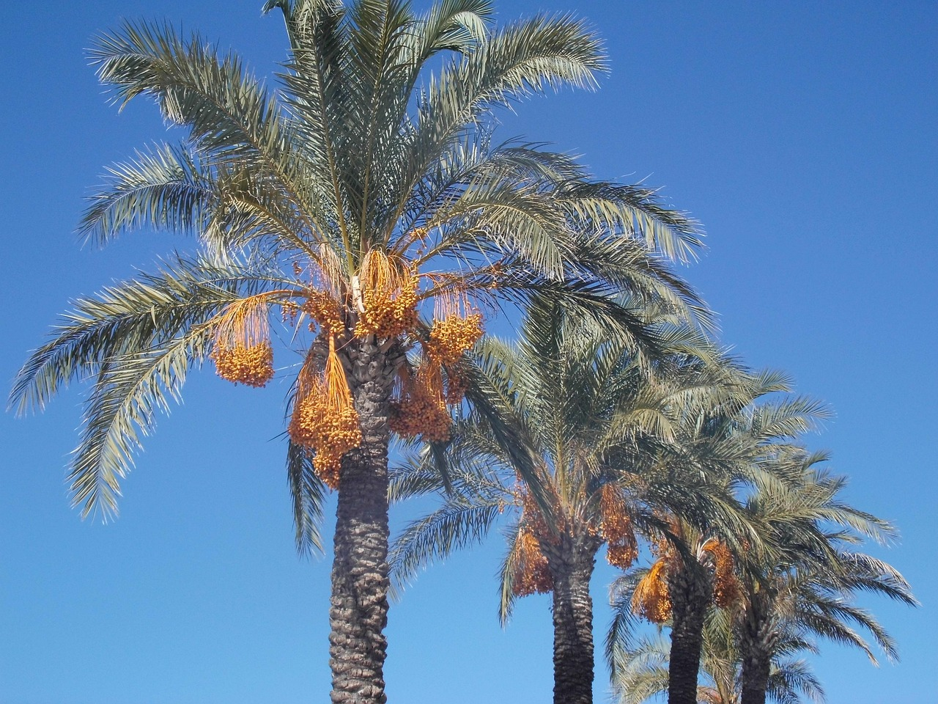
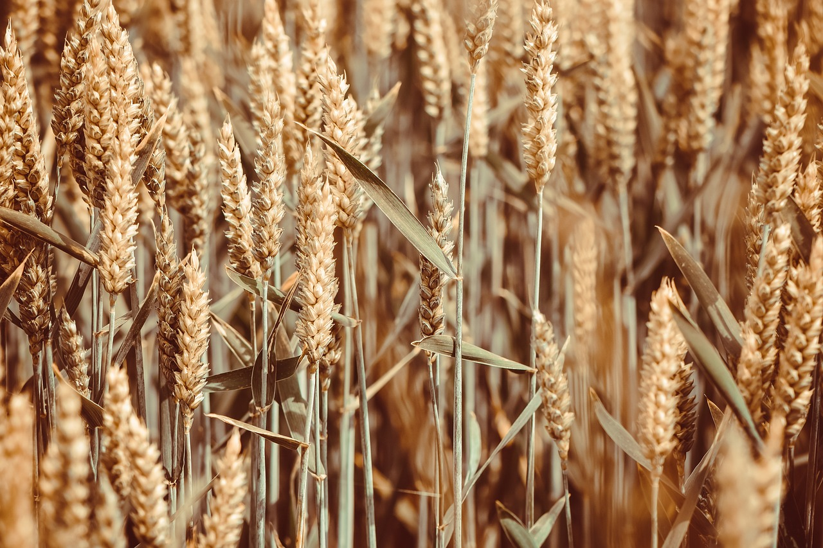
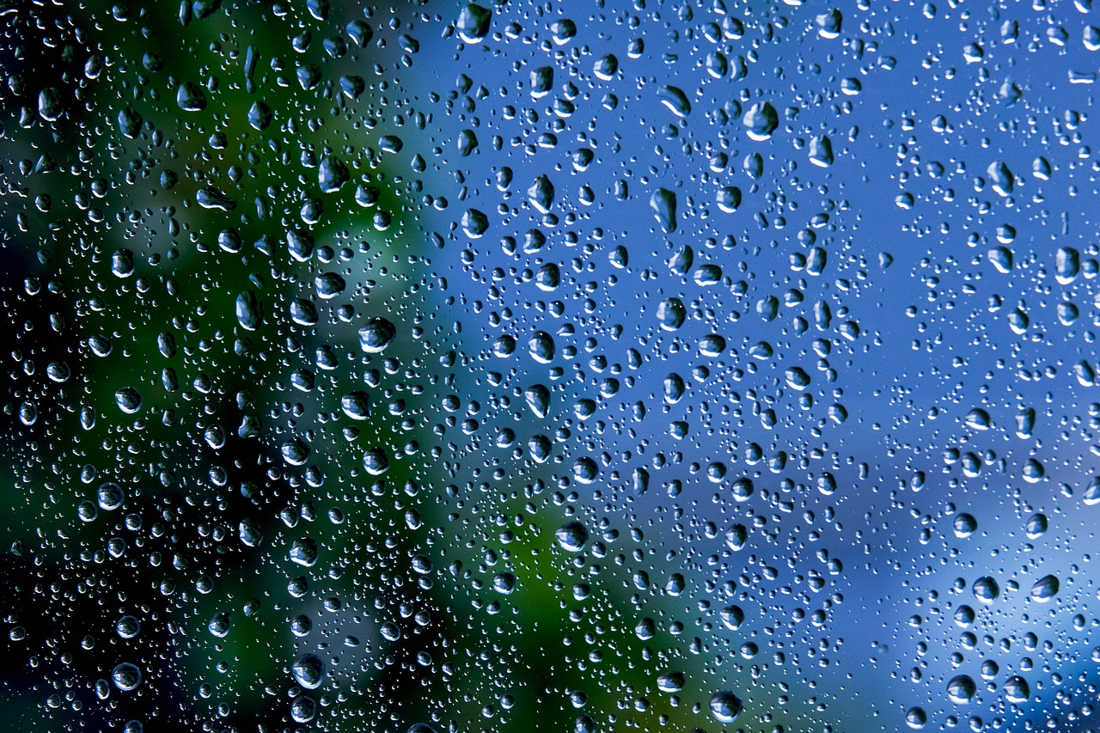
Match the Picture to the Ayah
1 | 2 | 3
4 | 5 | 6
Notes:
1) Mountains – 7
2) Quran – Ayah 1
3) Sky – 6
4) Palm trees – 10
5) Grains – 9
6) Rain – 9

Slide 25
Plenary
What does Allah take an oath by at the beginning of the surah? Why?
What were the two issues raised by the disbelievers?
Why does Allah remind us to reflect on His creation?
Why does Allah ask us to reflect on history?
On a sticky note, write down ONE action you can take in the next week based on what you have learnt today.
Notes:
Ask these as quick-fire questions.
Give time for the sticky note task and ask them

Slide 26
For Next Week
سُبْحَانَكَ اللّٰهُمَّ وَبِحَمْدِكَ ، أَشْهَدُ أَنْ لَّا إِلٰهَ إِلَّا أَنْتَ ، أَسْتَغْفِرُكَ وأَتُوْبُ إِلَيْكَ
1) Memorise Ayahs 1-12
2) Bonus: Memorise the translation

Slide 27
The End

Slide 28
Additional Activities
Paint a canvas/sketch with pencil the nature in this surah
Vocabulary activities/sheet
Splat with vocabulary (next slide)
Notes:
If you have additional time, give learners time to memorise the Arabic and the meanings. Then use these activities to consolidate the vocabulary.

Slide 29
SPLAT!
أَصْحَـٰبُ ٱلْأَيْكَةِ | ذِكْرَىٰ | كَذَّبَ
نَزَّلْنَا | مُّنذِرٌ | ٱلنَّخْلَ
ٱلْأَرْضُ | ٱلسَّمَآءِ | عَجِيبٌ

