Slide 1



THE PROPHET’S HAJJ
Tracing the footsteps of our beloved Messenger g

Slide 2

This PPT can be read by those who have been invited by Allah d to perform ḥajj this year, and those at home.
This PPT can be used for self-learning. If you are presenting to a group/class, feel free to reduce the text/omit some of the details etc. according to the needs of your audience.

Slide 3


What You Will Need
+
a present heart
a notebook to jot down reflections & duʿās

Slide 4
Hajj: The Ultimate Journey to Allah
As you go through this PPT:
Take some time to internalise the significance of this journey and each action of our beloved Messenger g.
Hajj connects us to our rich heritage. Think about the significance of each action and the sacrifices made by those beloved to Allah. Think about how Allah c loved & accepted their actions to the extent that we follow them to this day.
Think about how you can emulate the example of the Prophet g during your journey.
Note down the duʿās of the Prophet g.
Use this as an inspiration to formulate your own duʿās.
Reflect on why ḥajj is one of the greatest acts of worship.

Slide 5
Some History…
9 AH
9 AH
The āyah making ḥajj obligatory was revealed:
The Prophet g sent Abū Bakr and ʿAli k to lead the pilgrims.
فِيهِ ءَايَٰتُۢ بَيِّنَٰتٞ مَّقَامُ إِبۡرَٰهِيمَۖ وَمَن دَخَلَهُۥ كَانَ ءَامِنٗاۗ وَلِلَّهِ عَلَى ٱلنَّاسِ حِجُّ ٱلۡبَيۡتِ مَنِ ٱسۡتَطَاعَ إِلَيۡهِ سَبِيلٗاۚ وَمَن كَفَرَ فَإِنَّ ٱللَّهَ غَنِيٌّ عَنِ ٱلۡعَٰلَمِينَ ٩٧
10 AH
The Prophet g performed ḥajj

Slide 6
The Journey Begins!
Friday, 24
Dhul Qa’dah
The Prophet g reminded people of the purpose of ḥajj: “People, learn that Allah has ordained that ḥajj is a binding duty to you all, so perform ḥajj.”
Saturday, 25 Dhul Qa’dah
The Prophet g performed Dhuhr, applied perfume and started his journey. Thousands joined him: men, women, children; some walking, and some riding camels/horses.
Saturday, 25 Dhul Qa’dah
The Prophet g left Abū Dujānah in charge of Madinah. Just 5 years before, it was besieged by Arab tribes, but now Allah filled it with security & peace.

Slide 7
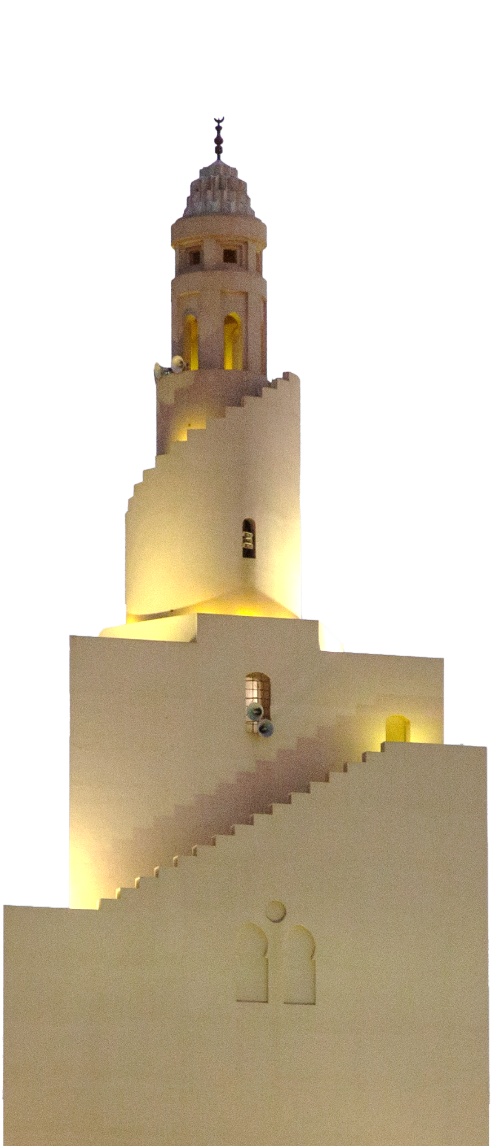
Dhul Hulayfah
Dhul Ḥulayfah was used as a gathering place at it was an open plane. It is 10km from Madinah and the Prophet g arrived before ʿAṣr prayer. He performed 2 units of ʿAṣr and stayed the night.
He visited all of his wives individually ensuring they were comfortable and well placed for the journey.
During the night, Asmā b. ʿUmays i gave birth to her son, naming him Muḥammad. The Prophet g ordered her to take a bath and perform all the rites other than ṭawāf.
He took a few sacrificial animals with him, distinctly marked.
He then took a bath, applied oil & a sticky paste to his head. He took some of ʿĀ’ishah’s i best perfume and applied it to his head and beard.
He wore iḥrām, prayed Dhuhr, rode his she-camel and glorified Allah.

Slide 8
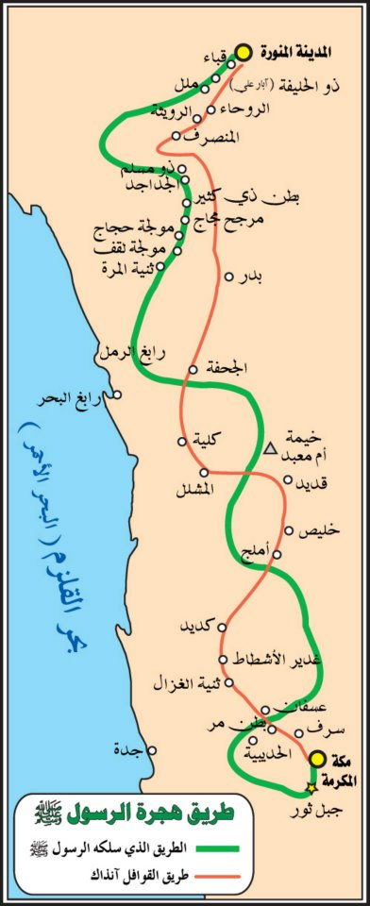
The Best Friend
Abū Bakr’s h luggage camel contained the food of the Prophet g.
This trip resembled a similar trip undertaken by the two 10 years ago, yet was so different in many aspects.
While they both were in the cave, he reassured his companion, “Do not worry; Allah is certainly with us.” (9:40)
The land was now under his authority. All the tribes that chased him on his first trip were now his followers on this one.
Think & Reflect
Ṣabr is a HUGE part of ḥajj. Imagine the ṣabr of the Prophet g and his companion. Through their ṣabr, the world transformed.

Slide 9

The Three Methods of Hajj
He g was full of humility: he walked with the people — no great carriage was prepared for him & no special tent erected for him.
The echoes & sounds of Labbayk Allahumma Labbayk filled the air. People were around him in all directions. He was receiving Qur’ānic revelations. Jābir h says: “Whatever he did, we did likewise.”
The Prophet g did qirān: Abū Bakr, ʿUmar, Ṭalḥah, Zubayr & ʿAbdul Raḥmān b. ʿAwf j did the same.
His wives did tamattuʿ.
Majority of the companions performed ifrād.
Qirān
Tamattuʿ
Ifrād

Slide 10
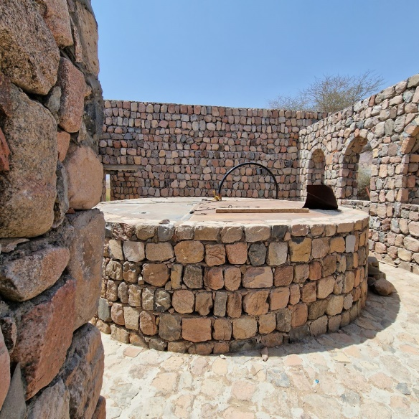
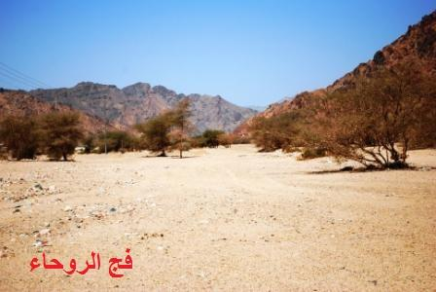
On the Shoulders of Giants
Upon passing Rawḥā’, he g said: “70 Prophets went through the Rawḥā’ passage to perform ḥajj.”

Slide 11
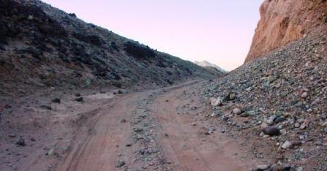
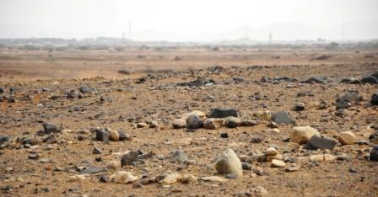
The Harsha Pathway
Al-Azraq Valley
He then went passed through the Harshā Pathway. He g said: “I can almost see (Prophet) Yunus b. Matta n riding a strong red camel, wearing a woollen top garment, and the rein of his she-camel is made of fibre, and he is reciting the talbiyah.”
He then went through the al-Azraq Valley. He g said: “I can almost see (Prophet) Mūsā n riding a red camel with a rope for his rein. His fingers are in his ears as he raises his voice reciting the talbiyah and passing through this valley.”

Slide 12
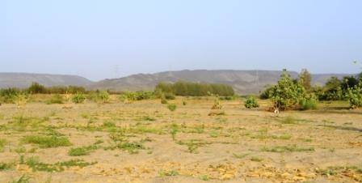
ʿUsfan Valley
Think & Reflect
Ḥajj was performed by Prophets & Messengers: it is an act of worship which connects us to our deep heritage. We are taking the same road taken by earlier Prophets and will be taken by ʿIsā n when he comes.
He then passed the ʿUsfān Valley.
He g said: “Prophets Hūd and Ṣāliḥ q went through it riding young red she-camels with fibre reins…reciting talbiyah and headed to offer ḥajj of the Ancient House.”
Act
Duʿā’ List: We should make duʿā’ that just as Allah enabled us to follow their way physically, He will also place us with them in the eternal abode:
وَمَن يُطِعِ ٱللَّهَ وَٱلرَّسُولَ فَأُوْلَٰٓئِكَ مَعَ ٱلَّذِينَ أَنۡعَمَ ٱللَّهُ عَلَيۡهِم مِّنَ ٱلنَّبِيِّ‍ۧنَ وَٱلصِّدِّيقِينَ وَٱلشُّهَدَآءِ وَٱلصَّٰلِحِينَۚ وَحَسُنَ أُوْلَٰٓئِكَ رَفِيقٗا ٦٩

Slide 13
The Teaching Never Ceases
He g would answer people’s questions & guide them throughout the journey.
The Prophet g would pass by people who were walking and would tell them to ride the camels they had brought for sacrifice (Pre-Islam: they would not ride sacrificial animals).
Abū Ṭalīq came to the Prophet g saying my wife asked me to give her a camel to ride on her pilgrimage, but I said it was dedicated for Allah’s cause only. She also asked for some money but I said I had nothing other than what I would need on my journey. The Prophet g then advised him saying: “Had you given her your camel, it would have been for Allah’s cause and had you given her your money, Allah would have given you more.”
Act
Be generous during ḥajj
Think & Reflect
Ḥajj is a reminder of the Hereafter. It is a sacrifice for Allah, and every action we do should bring us closer to Him.

Slide 14
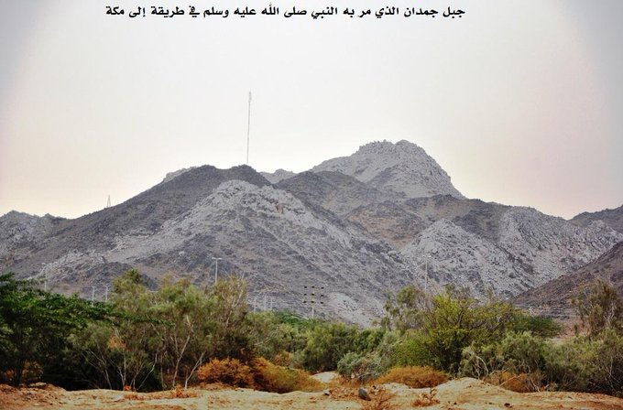
Racing For Rewards
The caravan was getting closer to Makkah and reached the Jumdān Mountain (a mountain near Makkah). The Prophet g said, “Keep walking, this is Jumdān. The Mufarridūn have outdone everyone.” They asked, “Who are the Mufarridūn?” He g replied, “The men and women who frequently remember Allah.”
Some of the companions had raced ahead of others in this physical journey. The Prophet g took this opportunity to remind them that the real journey is the journey of the heart to its Creator. And that the secret to racing ahead in this journey is abundant dhikr. Thus, the true winners are those who remember Allah the most.
Think & Reflect
Dhikr is the cornerstone of ḥajj.

Slide 15
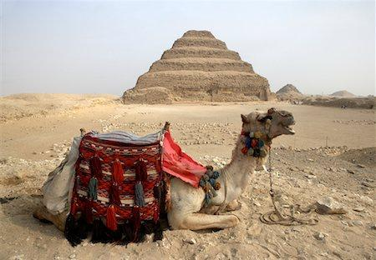
Travel Troubles
The Prophet g was unwell and suffered from migraines. He received cupping treatment on his head and foot.
At ʿArj, Abū Bakr’s h servant lost the camel which contained the provisions of the Prophet g. Abū Bakr was angered and hit the servant saying: “You had one camel to attend to and you lose him?!” The Prophet g then smiled and said to those around him: “Look at this man in iḥrām and what he is doing.”
Generosity of the companions: the family of Naḍlah brought a dish of ḥays (dry yoghurt, dates & fat); Saʿd b. ʿUbādah h offered the Prophet g a camel but he refused because Ṣafwān b. Muʿaṭṭal h found the camel and brought it back to Abū Bakr h.
Think & Reflect
The Prophet g was so caring and sympathetic to all. He taught his best friend that he should be more tolerant to his servant.

Slide 16

The Incidents of Our Mothers
Think & Reflect
Ṣafiyyah i was upset as her camel refused to move during the journey. The Prophet g came to comfort her and wiped away her tears. However, she would not calm down despite his repeated attempts and hence he rebuked her.
It was Ṣafiyyah’s i turn to spend the night with the Prophet g but she asked ʿĀ‘ishah i to take her turn instead. He was surprised that ʿĀ‘ishah i came and asked her why she came to which she replied: “It is Allah’s bounty and He grants it to whom he wills.”
The Prophet g said to Zaynab b. Jaḥsh i: “Lend a camel to your sister” to which she replied: “Shall I lend a camel to your Jewess (Ṣafiyyah was previously a Jew)?” This angered the Prophet and he g didn’t speak to her until they returned to Madinah.
The companions j were humans. There will be moments during the journey where we may have troubles/difficulties in our relationships, however this is part of our test and we should do our best to control ourselves.

Slide 17
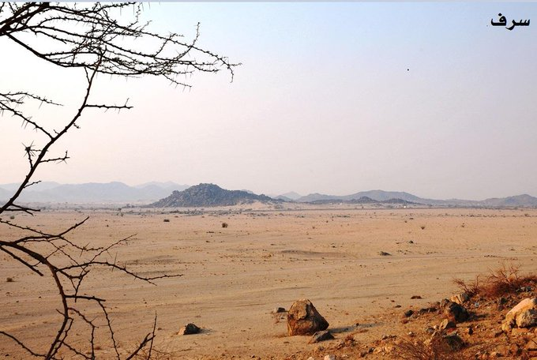
Camping at Sarif & ʿAishah i
Think & Reflect
The Prophet g was the best to his family, displayed by the empathy and kindness he showed to them.
There is a wisdom in everything Allah has ordained. This trouble (for ʿĀ‘ishah) served as a relief, mercy and blessing for the women of the Ummah.
The Prophet g camped at Sarif and told his companions: “Whoever does not have his sacrifice with him and wishes to make ʿumrah may choose to do so” — Some did so, whilst others didn’t.
He found ʿĀ‘ishah i weeping, whilst saying, “I wish I did not come for ḥajj this year… I am prevented from performing ʿumrah.” He then asked: “Perhaps you are on your period?” to which she replied in the affirmative.
The Prophet g consoled her, gently saying: “This is something that Allah has created women with… You will not be at a disadvantage. You do all that a pilgrim does, but do not perform your ṭawāf until you are clean from menstruation. Join the pilgrims so that Allah may grant it (ʿumrah) to you.”

Slide 18
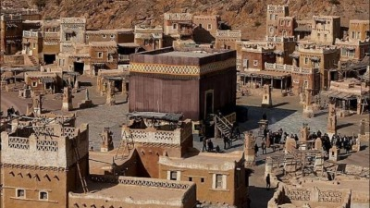
ENTERING MAKKAH

Slide 19
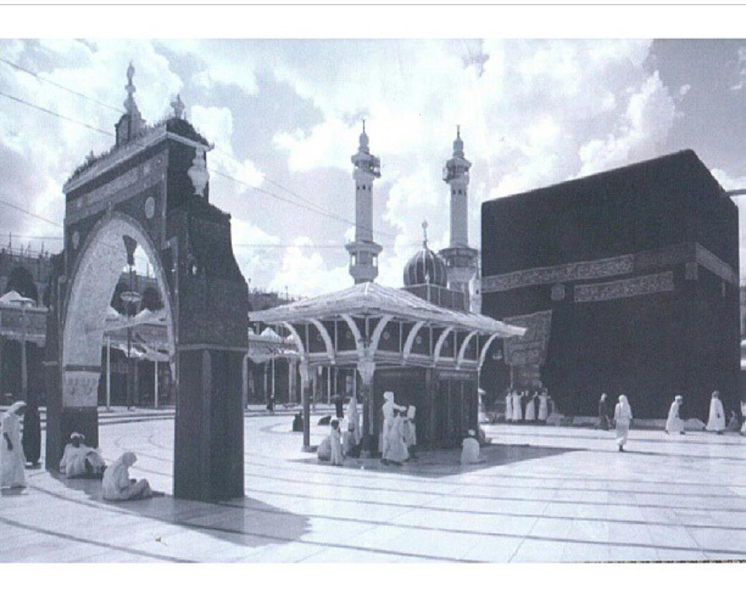
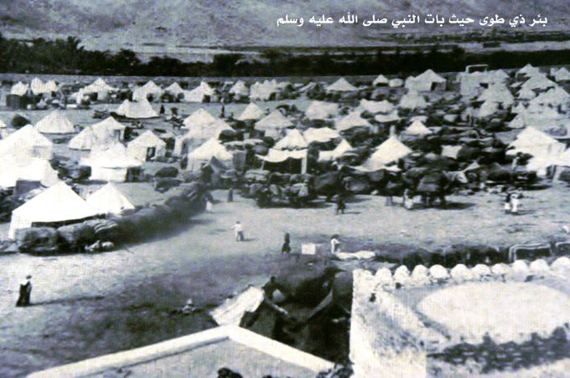
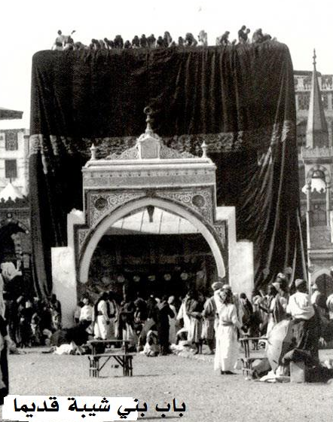
Coming Closer to His Beloved Hometown
8 days had passed since the blessed caravan had set off from Madinah.
The Prophet g encamped at Dhū Ṭawā (Jarwal), which was outside of Makkah, to rest at night and to ensure he was fresh and energetic to enter Makkah.
He offered the Fajr prayer, advised his companions to do tamattu’ and had a bath.
Reciting the talbiyah loudly, the Prophet g entered Makkah on the morning of Sunday 4th Dhul-Ḥijjah.
He dismounted, performed wudu and entered the masjid through the Banū Shaybah door (near Maqām Ibrāhīm).

Slide 20
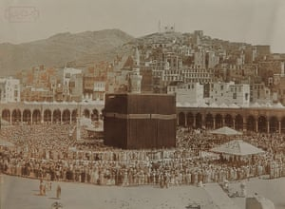
The Blessed House
The Kaʿbah, built by Ibrāhīm n was now in its original form: free from idols, naked people and disbelievers.
This space had transformed. A decade ago, he g received the worst form of treatment including constant ridicule & opposition.
Imagine, 10 + years ago, when the disbelievers threw the filthy remains of a slaughtered camel on his back, and the only one to stand by his side was his young daughter Fāṭimah i.

Slide 21
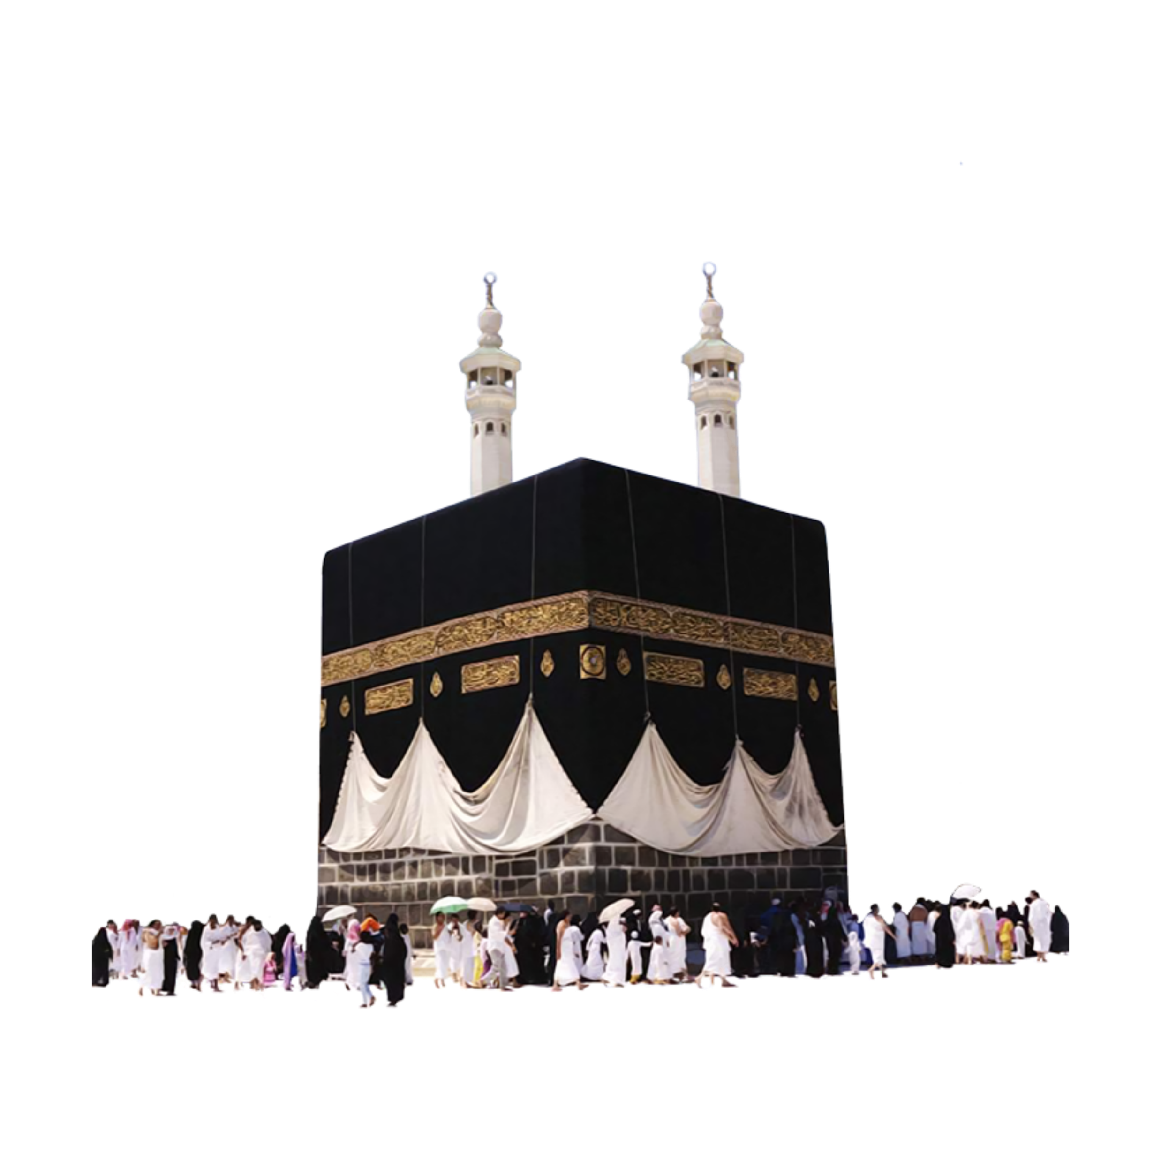
The Truth Prevails
Imagine, when the Quraysh tried to strangle him, and his best friend (Abū Bakr h) came to rescue him saying: “Will you kill a man because he says my Lord is Allah?”
10 years later, in this moment, everyone in this sacred place and all those accompanying him, were now believers. In this moment, it was clear that Allah had fulfilled His promise to His Messenger g.
Think & Reflect
Allah c never wastes the efforts of His servants. Ṣabr and perseverance are vital for the victory of Allah to arrive.

Slide 22
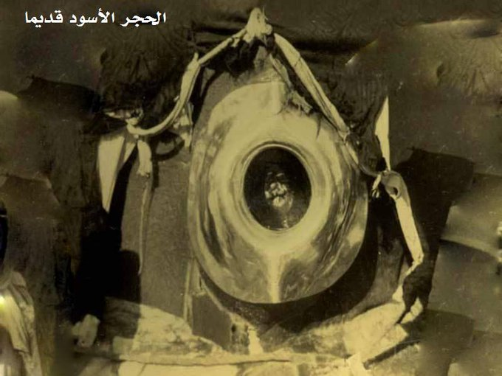
The ʿUmrah
He g walked towards the black stone, put his hands on it, glorified Allah c and kissed it, in a state of tears.
He performed ṭawāf, jogging in the first 3 rounds and walking in the remaining 4 rounds.
Between al-Rukn al-Yamānī & the Black Stone, he said:
رَبَّنَآ ءَاتِنَا فِى ٱلدُّنْيَا حَسَنَةً وَفِى ٱلْـَٔاخِرَةِ حَسَنَةً
وَقِنَا عَذَابَ ٱلنَّارِ

Slide 23
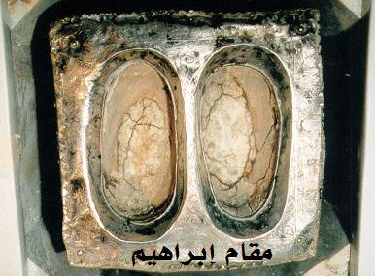
Honouring His Grandfather
After finishing ṭawāf, he then went to Maqām Ibrāhīm, reciting:
وَٱتَّخِذُوا مِن مَّقَامِ إِبْرَٰهِـۧمَ مُصَلًّى
He performed 2 rakʿahs and recited Sūrah al-Kāfirūn (109) in the 1st rakʿah and Sūrah al-Ikhlāṣ (112) in the second.
He then drank Zamzam and poured it over his head before returning to the Black Stone, kissing it and wiping it with his hands and face.
Think & Reflect
Ḥajj connects us to our rich heritage and in particular to Ibrāhīm n and his blessed family, their efforts, and Allah accepting their deeds.

Slide 24
Legacy of Hajar o
The Prophet g left the Masjid and as he approached Mount Ṣafā, he recited:
إِنَّ الصَّفَا وَالْمَرْوَةَ مِنْ شَعَآئِرِ اللّٰهِ أَبْدَأُ بِمَا بَدَأَ اللّٰهُ بِهِ
Indeed, Ṣafa and Marwah are among the symbols of Allah (2:158). I begin with what Allah began with.
He climbed Ṣafā until he could see the Kaʿbah. He then faced the qiblah, proclaimed the Oneness of Allah and glorified Him, and then said 3x:
لَا إِلٰهَ إِلَّا اللّٰهُ وَحْدَهُ لَا شَرِيْكَ لَهُ ، لَهُ الْمُلْكُ وَلَهُ الْحَمْدُ ، وَهُوَ عَلَىٰ كُلِّ شَيْءٍ قَدِيْرٌ ،
لَا إِلٰهَ إلَّا اللّٰهُ ، أَنْجَزَ وَعْدَهُ ، وَنَصَرَ عَبْدَهُ ، وَهَزَمَ الْأَحْزَابَ وَحْدَهُ
There is no god worthy of worship except Allah. He is Alone and He has no partner whatsoever. To Him Alone belong all sovereignty and all praise. He is over all things All-Powerful. There is no god worthy of worship except Allah. He fulfilled His promise, granted victory to His servant, and He Alone defeated the coalition forces.
He made duʿā' in between each utterance of the above.
Think & Reflect
Saʿy is a physically demanding act, even today. Imagine thousands of years ago where the path between the two mountains was full of stones and rocks. Imagine Hājar o running between the two mountains, all alone; just her trust in Allah keeping her going – an act that Allah d loved so dearly, we continue to enact it to this day.

Slide 25
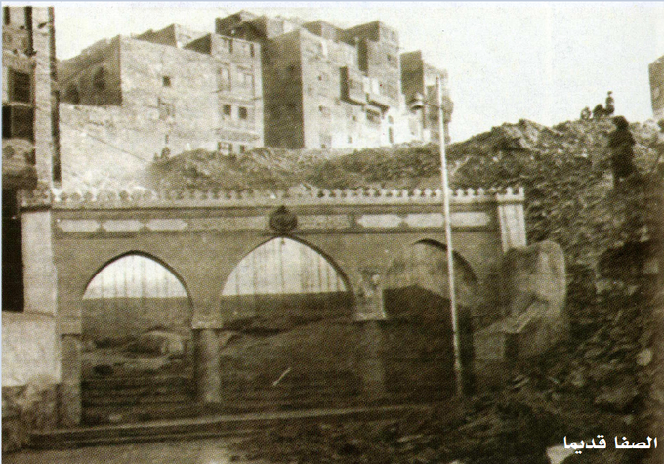
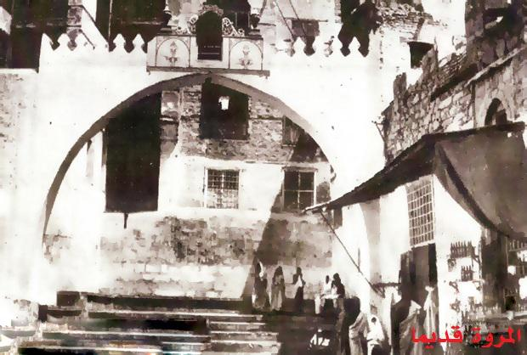
Crowds in Awe of the Beloved
The Prophet g then walked towards Marwah. At the bottom of the valley, he started jogging and after passing the middle of the valley, he continued walking to Marwah. He walked up the mountain until he could see the Kaʿbah and repeated what he did at Ṣafā.
People were now informed that he g had reached Makkah so they all came out to see him: men, women, children & slaves. Due to the crowds, he asked for his she-camel to be brought and mounted it so he could be seen by all. He then completed his saʿy riding his camel.
Think & Reflect
Imagine 23 years ago, when he climbed the same mountain (Mount Ṣafā) and called his people to the worship of the One True God, and they said to him: “Woe to you! Is this why you gathered us?!” — Today, this mountain is echoing with Allahu Akbar and La ilaha illa Allah!

Slide 26
Release From Ihram
Think & Reflect
The Prophet g asked his wives to release themselves from iḥrām, to which they all complied other than ʿĀ‘ishah as she was on her period.
Ḥafṣah asked him why he g wasn’t doing so. He replied: “I had applied a sticky paste to my head and marked my sacrifice therefore I cannot release myself from iḥrām until I have slaughtered my sacrifice.”
The companions felt uneasy about releasing themselves due to: (i) In pre-Islamic days, doing ʿumrah in the month of the pilgrimage was a grave sin; (ii) They wanted to follow the Prophet g who was still in the state of iḥrām; (iii) They found it strange not to be in iḥrām when the days of ḥajj were so close.
Surāqah was the one who chased the Prophet g when he embarked upon hijrah aiming to capture him for the enemies…and now he was here, asking the Prophet g about his dīn.
The Prophet g felt their reluctance and was angry. He addressed the people starting with praising Allah and then said: “You know that I have the most taqwā amongst you… Do as I tell you. If it were not for the fact that I brought my sacrifice with me, I would have released myself from iḥrām as you do. Were I to start again, I would have not brought my sacrifice with me.”
The companions complied immediately & obeyed him as they always did – may Allah be pleased with them!
Surāqah b. Mālik h asked whether tamattuʿ was applicable to all years. The Prophet g replied in the affirmative and said, “ʿUmrah is intertwined with the ḥajj until the Day of Judgement.”

Slide 27
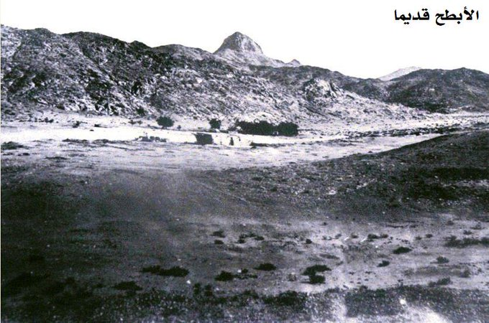
Abtah
After finishing ʿumrah, the Prophet g and his companions stayed at Abṭaḥ from Sunday-Wednesday (4 days).
He was very caring & empathetic and didn’t go to the Kaʿbah on those days as it would have been difficult for all of his companions to do so.
The Prophet g stayed in a red tent. After performing his ablution, Bilāl h took the remains of ablution water and sprinkled it on the people who then wiped it on their bodies to gain the blessings.

Slide 28
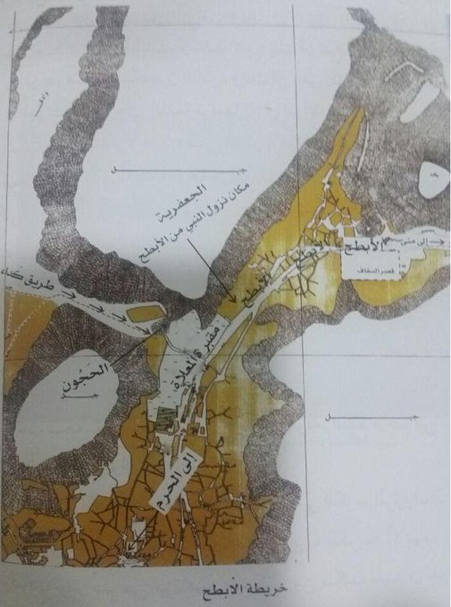
Emulating The Prophet g
Abṭaḥ was the meeting ground for people who were unable to be with the Prophet during the journey from Madinah to Makkah:
ʿAlī h: was sent to Yemen to collect taxes and so he came to Abṭaḥ and entered upon his wife Fāṭimah i who was dressed and wore kohl. He questioned her about it and went to complain to the Prophet g about her actions who then replied: “I have ordered her to do so.” The Prophet g then asked him his intention for iḥrām. Ali replied: I said, “My Lord, I will do what Your Messenger is doing.” — The Prophet g told him not to release himself from iḥrām as he had brought an animal.
Abū Mūsā al-Ashʿarī h: made the same intention as the Prophet g but didn’t bring an animal so the Prophet g told him to do ʿumrah and release himself from iḥrām.

Slide 29
The Care & Compassion of The Prophet g
The Prophet g went to see Saʿd b. Abī Waqqāṣ h who was ill. He g found him weeping as he “feared that he may die in the land he had emigrated from” i.e Makkah.
He had one daughter and he asked the Prophet g whether he should give all of his wealth to charity, to which the Prophet replied no. He then asked whether he should give half, and again the Prophet replied no. Upon asking about a third, the Prophet replied: “One third, although one third is much. To leave your heirs well off is better than to leave them poor.”
He then asked the Prophet g to pray for his cure. The Prophet g placed his hands on Saʿd’s h forehead and wiped his face, chest and stomach and said “My Lord, cure Saʿd… bestow Your grace on Saʿd.”
Saʿd h lived for over a half a century after this incident and subsequently had 34 children.
Think & Reflect
The Prophet g was so caring & compassionate; despite his task of leading the ummah, he did not forget the weak and ill and provided tranquillity & comfort to them.

Slide 30

Yawm al-Tarwiyah
7 Dhul-Ḥijjah
After Dhuhr prayer, the Prophet g explained the rituals of ḥajj to his companions.
8 Dhul-Ḥijjah
(Day of Tarwiyah): At midmorning, the Prophet g went to Minā , with his companions resuming their iḥrām. They performed Dhuhr, ʿAṣr, Maghrib, ʿIshā’ and Fajr, shortening the 4 unit prayers into 2. They prayed these at the normal times.
Think & Reflect
At every place & in every situation, the Prophet g gave a lesson; he truly was the best teacher.
Ṣall Allāhu ʿalayhi wa sallam.

Slide 31
THE BEST DAY OF THE YEAR
ʿArafah – 9th of Dhul-Ḥijjah

Slide 32
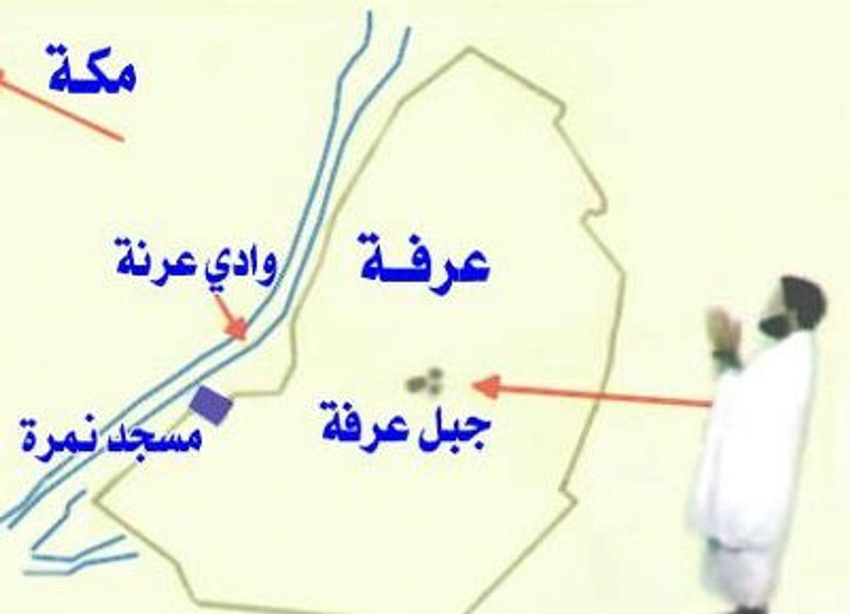
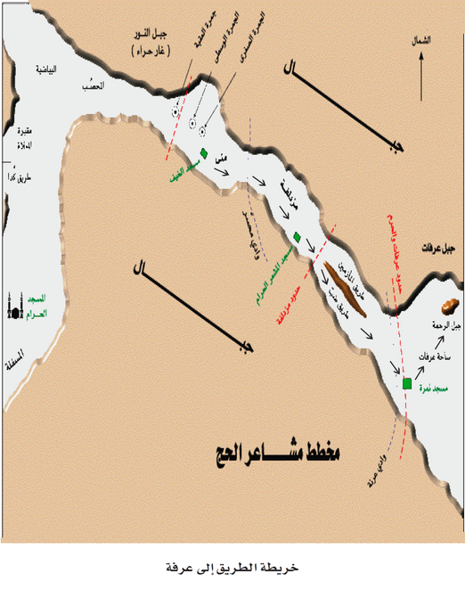
Towards ʿArafah
Friday 9th of Dhul-Ḥijjah: The Prophet g and his companions marched from Mina to ʿArafah via the Ḍabb route. The air was full of loud voices of Allah’s praise. Some were repeating the talbiyah, others la ilaha illa Allah, and some Allahu Akbar.
He arrived at Namirah (situated just before ʿArafah) and stayed there until after the sun started to move down (approx. 12:30pm).
He then rode his she-camel and went to a spacious area (ʿUranah valley) so people could see & hear him.

Slide 33
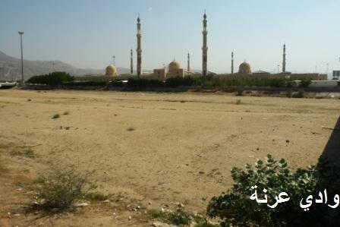
The Farewell Sermon (Part 1)
All eyes and hearts were focused on the Messenger of Allah g as he said: “Listen to me. You may not see me after this year.”
He started by praising & glorifying Allah, and delivered key messages:
  Upholding human dignity – “Hurt no one so that no one may hurt you.”
  Honour & respect the rights of women – “Fear Allah in your treatment of women… take good care of (them).”
  Staying away from interest – “Allah has decreed that no usury is permitted.”
  Everyone is equal in the sight of Allah – “An Arab has no superiority over a non-Arab… a white has no superiority over a black – except by piety and good action.”
  Stay away from Shaytan & hold on to the Qur’ān and Sunnah.

Slide 34
The Amanah Has Been Fulfilled
Think & Reflect
The sermon was repeated loudly, sentence by sentence by Rabīʿah b. Umayyah b. Khalaf h. His father was killed by the Muslims in the Battle of Badr, but now the son was repeating the Prophet g’s words. There were no grudges and the light of Islam extinguished all ill feelings and desire for revenge.
The Prophet g asked “People, have I faithfully delivered unto you my message?”
A powerful reply vibrated in the air: “O Allah! Yes!” Thousands of pilgrims replied saying “Allahumma Naʿam”. The Prophet g raised his forefinger and said: “O Allah bear witness that I have conveyed Your message to Your people.”
Upon finishing the speech, Bilāl h called the adhān and iqāmah. They offered the Dhuhr prayer, called the iqāmah again and performed ʿAṣr, shortening the prayers.
The Prophet g started the day early, shortened his speech and combined the prayers to devote the rest of his time to glorifying Allah & making duʿā’. Hajj is about strengthening your bond with Allah and spending time in intimate conversation with Him d!
Think & Reflect
The Prophet g had experienced 23 years of hardship & sacrifice, remaining steadfast and exercising immense patience. He was driven out of his home, humiliated and hurt for the greatest purpose of delivering the Divine message.

Slide 35
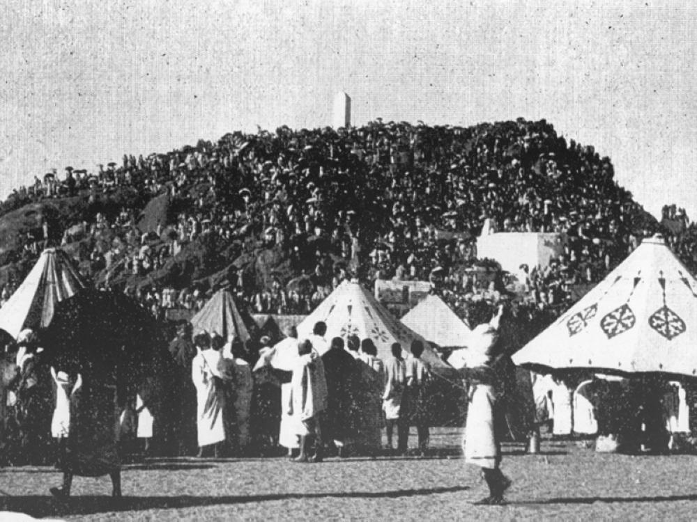
The Mount of Mercy
The Prophet g mounted his she-camel and stopped at the bottom of the Mount of Mercy. He faced the qiblah, raised his hands and repeated the talbiyah.
He continued teaching and was asked about ḥajj to which he replied: “The ḥajj is attendance at ʿArafah.”
He also made clear that no place in ʿArafah has a special distinction & told Ibn Mirbaʿ to tell the people: “Be sure to attend to your worship. You have inherited this from your first father, Ibrāhīm.”

Slide 36

The Religion Has Been Perfected
One pilgrim fell off his camel, broke his neck and died instantly. The Prophet g said: “He will be resurrected on the Day of Judgement saying the talbiyah.”
On that day, the following verse was revealed:
“Today I have perfected your faith for you, completed My favour upon you, and chosen Islam as your way” (5:3)
ʿUmar h was tearful upon hearing this, realising that the death of the Prophet g was imminent as his job was complete.

Slide 37
Duʿa & Forgiveness
The Messenger of Allah g said: “The best duʿā’ is the duʿā’ of the Day of ʿArafah.”
The Prophet g spent the rest of the day at ʿArafah in passionate duʿā’ & glorification of Allah.
He repeatedly said:
لَا إِلَهَ إِلَّا اللَّهُ وَحْدَهُ لَا شَرِيكَ لَهُ لَهُ الْمُلْكُ وَلَهُ الْحَمْدُ
وَهُوَ عَلَى كُلِّ شَيْءٍ قَدِير
He also repeated the talbiyah and was heard saying:
لبَّيْكَ إنَّ العَيْشَ عَيْشُ الآخِرَةِ
Think & Reflect
After years of struggle in conveying the message of his Lord, the whole of the Arabian Peninsula comes under his control and finally accepts his message. Yet, gathered on the plains of ʿArafah, at his highest point of victory, we do not witness parades or displays of pomp. Rather we witness nothing but humility and turning to Allah in desperate need.
He spent approximately six hours in continuous duʿā’. He was so focused on making duʿā’ that even when the rein of his camel fell down, he grasped it with only one hand, and left his other hand raised towards the sky. How strong was his connection with His Lord!
Think & Reflect
Despite being over 60 years old, undertaking a long journey from Madinah to Makkah, and being responsible for huge crowds, none of it came in the way of worshipping His Beloved b!

Slide 38
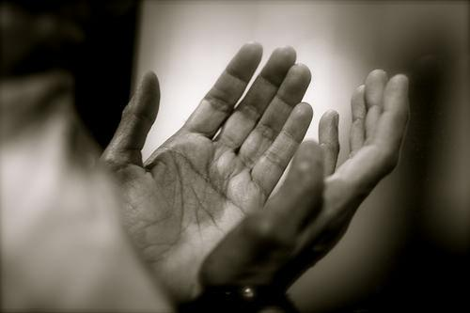
Jibril Descends With Good News
Before sunset, the Prophet g gave the pilgrims the happy news and said to them: “Jibrīl n came to me… He said: ‘Allah has forgiven the people at ʿArafah and Muzdalifah and has taken over their responsibilities (He will fulfill the rights others have over them e.g. help them to repay their loans).’”
ʿUmar h asked whether this was specific to them, to which the Prophet g replied: “It applies to you and to all who come after you until the Day of Judgement.” ʿUmar h then said: “Allah’s grace is plentiful and beautiful!”
The Messenger of Allah g said: “There is no day in which Allah sets free more slaves from Hell-fire than the Day of ʿArafah. Indeed, He draws near, and He then boasts about them to the angels and says: ‘What do these (slaves of mine) want?’” (Muslim)

Slide 39
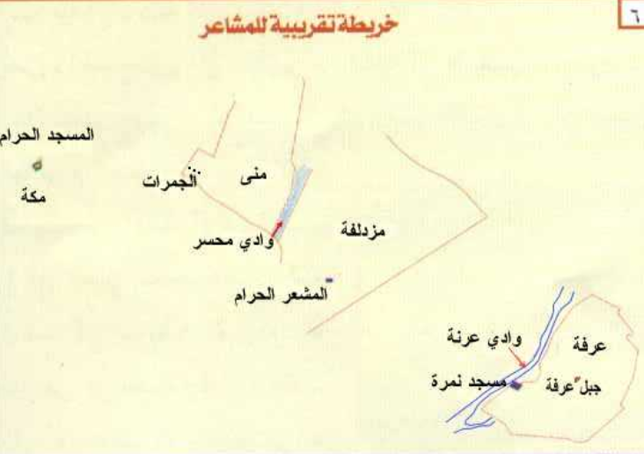
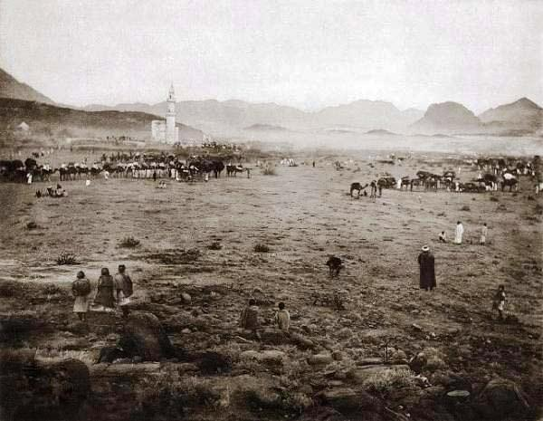
Muzdalifah
After the sun had set, the Prophet g set off for Muzdalifah, advising: “People, remain calm and proceed easily… there is no virtue in rushing.”
Upon reaching Muzdalifah, he got off his camel, performed wuḍūʾ and Bilāl h called the adhān. The Prophet g and his companions combined both Maghrib & ʿIshā’. He did not offer any sunnah prayers in between them.
The Prophet g approved Sawdah’s i request to proceed to Minā ahead of the people, due to her old age. ʿĀ’ishah i says she wished she had also asked for the same.
The Prophet g slept in Muzdalifah till just before dawn, leaving out the tahajjud prayers (which he never missed).

Slide 40
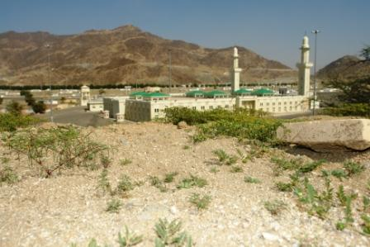
Concern & Care for Others
He g asked his uncle ʿAbbās to “take our weaker ones and our women so that they may offer Fajr at Minā so that they may do the stoning at ʿAqabah before the crowd catches up with them.”
Think & Reflect
During ḥajj, always be considerate to the weak and elderly. Think of others first, and do not be selfish.
The Prophet g performed Fajr at its beginning time. He mounted his camel and went up to Mt. Quzaḥ; facing the qiblah and lifting his hands, he thanked, praised & glorified Allah:
فَإِذَآ أَفَضۡتُم مِّنۡ عَرَفَٰتٖ فَٱذۡكُرُواْ ٱللَّهَ عِندَ ٱلۡمَشۡعَرِ ٱلۡحَرَامِۖ
He also made duʿā’ and constantly recited the talbiyah.

Slide 41
THE GRAND DAY OF HAJJ
10th of Dhul-Ḥijjah

Slide 42
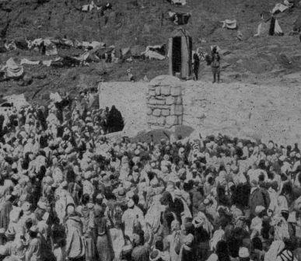
The Best Example
The Prophet g asked his young cousin, Faḍl b. ʿAbbās h to pick 7 small stones for him, and then raised them to show the people how the pelting should be done. He then left Muzdalifah before sunrise.
Usāmah b. Zayd h & other young men jogged to Mina.
The Prophet g moved at a normal pace, telling the people to remain calm.
The Prophet g then reached the Jamarāt with Bilāl and Usāmah b. Zayd k to his sides, one holding his she-camel and the other, shading him g with his robe. Upon throwing each stone, he said “Allahu Akbar”.
Think & Reflect
Bilāl was a black, former slave. Usāmah was the son of former slaves. The Prophet g chose them out of everyone, and practically demonstrated the beauty and justice of Islam.

Slide 43
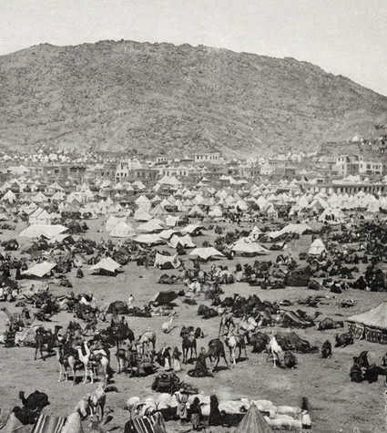
The Best Teacher
People were all around the Prophet g. He advised them: “Do not kill one another and do not injure one another. When you do your stoning, choose small stones. Learn your rituals from me!”
A woman came to ask the Prophet g a question and the Prophet g noticed Faḍl h was looking at her. He thus, turned his cousin’s head away from the woman.
Think & Reflect
The Prophet g was accessible to all, even a young woman. He was also very understanding of the feelings of men and women and showed them how to behave.

Slide 44
The Farewell Sermon (Part 2)
The Prophet g asked Jarīr b. ʿAbdillah to gather the people as he wanted to speak to them.
He sat on his camel on the morning of the 10th in between the Jamarāt and gave a long sermon. He g began by praising & thanking Allah. He then mentioned:
  Your blood, property and honour are forbidden for you (to claim unlawfully) just like the violation of the sanctity of this day in this month.
  A true Muslim is the one who keeps all Muslims safe from his tongue and hand.
  A true Believer is the one whom people trust with their lives and property.
  A Muhājir (migrant for Allah’s sake) is the one who abandons all sins.
  A Mujāhid (striver) is the one who strives in obedience to Allah.
  Parents should not harm their children & vice versa.
  Protect yourself from Shayṭān.
  Three vital things for a believer: ikhlāṣ (sincerity), giving sincere advice to those in authority & staying with the Muslim community.

Slide 45
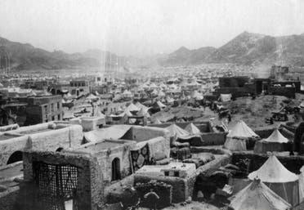
The Mission Has Been Accomplished
The Prophet g concluded with: “I do not know whether I will meet you after this day. May Allah have mercy on anyone who listens to my words, understands and conveys them to others.”
He also requested: “Let those of you who are present inform those who are absent.”
He g then lifted his head to the sky and said: “Have I delivered my message?”, to which the people replied: “Yes”. He then said: “My Lord, bear witness!” thrice.

Slide 46
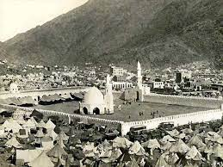
The Questions Continue…
People came to him from all directions asking questions.
He g replied with patience and kindness.
One man asked: “I have shaved my head before stoning.” The Prophet g told him: “Do the stoning now, there is no harm.” Others asked: “I performed ṭawāf before stoning”, He g replied
once again, “There is no harm.”
Some asked whether they should seek medical treatment to which he replied: “Yes.. Allah has not placed an illness without creating a cure for it, except for one disease (old age).”
He was also asked what the best thing was that people were given to which he replied: “Good manners.”
The Prophet g then went to his place in Minā (where Masjid al-Khayf is now located). The companions asked whether they could erect a structure to give him shade. He g refused as “The space in Minā is for whoever comes first” and he did not want to distinguish himself from the pilgrims.

Slide 47
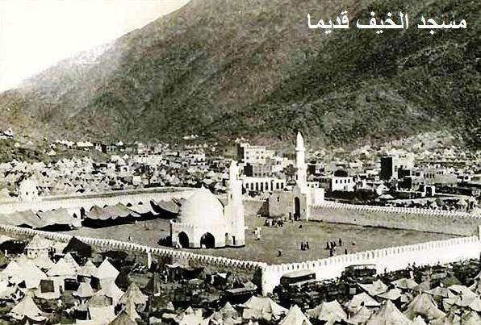
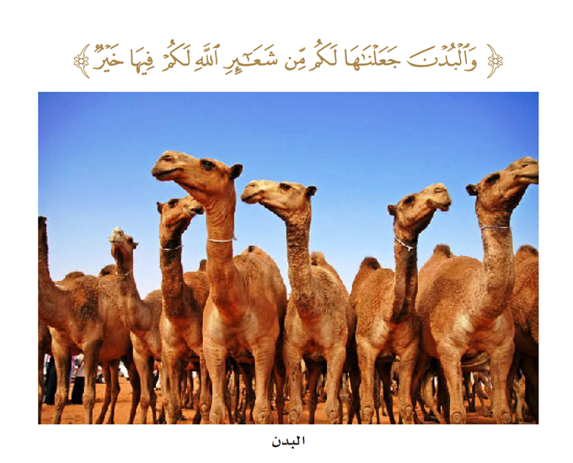
The Day of Sacrifice
The Prophet g then went to a place in between where he was staying (Masjid al-Khayf) and the first Jamarah to sacrifice the animals.
He g sacrificed 63 camels with his own hands (equating the years of his life). He told ʿAlī h to sacrifice the rest and cook a portion for them to eat. He also told the companions: “Whoever wishes to take a portion may do so.”
His companions asked him whether they could preserve the meat as they were forbidden in the previous year to keep it for more than 3 days [as there were lots of delegations which arrived in Madinah, it was a ‘year in which people were facing hardship’ and the Prophet g wanted the Muslims to help one another.]
The Prophet g replied in the affirmative saying, “Now I make it permissible for you. Eat what you wish, feed others and preserve what you can.”
He also asked his servant, Thawbān to take care of the meat (i.e. dry it) and the Prophet g ate of it until he arrived back to Madinah.
He g also sacrificed a cow on behalf of all of his wives.

Slide 48
Always Bringing a Smile to Others
After finishing his sacrifice, Maʿmar b. ʿAbdillāh h came to the Prophet g to shave his head.
The Prophet g joked with him saying, “Maʿmar, Allah’s Messenger lets you have his head when your blade is in your hand”. Maʿmar replied saying, “This is a favour Allah has bestowed upon me” to which the Prophet g replied, “Then I will sit still for you.”
The companions surrounding the Prophet were eager to not allow a single hair to fall to the ground and instead collected it.
Upon shaving the left part of the his head, the Prophet called upon Abū Ṭalḥah h and gave him all the hair from his left side.
The Prophet g then prayed for people who shaved their heads 3 times: “Allah, bestow your mercy on those who shaved.”
He g then put on his normal clothes and ʿĀ’ishah i applied musk on him with her own hands.
Think & Reflect
Abū Ṭalḥah h, his wife Umm Sulaym i and his step-son, Anas h served and welcomed the Prophet g in Madinah. The Prophet g chose this day to repay the favour, and honour Abū Ṭalḥah h—and in what a blessed way! Allāhu Akbar!

Slide 49
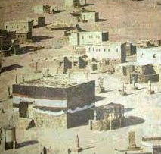
The Blessing of the Prophet g
The Prophet g headed for Makkah and performed ṭawāf on his she-camel so that people could see him and access him easily.
Upon finishing ṭawāf, he performed the 2 rakʿahs of ṭawāf.
He g then went to where his uncle ʿAbbās h was giving people a drink of water infused with dates/raisins to sweeten the salty water. ʿAbbās h asked his son Faḍl to go home and bring a drink from home, but the Prophet g wanted a “drink from what you serve to people”. The Prophet drank from it, saying “You have done well. Carry on with this good work.”

Slide 50
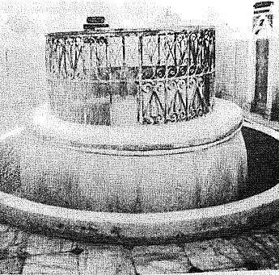
Serving the Pilgrims
He g then went to the Zamzam well and saw people from the family of ʿAbdul Muṭṭalib working there, pulling out the water. He also commended them saying “Carry on with this good work”.
He drank the water and said: “Had it not been for fear that you may be overwhelmed, I would have worked with you” i.e. He was fearful people may treat it as a sunnah and thus most would want to do it causing congestion.
Think & Reflect
Imagine, the Prophet g accomplished all of this: stoning at the Jamarah, giving a speech, answering questions, assigning camping places, slaughtering 63 animals, shaving his head, changing his clothes, going to Makkah, doing ṭawāf, blessing people and then going back to Minā, all in the space of half a day. Allah blessed him and his time immensely, and he was thus able to deliver the enormous message in 23 years of his blessed life too. Ṣall Allāhu ʿalayhi wa sallam.

Slide 51
The Days of Eating, Drinking & Dhikr
11-13th of Dhul-Ḥijjah
(The Days of Tashriq)

Slide 52
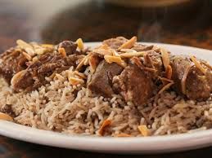
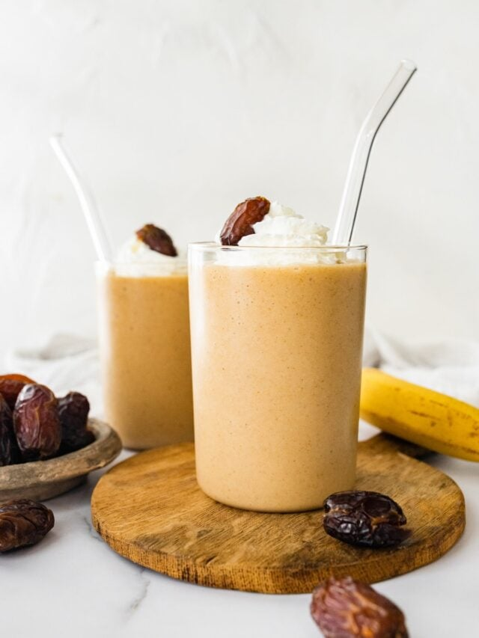

The Mountains of Mina Echo With Takbir
The Prophet g stayed in Minā for the rest of the day, shortening his prayers in congregation in Masjid Khayf, saying: “70 Prophets offered prayers here”. The masjid was open and without walls.
The Prophet g filled his time with remembering Allah and glorifying Him (2:203). Everyone around him followed suit:
وَٱذۡكُرُواْ ٱللَّهَ فِيٓ أَيَّامٖ مَّعۡدُودَٰتٖۚ
The Prophet g sent his companions, including ʿAlī, Abū Hurayrah, and Ibn ʿUmar j to walk through the camps in Minā and announce: “No one will enter Jannah except the one who believes. The days of Minā are days of eating, drinking & glorifying Allah. No fasting is allowed in these days.”

Slide 53
Your Blood, Property & Honour
On the 11th of Dhul-Ḥijjah, the Prophet g climbed on a grey mule to deliver a speech, with the following messages:
All believers are brothers. Everyone has been created equal – the only distinguisher in front of Allah d is taqwā
Be kind to your slaves
Your blood, property & honour are forbidden for you
Think & Reflect
On three consecutive days, which are the most sacred days of the year, the same message was repeated: Your blood, property and honour are forbidden for you just like the violation of the sanctity of this day, in this month and this city.

Slide 54
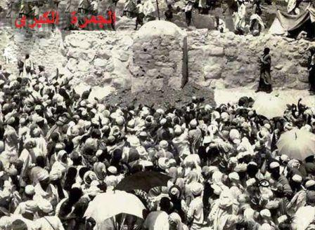
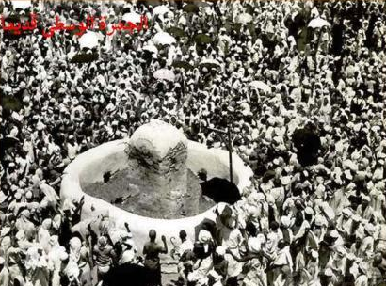
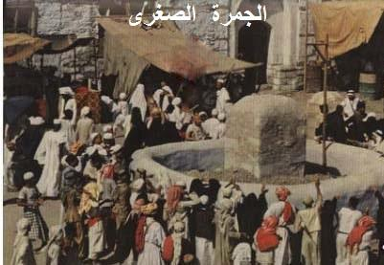
Stoning the Jamarat
After mid-day, the Prophet g walked to the Jamarāt.
  Starting at the first one, he threw 7 small stones, glorifying Allah with each stone. He then walked away from the crowd, stopped and faced the qiblah, continued to praise Allah d and made duʿā’ for a very long time (equivalent to the time it takes to recite Sūrah al-Baqarah).
  He then walked to the second Jamarah doing the same as the first, but making duʿā’ for an even longer period.
  He then walked to Jamarah al-ʿAqabah, threw 7 stones, glorifying Allah with each one, and walked away without stopping.
He repeated the above on both the 12th and 13th of Dhul-Ḥijjah.

Slide 55
Allah’s Favours Are Plentiful
The Prophet g spent 3 days at Minā.
After finishing the rituals at Minā on the 13th of Dhul-Ḥijjah, he g encamped at Khayf Banī Kinānah.
Think & Reflect
15 years ago, in the same place, the Quraysh and the Banū Kinānah tribe made a treaty to boycott the Banū Hāshim and Banū ʿAbdul-Muṭṭalib clan (The Prophet’s relatives) to suppress the Prophet g and his message. Yet, 15 years later, the light of Allah had spread, despite the attempt of the disbelievers. Allah granted the Prophet g a great victory: He perfected His grace upon him g and made the religion of Islam complete.
At Khayf Banī Kinānah, he offered Dhuhr, ʿAṣr, Maghrib & ʿIshā’. People started to leave for home but he told them: “No one should leave without bidding farewell to the Kaʿbah.”

Slide 56
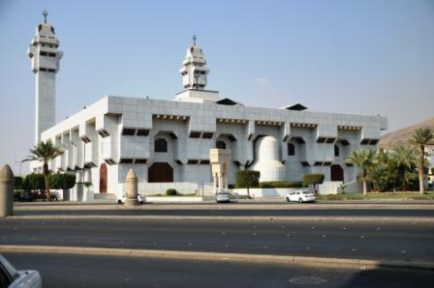
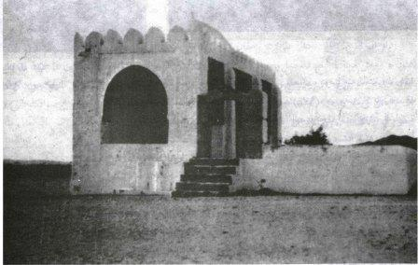
Our Mothers & The Care of The Prophet g
ʿĀ’ishah i wanted to perform an ʿumrah as she was previously unable to do so due to her period. The Prophet g told her she did not need to do so but she was very keen so he sent her with her brother ʿAbdul-Raḥmān to al-Tanʿīm to put her iḥrām on from there and perform ʿumrah.
The Prophet g found his wife Ṣafiyyah i looking upset as she had started her period and thus was unable to perform the farewell ṭawāf. He reassured her by saying that the tawaf on the 10th was sufficient for her and she did not need to do the farewell ṭawāf.
Umm Salamah i was unwell and could not perform the farewell ṭawāf with the rest of the people. The Prophet g advised her to do her ṭawāf on the camel whilst the people were performing the congregational prayer.
Think & Reflect
The Prophet g was so kind, considerate and compassionate towards his wives. Due to their various issues, the women of the ummah have concessions for years to come. This is all part of Allah’s immense mercy.

Slide 57
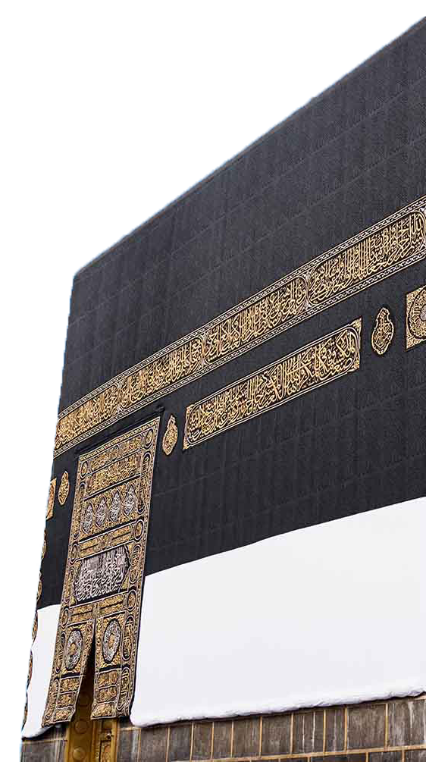
The Last Prayer By The Blessed House
The Prophet g went to the Ḥaram to perform the farewell ṭawāf before dawn on the 14th of Dhul-Ḥijjah.
He g then led the final prayer by the House of his Beloved (i.e. Kaʿbah): Fajr, reciting Sūrah al-Ṭūr.
He g then left Makkah, taking the Kuday route, until he arrived at Dhū Ṭuwā. He stopped there waiting for the rest of his companions to catch up.
Think & Reflect
The mission had been accomplished and the message had been delivered. These were an immensely blessed 10 days. No one imagined that as he g was bidding them farewell, he was also bidding farewell to this world. No one imagined that it would only be two months and a few days when he g would leave this world and be united with his Lord. Ṣall Allāhu ʿalayhi wa sallam.

Slide 58
وصلى الله على نبينا وحبيبنا وقدوتنا محمد
وعلى آله وصحبه وسلم تسليما كثيرا
May Allah allow us to follow in the footsteps of His beloved and grant us his companionship in the next world. May He grant us all an accepted and truly transformational ḥajj. Āmīn.

Slide 59
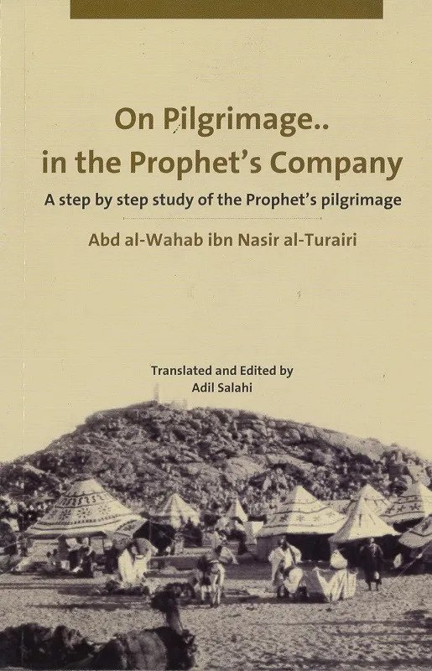

These slides are based on the following book. Please refer to the book for individual references.
May Allah bless the author and the translator, and make their efforts weigh heavy on the Scales on the Day of Judgement.

Slide 60
Appendices
Dhikr & Duʿā’

Slide 61
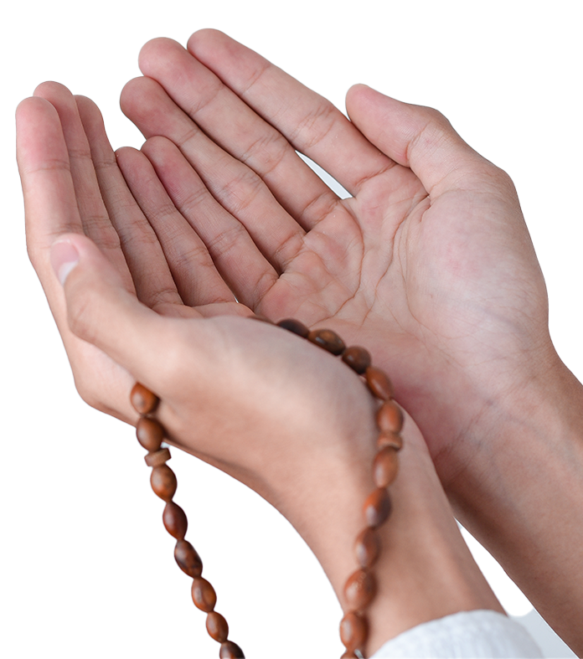
How to Make Duʿa on the Day of ʿArafah
Spend a long-time praising Allah at the start of your duʿā’ and during it.
Send abundant ṣalawāt on our beloved Messenger ﷺ .
Ask Allah with the duʿās from the Qur’ān and Sunnah. Have a book/print-out ready. (See the book ‘I Am Near’/‘Dhikr & Dua’ App by LWA for a collection of duʿās).
Write down a list of duʿās beforehand.
Keep repeating certain duʿās. E.g. Don’t just ask Allah for Paradise once. Keep asking Him, and keep coming back to it.
Make duʿā’ for people by their names.
Make duʿā’ for the Ummah, especially the weak, those who are suffering, and imprisoned.
Learn the deeper meanings of and reflect on the Qur’ānic and Prophetic duʿās.
Uphold the etiquettes of duʿā’.

Slide 62

Dhikr: The Foundation of Hajj
A man asked the Messenger of Allah g, “Which warriors are the best?” He g replied, “Those who remember Allah the most.” The man asked, “Which of those who fast are the best?” He g replied, “Those who remember Allah the most.” Then the man mentioned ṣalāh, zakāh and ḥajj, and each time the Messenger of Allah g replied, “Those who remember Allah the most.” Abū Bakr h said to ʿUmar h, “Those who remember (Allah) have taken all the good,” at which the Messenger of Allah g remarked, “Yes, indeed!” (Aḥmad).
To have the best ḥajj, your heart has to be attached to Allah, constantly remembering Him, praising Him, supplicating to Him, humbling your heart to Him, and obeying Him.

Slide 63
Internalising Dhikr
سُبْحَانَ اللّٰهِ
glorify Allah above any imperfection or deficiency i.e. Allah is free from all defects
combines both:
  (1) Gratitude for what Allah has blessed us with; īmān, life, health etc.
  (2) Praise: Allah is worthy of every possible praise on account of His very existence, His mercy, beauty, generosity and all of His other noble Attributes and Names. Even if none of His slaves praised Him, He would still be worthy of all praise. Our praise of Him is, in fact, a blessing from Him which deserves even more praise.
اَلْحَمْدُ لِلّٰهِ
means ‘Allah is Greater than…’ By not specifying what He is Greater than, we are saying that He is Greater than everything.
اَللّٰهُ أَكْبَرُ
Notes:
:سُبْحَانَ اللّٰهِ Negating all defects, flaws, and shortcomings from Allah.
اَلْحَمْدُ لِلّٰهِ : Affirming all of the attributes of perfection and majesty for Allah.
اَللّٰهُ أَكْبَرُ : Magnifying Allah and proclaiming His greatness above everything.

Slide 64
لَا إِلٰهَ إِلَّا اللّٰهُ : The Focus of Hajj
There is no god, deity or being which deserves to be worshipped and obeyed except Allah. It means to be a slave of Allah alone, and not of any another being, ideology, object or desire.
To internalise لَا إِلٰهَ إِلَّا اللّٰهُ , we submit ourselves to Allah and worship Him alone. We fear none but Him and love none as much as Him. We depend only on Him, seek protection only with Him and invoke Him alone for help and forgiveness. We turn to Him alone for judgement in all matters. Our bowing, prostration and unyielding obedience is solely reserved for Him.

