Slide 1
Fearing Allah
أعمال القلوب الخوف
Notes:
Start session with Bismillah, Praises of Allah and Salawat
Resource article: https://lifewithallah.com/articles/heart/fearing-allah/
Feel free to adjust this ppt to your learners’ needs.
The ppts sometimes assume prior knowledge and/or knowledge of Arabic.
Read the notes before delivering the lesson.
To make the lessons interactive, you will find ‘[A]’ = Activity throughout the slides. This can be done orally, in writing, on mini whiteboards (MWB), classroom board, flipchart paper, through discussion; alone, in pairs, groups etc, and through other methods. Vary the activity method to keep the learners engaged.
LWA is not responsible for external links.
Teach with ikhlas, love, passion and genuine care for your students. Build a rapport, be positive and help them to increase their love for Allah and His Messenger ﷺ.
Please give us feedback on these slides by filling in this short feedback form (you can remain anonymous): https://forms.gle/yP45KNYEbemxT7hS6

Slide 2
Starter: Match
Claustrophobia
Islamophobia
Agoraphobia
Necrophobia
Aquaphobia
Xenophobia
fear of open places
fear of water
fear of strangers, foreigners, or aliens
fear of having no escape and being closed in
fear of death or the dead
fear of Muslims
Notes:
Define these (extension task)
Match the following (all)
Agoraphobia – fear of open places
Aquaphobia – fear of water.
Necrophobia – fear of death or the dead
Xenophobia – fear of strangers, foreigners, or aliens
Islamophobia – fear of Muslims
Claustrophobia – fear of having no escape and being closed in

Slide 3
Session Objectives
To differentiate between worldly fears and the fear of Allah
To describe how to acquire the fear of Allah
To analyse the positive effects of fearing Allah

Slide 4
Khawf: An Integral Component of Iman
فَلَا تَخَافُوهُمْ وَخَافُونِ إِن كُنتُم مُّؤْمِنِينَ
[A] What should a believer fear?
Notes:
Fear (khawf) is an integral part of īmān. Allah says, “…So do not fear them, but fear Me if you are (true) believers” (3:175).

Slide 5
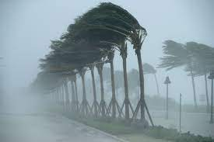
A Believer Fears…
Punishment in the world. E.g?
A bad ending
Punishment of the grave
Standing in front of Allah
Horrors of the Day of Judgement
Torment of Hell-fire
Deeds not being accepted
Allah Himself ﷻ

Slide 6
Khashyah
Khawf and Khashyah
The fear of Allah is unique to other types of fears:
It makes you run to Him, and not away from Him.
the fear of Allah is coupled with love and respect for Him, since you are in awe of Him.
[A] Write 35:28
إِنَّما يَخشَى اللَّهَ مِن عِبادِهِ العُلَمٰؤُا۟
What can we learn from this ayah?
Notes:
Allah says, “Of all of Allah’s servants, only the knowledgeable (of His might) are truly in awe of Him” (35:28).
The fear of Allah is unique to other types of fears. In life, you tend to run away from things you fear. For example, anyone who is scared of spiders or rodents will freeze or run upon seeing them. However, fearing Allah (subḥānahū wa taʿālā) is unique and beautiful. It makes you run to Him, and not away from Him. The more you fear Him, the more you turn to Him.
A fear of worldly matters is usually accompanied with a dislike of it. However, the fear of Allah is coupled with love and respect for Him, since you are in awe of Him.
Although Allah is beyond all worldly examples, think of an elderly grandfather or an older person who is well-respected. As soon as he enters the room, everyone falls quiet out of respect for him. The silence is not because he is a tyrant of the household; rather, it is because of the respect that his family accords him. This type of fear is known as haybah or khashyah, a reverential type of fear.
It is this emotion that the senior Companion ʿAmr b. al-ʿĀṣ (raḍiy Allāhu ʿanhu) felt when he was in the presence of the Messenger of Allah ﷺ. He said even though the Prophet ﷺ was the most beloved of people to him, he could not describe him. This is because whenever he was in his company, he was unable to look directly at his blessed face. He would lower his head and humbly gaze downwards, out of deep respect and awe.

Slide 7
Knowing Allah → Awe of Him
The more we know Allah, the greater our awe of Him will be.
When we realise how GREAT and POWERFUL Allah is, we will truly feel scared and humbled.
The beauty, harmony and vastness of the earth, solar system and the heavens
On the Day of Judgement, the whole earth will be in a single grip of Allah’s Hand, and the heavens will be rolled up in His Right Hand.
Ibn ʿAbbās (radiy Allāhu ʿanhumā) said, “The seven skies and earths are not in the Hand of The Most Merciful, except like a mustard seed in one of your hands.”
Have you ever seen a video of an earthquake? How did you feel?
If Allah wished, He could destroy the heavens and the earth in an instant.
Watch Video: The Awe and Majesty of Allah
Notes:
https://www.youtube.com/watch?v=niCL-oWB_EA
The Awe and Majesty of Allah (Last Miracle)
The fear of Allah (subḥānahū wa taʿālā) is not an irrational fear. It is a fear built on knowledge. The more you get to know Him, the more you fear Him. You are in constant awe of His majesty, greatness and power. Allah says, “Of all of Allah’s servants, only the knowledgeable (of His might) are truly in awe of Him” (35:28).
We should always think of the grandeur, magnificence and power of Allah
We should reflect regularly on Allah’s greatness by reflecting on His Names. This will create a greater fear of Him. Allah is The All-Powerful (al-Qadīr), The All-Dominant (al-Qahhār), The Compeller (al-Jabbār), The Supreme (al-ʿAẓīm); nothing can overcome Him. If He wished, He could destroy the heavens and the earth in an instant.
Likewise, we should reflect on His creation to help us appreciate His power and might. Reflecting on the beauty, harmony and vastness of the earth, solar system and the heavens will help us appreciate Allah’s greatness. Our awe of Him will increase further when we recall the Day of Judgement, a day upon in which the whole earth will be in a single grip of Allah’s Hand, and the heavens will be rolled up in His Right Hand. Ibn ʿAbbās (radiy Allāhu ʿanhumā) said, “The seven skies and earths are not in the Hand of The Most Merciful, except like a mustard seed in one of your hands.”

Slide 8
“
“The origin of all goodness in the world and the hereafter is the fear of Allah, Exalted and Majestic is He. Every heart that does not contain the fear of Allah is a heart which is ruined.”
– Abū Sulaymān al-Dārānī (raḥimahullāh)

Slide 9
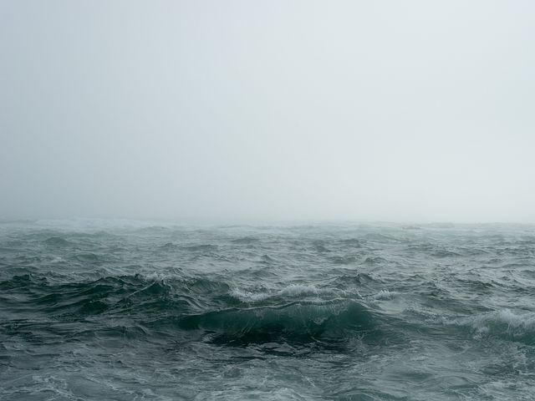
Story
“What made you do that?”
Notes:
There was once a wealthy man from the Banū Isrā’īl who had indulged in sin throughout his life. When his death was near, he instructed his children to burn him after his death, crush his bones, and scatter his ashes on a windy day by the sea. After he died, his children did just as he asked. Allah then gathered his ashes together and asked him, “What made you do that?” The man replied, “Fear of you.” And so Allah forgave him (Bukhārī).
عَنْ أَبِي هُرَيْرَةَ ـ رضى الله عنه ـ عَنِ النَّبِيِّ صلى الله عليه وسلم قَالَ ‏"‏ كَانَ رَجُلٌ يُسْرِفُ عَلَى نَفْسِهِ، فَلَمَّا حَضَرَهُ الْمَوْتُ قَالَ لِبَنِيهِ إِذَا أَنَا مُتُّ فَأَحْرِقُونِي ثُمَّ اطْحَنُونِي ثُمَّ ذَرُّونِي فِي الرِّيحِ، فَوَاللَّهِ لَئِنْ قَدَرَ عَلَىَّ رَبِّي لَيُعَذِّبَنِّي عَذَابًا مَا عَذَّبَهُ أَحَدًا‏.‏ فَلَمَّا مَاتَ فُعِلَ بِهِ ذَلِكَ، فَأَمَرَ اللَّهُ الأَرْضَ، فَقَالَ اجْمَعِي مَا فِيكِ مِنْهُ‏.‏ فَفَعَلَتْ فَإِذَا هُوَ قَائِمٌ، فَقَالَ مَا حَمَلَكَ عَلَى مَا صَنَعْتَ قَالَ يَا رَبِّ، خَشْيَتُكَ‏.‏ فَغَفَرَ لَهُ ‏"‏‏.‏ وَقَالَ غَيْرُهُ ‏"‏ مَخَافَتُكَ يَا رَبِّ ‏"‏‏.‏
https://sunnah.com/bukhari:3481

Slide 10
The Fear of the Elite
Fear of the Masses
Fear of the Elite
Watch Video: True fear of Allah
Notes:
There are two categories of people who fear Allah: (1) the general people who fear the punishment of the world and the hereafter (grave, Hell-fire etc.); (2) the elite who are acquainted with Allah through His Names, and thus fear Allah Himself due to His greatness, grandeur, power and magnificence. This does not mean that they do not share the fears of the first category, but their fear and awe of Allah Himself outweighs the fear of His punishment. In other words, they are scared of being distanced from Him and of there being a barrier (ḥijāb) in between them.
Ibn al-Qayyim (raḥimahullāh) writes, “The fear of the lover is the greatest of fears” as he fears “falling from the eyes of the beloved, and being rejected by, distanced from, or veiled from Him.”
https://www.youtube.com/shorts/bmlgKIwyn18

Slide 11
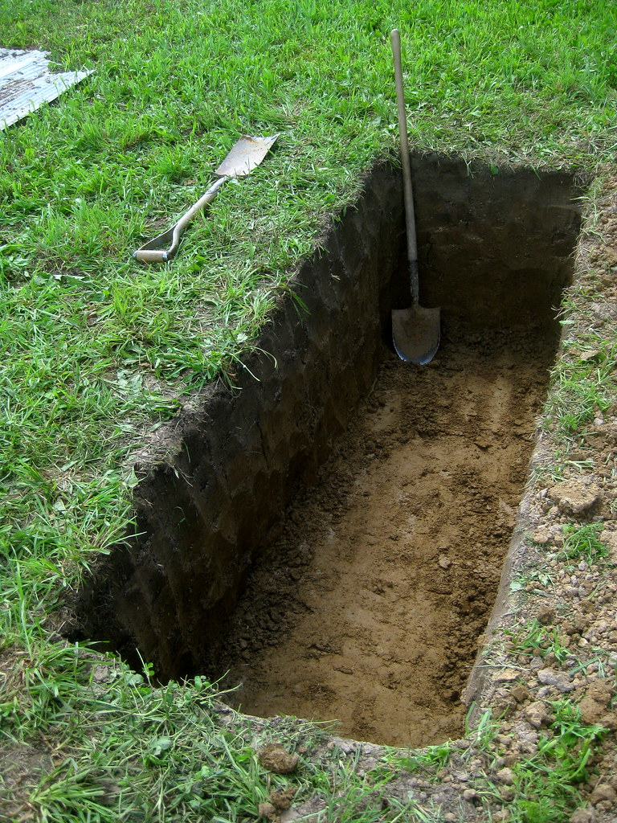
How to Cultivate the Fear of Allah in Your Heart
[A] How can we cultivate the fear of Allah in our hearts?
Reflect on Allah’s greatness and might
Reflect on the Qur’ān (tadabbur)
Reflect on the hereafter and its various stages
Reflect on your sins and their consequences
Ask Allah to grant you awe of Him
Notes:
Reciting and reflecting on verses about the Hell-fire, the destruction of the previous nations, and about the greatness of Allah, will all help to increase our fear of Allah.
“By Allah, if an intelligent believer recited Sūrah al-Ḥadīd, the end of Sūrah al-Ḥashr, Āyah al-Kursī, and Sūrah al-Ikhlāṣ with deep thought and contemplation, his heart would burst open out of the awe of Allah, and he would be baffled by His greatness.” Ibn al-Jawzī (raḥimahullāh)
We should reflect on the gravity of standing before Allah, the terrors of the grave, the horrors of the Day of Judgement, the sharpness of the ṣirāṭ and the torment of the Hell-fire. A practical means to do this is to visit the graveyard and ponder on all of the above.
We should think about how much we have disobeyed Allah. We should feel scared that we may not get a chance to repent before we die, and that we may not be forgiven. We should reflect on how little we have prepared for our journey to the hereafter, and feel very scared.
Similarly, we should fear the consequences of sins, especially a bad ending

Slide 12
Fear: A Deterrent
وَلِمَنْ خَافَ مَقَامَ رَبِّهِ جَنَّتَانِ
“But for he who fears the standing before his Lord, there will be two gardens (i.e. in paradise).” (55:46)
“It refers to a person who, when he intends to sin, remembers the standing before his Lord and stops himself from committing the sin.”
- Mujāhid (raḥimahullāh)
Notes:
Today, we witness so many earthquakes, floods, volcanoes, hurricanes and other disasters, but, unfortunately, we do not learn from these frightening incidents. We remain immersed in sin and fail to repent. Allah sends us minor punishments in this world to remind us to repent and turn back to Him. He says, “And We do not send signs except to frighten” (17:59).
The fear of Allah should be a deterrent, which leads us to stop sinning. Allah says,
وَلِمَنْ خَافَ مَقَامَ رَبِّهِ جَنَّتَانِوَلِمَنْ خَافَ مَقَامَ رَبِّهِ جَنَّتَانِ
But for he who fears the standing before his Lord, there will be two gardens (i.e. in paradise).” (55:46)
Mujāhid (raḥimahullāh) says regarding this verse: “It refers to a person who, when he intends to sin, remembers the standing before his Lord and stops himself from committing the sin.”

Slide 13
“
“When fear resides in the hearts, it burns away the sources of lust and eradicates worldly attachments.”
– Abū Sulaymān al-Dārānī (raḥimahullāh)

Slide 14
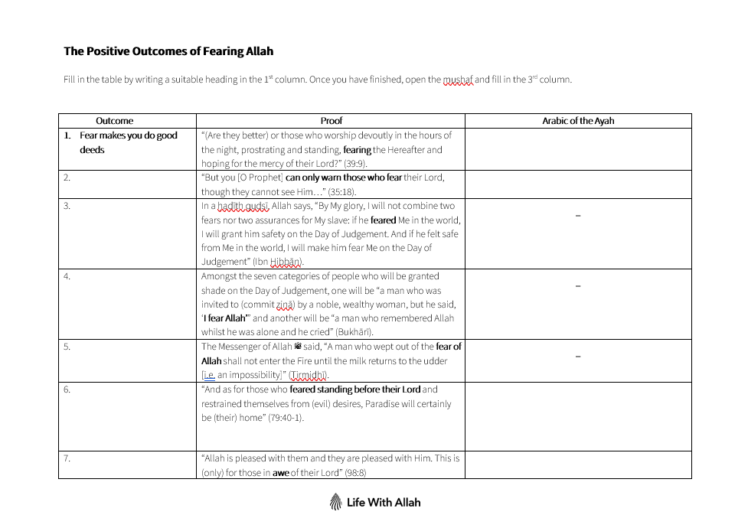
The Positive Outcomes of Fear
[A] What are the positive outcomes of fear?
Notes:
[A] What are the positive outcomes of fear?
Complete worksheet.
Please find worksheet under the lesson on https://lifewithallah.com/teaching-resources/

Slide 15
The Positive Outcomes of Fear
[A] What are the positive outcomes of fear?
Makes you do good deeds
Allows you to benefit from reminders
No fear in the hereafter
Shade on the Day of Judgement
Freedom from Hell-fire
Paradise
Allah will be happy with you
Stops you sinning

Slide 16
“
“By My glory, I will not combine two fears nor two assurances for My slave: if he feared Me in the world, I will grant him safety on the Day of Judgement. And if he felt safe from Me in the world, I will make him fear Me on the Day of Judgement”
(Ḥadīth Qudsī, Ibn Ḥibbān)

Slide 17
Duʿa
Our beloved Prophet ﷺ would ask Allah:
اَللّٰهُمَّ وَأَسْأَلُكَ خَشْيَتَكَ فِي الْغَيْبِ وَالشَّهَادَةِ…
“O Allah, I ask You for Your fear in private and in public…” (Nasā’ī).
Can you remember when we pray this du‘a?
Notes:
Du’a after tashahhud before salam
(Nasā’ī 1305)
اَللّٰهُمَّ بِعِلْمِكَ الْغَيْبَ ، وَقُدْرَتِكَ عَلَى الْخَلْقِ ، أَحْيِـنِـيْ مَا عَلِمْتَ الْحَـيَاةَ خَيْرًا لِّيْ ، وَتَوَفَّنِيْ إِذَا عَلِمْتَ الْوَفَاةَ خَيْرًا لِّيْ ، اَللّٰهُمَّ وَأَسْأَلُكَ خَشْيَتَكَ فِي الْغَيْبِ وَالشَّهَادَةِ ، وَأَسْأَلُكَ كَلِمَةَ الْحَقِّ فِي الرِّضَا وَالْغَضَبِ ، وَأَسْأَلُكَ الْقَصْدَ فِي الْفَقْرِ وَالْغِنَىٰ ، وَأَسْأَلُكَ نَعِيْمًا لَّا يَنْفَدُ ، وَأَسْأَلُكَ قُرَّةَ عَيْنٍ لَّا تَنْقَطِعُ ، وَأَسْأَلُكَ الرِّضَا بَعْدَ الْقَضَاءِ ، وَأَسْأَلُكَ بَرْدَ الْعَيْشِ بَعْدَ الْمَوْتِ ، وَأَسْأَلُكَ لَذَّةَ النَّظَرِ إِلَىٰ وَجْهِكَ ، وَالشَّوْقَ إِلَىٰ لِقَائِكَ ، فِيْ غَيْرِ ضَرَّاءَ مُضِرَّةٍ ، وَلَا فِتْنَةٍ مُّضِلَّةٍ ، اَللّٰهُمَّ زَيِّنَّا بِزِيْنَةِ الْإِيْمَانِ ، وَاجْعَلْنَا هُدَاةً مُّهْتَدِيْنَ

Slide 18
Journal & Reflect
Notes:
5 or more minutes.
In this series of lessons (on the actions and diseases of the heart), ask learners/participants to keep a reflective journal. Tell them that you will not be checking it, and it is personal to them. Ask them: reflect on what we have discussed today, and jot down some key reflections. How does it link to your life? How would you like to incorporate *today’s action of the heart* / eliminate *today’s disease of the heart* in your life? How are you going to attain Allah’s closeness through it? Write down at least 1 tangible thing you are going to do/not do.
Each week, ask them to review last week’s and if they did/stopped doing what they wrote down in the previous week.
At the end of the term/end of sessions, ask them to do a complete review, to remind themselves.
(Tafakkur and reflection are key aspects of journeying to Allah. It is not enough to provide learners with information, but to give them some quiet space and time to think and reflect.)

Slide 19
Plenary
List 5…
ways in which we can increase our fear of Allah
benefits of fearing Allah

Slide 20
Alternative Plenary
What should the fear of Allah lead to?
What is the difference between khawf and khashyah?
Why is the fear of Allah unique from other types of fears?
What is the difference between the fear of the ‘general people’ and the fear of the ‘elite’?
What are some of the rewards and positive consequences of fearing Allah?
What leads to the fear of Allah? What can help you to fear Him?
Notes:
[OPTIONAL SLIDE:
For this slide to show in this PPT when presenting, right click on the slide selection on the left hand side, and select “Hide Slide” to unhide the slide ]

Slide 21
Homework
Go through the list of the Names of Allah.
Write down the Names which should invoke in you the fear and awe of Allah.

Slide 22
Next Lesson inshallah
Balancing Fear and Hope

