Slide 1
Starter
How should we recite Qur’an in & outside salah?

Slide 2
Lesson 3
Year 10
How to
develop
khushu
Tadabbur and Tartil

Slide 3
LOs
To link Qur’an and khushu
To explore how to recite Qur’an in salah
To identify how to do tadabbur

Slide 4
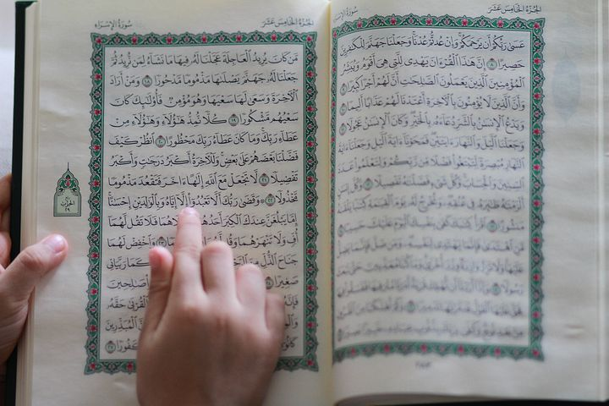
Qur’an and Khushu‘
How would you describe his recitation?
Holy Quran Recitation by Idrees Abkar - QuranicAudio.com
Surat al-Isra, Surah 17 33:06 – 35:09
Notes:
There is a direct link between Qur’an and Khushu
﴿قُلۡ ءَامِنُوا۟ بِهِۦۤ أَوۡ لَا تُؤۡمِنُوۤا۟ۚ إِنَّ ٱلَّذِینَ أُوتُوا۟ ٱلۡعِلۡمَ مِن قَبۡلِهِۦۤ إِذَا یُتۡلَىٰ عَلَیۡهِمۡ یَخِرُّونَ لِلۡأَذۡقَانِ سُجَّدࣰا ۝١٠٧ وَیَقُولُونَ سُبۡحَـٰنَ رَبِّنَاۤ إِن كَانَ وَعۡدُ رَبِّنَا لَمَفۡعُولࣰا ۝١٠٨ وَیَخِرُّونَ لِلۡأَذۡقَانِ یَبۡكُونَ وَیَزِیدُهُمۡ خُشُوعࣰا ۩ ۝١٠٩﴾
Allah describes those who were given knowledge as those who, when they heard the Qur’an, it made them weep and increased them in khushu. Therefore there is a direct correlation between the Qur’an and khushu. The Qur’an is supposed to increase our khushu, our humility with Allah (swt).
Why do we not weep when we hear the Qur’an? Why does it not increase our khushu? How can we have that deep spiritual and emotional connection to the Qur’an?

Slide 5
Tilawah
Tartil
Tajwid
Tadabbur
Taghanni(n)
T

Slide 6
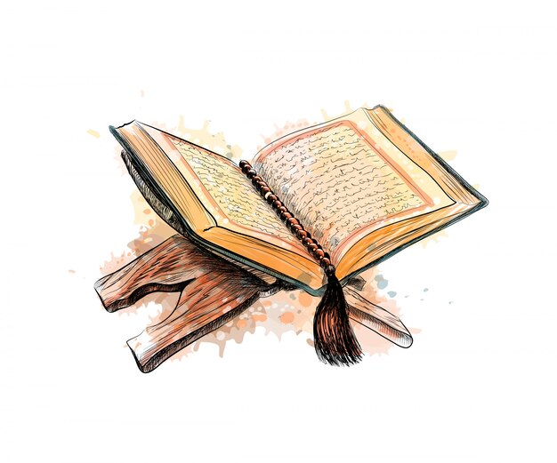
Tartil
[A] Write 73:4
أَوْ زِدْ عَلَيْهِ وَرَتِّلِ ٱلْقُرْءَانَ تَرْتِيلًا ‎﴿٤﴾
Tartil: reciting slowly and calmly, making each word distinct, and not exceeding the limits.
The recitation of the Prophet g
A man came to ʿAbdullāh b. Masʿūd and said, “I recite all the mufaṣṣal sūrahs in one rakʿah.” Upon this ʿAbdullāh said, “(Do you recite it) hastily like the recitation of poetry? Indeed, there are people who recite the Qur’ān, but it does not go down beyond their collar bones. However, it benefits when it enters the heart and becomes deeply-rooted in it…
Notes:
Tartīl refers to reciting slowly and calmly, making each word distinct, and not exceeding the limits.
Qatādah narrated that Anas b. Mālik was asked, “How was the recitation of the Prophet g?” He replied, “It was elongated. He then recited بِسْمِ اللهِ الرَّحْمٰنِ الرَّحِيْمِ , elongating بسم الله, elongating الرحمن and elongating الرحيم” (Bukhārī).

Slide 7
Taghanni
“He who does not recite the Qur’ān melodiously is not one of us.”
(Abū Dāwūd)
“Of those who recite the Qur’ān with the best voice is the one who, when you hear him recite, you think that he fears Allah.” (Ibn Mājah)
Notes:
The purpose of melodious recitation is not merely to ensure the reciting of the Qur’ān sounds good; instead, it is to ensure that the recitation is beautiful, with complete focus and khushūʿ. Such a recitation would inevitably result in the heart being moved. It should increase your fear of Allah and provide peace.

Slide 8
“
“Do whatever you wish to get close to Allah, but know you will never get closer to Him with anything more beloved to Him than His own words (i.e. the Qur’ān).”
- Khabbāb radiyallahu ‘anhu

Slide 9
Tadabbur
Know what the Qur’an is.
[A] How can we start doing tadabbur?
[A] Complete the worksheet
Notes:
The magnificence of the Qur’an has to settle in our hearts. Not my words or your words. The words of the LORD of the WORLDS.

Slide 10
Tadabbur Tips
Think of Who is talking to you
Personalise. Allah is talking to you
Visualise
Feel the emotion and repeat the āyah
Interact with the āyāt. What do you remember from the hadith of Hudhayfah?
To do the above, ‘study’ is essential.
Notes:
https://lifewithallah.com/articles/quran/tips-for-reflecting-upon-the-quran/

Slide 11
Story Time
فَمَنَّ ٱللَّـهُ عَلَيْنَا وَوَقَىٰنَا عَذَابَ ٱلسَّمُومِ ﴿٢٧﴾
Notes:
Additional task for Arabic students: Fi’l al-Amr of Manna/Waqaa (before teacher proceeds to relate the story).
Qāsim, the nephew of ʿĀ’ishah said:
“Every morning, I would begin my day with visiting ʿĀ’ishah and greeting her. One day I went, and she was standing in prayer, reciting:
فَمَنَّ اللَّـهُ عَلَيْنَا وَوَقَانَا عَذَابَ السَّمُومِ ﴿٢٧﴾
So Allah has graced us and protected us from the torment of (Hell’s) scorching heat. (52:27)
She was supplicating, crying and repeating the āyah. I stood and waited until I became tired of waiting, so I went to the market for my needs. When I returned, she was standing in the same position, praying and crying.” (Sifat al-Safwah)
Masrūq said, “ʿĀ’ishah recited the āyah:
فَمَنَّ اللَّـهُ عَلَيْنَا وَوَقَانَا عَذَابَ السَّمُومِ ﴿٢٧﴾ إِنَّا كُنَّا مِن قَبْلُ نَدْعُوهُ إِنَّهُ هُوَ الْبَرُّ الرَّحِيمُ ﴿٢٨﴾
‘But Allah was gracious to us and protected us from the punishment of the scorching fire. We used to pray to Him before. He is surely the Most Kind, the Very Merciful’ (52:27).
Then she said, ‘O Allah, be gracious to us and protect us from the punishment of the scorching fire.’” Aʿmash, one of the narrators, was asked if she said this in her ṣalāh. He replied, “Yes” (Tafsīr Ibn Kathīr).
وَقَالَ ابْنُ أَبِي حَاتِمٍ: حَدَّثَنَا عَمْرُو بْنُ عَبْدِ اللَّهِ الأوْدِيّ، حَدَّثَنَا وَكيع، عَنِ الْأَعْمَشِ، عَنْ أَبِي الضحَى، عَنْ مَسْرُوقٍ، عَنْ عَائِشَةَ؛ أَنَّهَا قَرَأَتْ هَذِهِ الْآيَةَ: ﴿فَمَنَّ اللَّهُ عَلَيْنَا وَوَقَانَا عَذَابَ السَّمُومِ إِنَّا كُنَّا مِنْ قَبْلُ نَدْعُوهُ إِنَّهُ هُوَ الْبَرُّ الرَّحِيمُ﴾ فَقَالَتْ: اللَّهُمَّ مُنَّ عَلَيْنَا وَقِنَا عَذَابَ السَّمُومِ، إِنَّكَ أَنْتَ الْبَرُّ الرَّحِيمُ. قِيلَ لِلْأَعْمَشِ: فِي الصَّلَاةِ؟ قَالَ: نَعَمْ^{(١٦)}

Slide 12
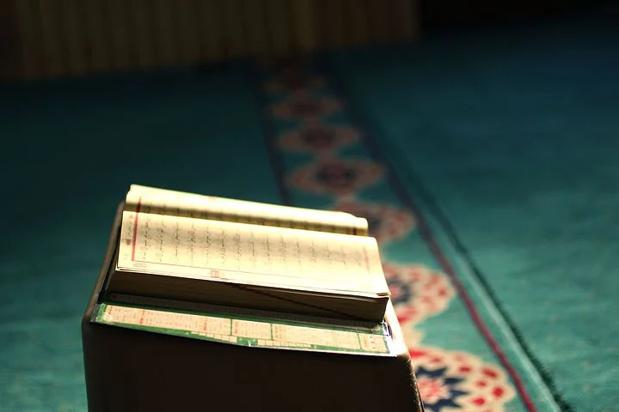
“Know that everything that distracts you from understanding the meaning of your recitation is a whispering of doubt from Shayṭān.”
(al-Ghazālī)

Slide 13
The Adhkar Bank
Adhkar of Ruku‘
سُبُّوْحٌ، قُدُّوْسٌ، رَبُّ الْمَلَائِكَةِ وَالرُّوْحِ.
The Supremely Perfect, The Most Pure, The Lord of the Angels and the Spirit [Jibrīl] (Muslim).
سُبْحَانَكَ اللّٰهُمَّ رَبَّنا وَبِحَمْدِكَ، اَللّٰهُمَّ اغْفِرْ لِيْ.
How perfect are You, O Allah, our Lord, and all praise is for You. O Allah, forgive me (Muslim).
سُبْحَانَكَ وَبِحَمْدِكَ لَا إِلٰهَ إِلَّا أَنْتَ.
How Perfect are You, and all praise is for You. There is no god worthy of worship except You (Muslim).

Slide 14
Plenary
Write down 5 tips for how we can recite Qur’an to increase our khushu:
5

Slide 15
Practising What We’re Learning
Let us pray_______with the highest level of khushu we can, with the help of Allah b
Notes:
Pray Salah al-Duha/upcoming fard prayer/2 rak’ah nafl etc with a full focus on Allah, and try to practice something we have learnt today.

