Slide 1
Starter: What’s The Question?
Q1: _____________________________
A: Utmost humility and utmost love.
Q2: _____________________________
A: Humility and fully focusing your heart on Allah.
Q3: _____________________________
A: Worship Allah as though you can see Him.
Notes:
What are the two components of ibadah?
What is khushu?
What is ihsan?
Tell learners there will be a class quiz today.

Slide 2
Lesson 4
Year 9
The Journey Through Salah
Preparation-Standing Up From Ruku

Slide 3
LOs
To identify the significance of the postures in salah
To link the spiritual elements to the physical movements

Slide 4
Before Salah
Annotate you Salah JourneyBoard as we go along this journey…
Attending the Court of the Almighty
Mentally remind yourself of WHO you are going to be conversing
Wuḍū’
Nice clothes
Facing the qiblah
Notes:
Whilst its outer dimension is to purify the body’s various parts from physical dirt, its inner dimension is to purify yourself from the ‘dirt’ of your sins.
The Messenger of Allah g said, “Whoever performs wuḍū’, and does so in an excellent manner, his sins will leave from his body, even coming out from under his nails” (Muslim).
If you are going to meet an important leader or king, you will make sure that you are prepared. You will shower, perfume and wear your smartest clothes. When preparing for ṣalāh, you are actually preparing to meet the King of all kings: Allah b Himself.
Whilst turning your face in the direction of the Kaʿbah, simultaneously turn your heart towards the Lord of the Kaʿbah

Slide 5
Allahu Akbar
Raising the hands
Surrendering
Pushing the dunya behind you
Takbīr
أَكْبَرُ
Greater than…
Video
7 Heavens, Kursi (Footstool) and The Arsh (Throne) Of Allah - By Sheikh Ahmed Ali (HD)
https://www.youtube.com/watch?v=Uy8DT0jemE8
Notes:
When soldiers or opponents surrender, they will raise their hands, as if to say ‘You’ve got me. I’m all yours!’ Similarly, raising your hands in ṣalāh is a physical manifestation of your surrender to Allah
As you raise your hands, throw the world behind you and get ready to converse with your Creator.
In Arabic, you may say: Zayd is bigger than Maḥmūd (ممود من أكب زيد). Here we say Allāhu Akbar, hence, Allah b is greater than … Thus, what He is greater
than has not been specified. This lack of specification (also known as ellipsis) indicates that Allah b is greater than everything.
Allah b is Greater than anything we can imagine.
Each time you utter the words ‘Allāhu Akbar’, remind yourself of the Greatness of Allah and say: Allah is Greater… He is greater than me, greater than my desires, greater than my loved ones, greater than my hobbies, greater than the most powerful armies and empires, greater than everything.
Why do you fold your hands and place them over each other?
Imagine you walk into a palace and see two groups of people: one group have their hands on their hips, eyes roaming around everywhere, whilst the second group have their hands neatly clasped together and are respectfully looking down. Seeing this, you would easily identify those who are royalty and those who are the slaves. Similarly, as you are a slave standing in front of Allah, placing one hand on the other respectfully symbolises your humility in front of Him.

Slide 6
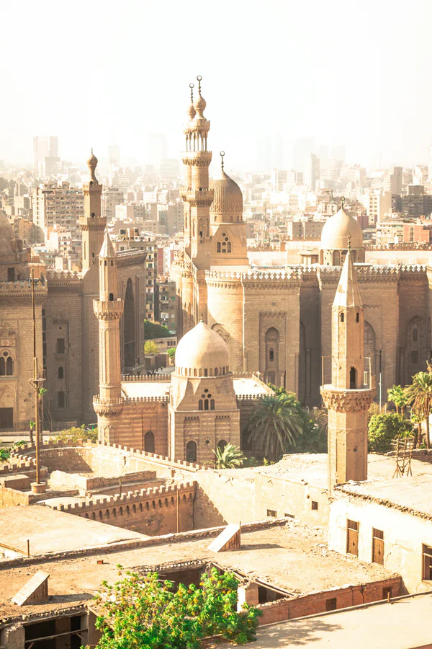
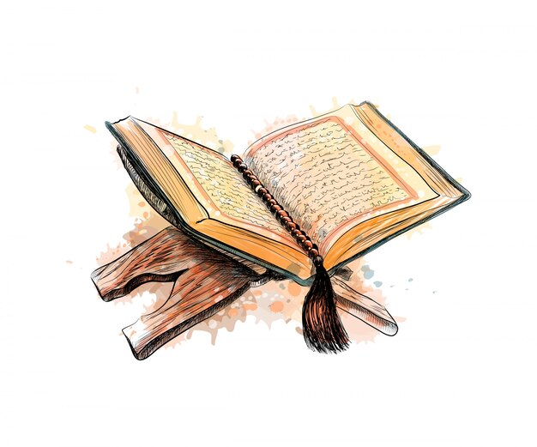
Qiyam
Qiyām (Standing)
Humbly lowering your gaze
Clasping right hand over left hand
[A] Write 2:238
حَٰفِظُوا۟ عَلَى ٱلصَّلَوَٰتِ وَٱلصَّلَوٰةِ ٱلْوُسْطَىٰ وَقُومُوا۟ لِلَّهِ قَٰنِتِينَ ‎﴿٢٣٨﴾
Take due care of all the prayers, and the middle prayer, and stand before Allah in total devotion ‏
Notes:
When soldiers or opponents surrender, they will raise their hands, as if to say ‘You’ve got me. I’m all yours!’ Similarly, raising your hands in ṣalāh is a physical manifestation of your surrender to Allah
As you raise your hands, throw the world behind you and get ready to converse with your Creator.
In Arabic, you may say: Zayd is bigger than Maḥmūd (ممود من أكب زيد). Here we say Allāhu Akbar, hence, Allah b is greater than … Thus, what He is greater
than has not been specified. This lack of specification (also known as ellipsis) indicates that Allah b is greater than everything.
Allah b is Greater than anything we can imagine.
Each time you utter the words ‘Allāhu Akbar’, remind yourself of the Greatness of Allah and say: Allah is Greater… He is greater than me, greater than my desires, greater than my loved ones, greater than my hobbies, greater than the most powerful armies and empires, greater than everything.
Why do you fold your hands and place them over each other?
Imagine you walk into a palace and see two groups of people: one group have their hands on their hips, eyes roaming around everywhere, whilst the second group have their hands neatly clasped together and are respectfully looking down. Seeing this, you would easily identify those who are royalty and those who are the slaves. Similarly, as you are a slave standing in front of Allah, placing one hand on the other respectfully symbolises your humility in front of Him.
Qur’anic Focus (QF)
This is an attempt to connect learners’ to the Qur’an and form a strong personal bond with it.
At the beginning of the year, instruct learners to bring in their personal mushaf to every class.
Each lesson (wherever possible), physically make them open the Mushaf at least once.
Ask learners to write down the chosen ayah in their books. Ask one student to recite. Ask another student to attempt a translation. Discuss and explain the meaning of the ayah.

Slide 7
Beginnings
Istiftāḥ (Opening Duʿā’)
Greet & praise Allah
Seek forgiveness
Istiʿādhah
Seeking protection from s.o who wants to DESTROY.
Only one who can protect us from him is Allah.
Basmalah
Ba: seeking help & blessing
Notes:
Review the meaning of the dua of istiftah. We enter our salah and we praise Allah. We affirm His Oneness. We praise His majesty and greatness.
Alternative dua – cleanse yourself before you start.
Ṣalāh is the Shayṭān's battlefield. No other situation enrages and annoys Shayṭān more than ṣalāh. Shayṭān is a thief who wants to ‘steal’ from your ṣalāh until you have nothing left in it.
You start by asking for the help of Allah. Through this, you are expressing your servitude to Him.
By uttering His Name, you are also asking Him to bless you in all that you do.

Slide 8
Qur’an & Ruku
Reciting Qur’ān
Calmly
Tajwid
Hear yourself recite (NOT IN YOUR MIND)
Reflect
Sūrah al-Fātiḥah
Try to pause + think of what Allah is saying
Rukūʿ
Strong symbol of submission
Praising and glorifying Allah + simultaneously humbling yourself physically and in your heart
Notes:
Lower your head in awe of the Lord of the worlds. Straighten your back, let every joint in your body relax, and glorify Him by uttering:
Rukūʿ is one of the most significant pillars of ṣalāh. Its position is one of the most intense symbols of servitude, submission and humility. In rukūʿ, not only do you glorify Allah b but you also simultaneously humble: the heart, the tongue and the limbs. Feel your self-importance diminishing, whilst the awe and glory of Allah b expand in your heart.

Slide 9
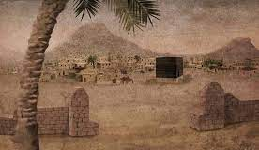
Story Time
أبو بكر
h
Notes:
Abū Bakr (ra) was known for his excessive weeping. In Makkah, he built a masjid in his courtyard in which he would perform ṣalāh and recite Qur’ān. As he was a very soft-hearted person, he would not be able to control himself when he was reciting the Qur’ān and he would cry extensively. The women and children of the polytheists would gather to listen to his moving recitation, to the extent that it frightened the chiefs of the Quraysh.
.‏ قَالَتْ عَائِشَةُ قُلْتُ إِنَّ أَبَا بَكْرٍ إِذَا قَامَ فِي مَقَامِكَ لَمْ يُسْمِعِ النَّاسَ مِنَ الْبُكَاءِ، فَمُرْ عُمَرَ فَلْيُصَلِّ‏.
https://sunnah.com/bukhari:7303

Slide 10
Standing Up From Ruku
سَمِعَ اللَّهُ لِمَنْ حَمِدَهُ
اللهم رَبَّنَا لَكَ الْحَمْدُ
Notes:
May Allah respond to the one who praises Him.
Arabic learners: Past tense used for du’a
Arabic learners: What do you notice about the placement of laka? Muqaddam lil-hasr….For You Alone…
O Allah, our Lord, to You Alone belongs all praise.
Take your time in this posture as it is a unique posture that precedes and prepares you for the greatest pillar of ṣalāh: sujūd. Stand up calmly and give this posture its due. The Prophet g used to lengthen this posture, just as he would lengthen his rukūʿ and sujūd.

Slide 11
Class Quiz
1 point for a decent-ish answer
2 points for a good answer
3 points for an outstanding answer!
بالتوفيق!
Notes:
Give learners a few minutes to review their notes. Divide the class into groups. Write the scores on the board. Reward the winning group.

Slide 12
Quiz questions
What can you think of when you are doing wudu?
Why should you dress nicely for salah?
What is the spiritual significance of facing the qiblah?
Just before you start salah, what you can tell yourself?
What is the significance of raising our hands when we start salah?
What does ‘Allahu Akbar’ mean beyond a simple translation?
Why do we put our right hands on our left hands, and look down?
What are we doing when we start our salah with the ‘opening du’a’?
Why do we recite the isti’adhah?
What does the ‘baa’ in Bismillah denote?
How should we recite Qur’an in salah?
Why is Surah al-Fatihah in salah one of the most amazing conversations?
What does سَمِعَ اللَّهُ لِمَنْ حَمِدَهُ mean?
What does ruku’ symbolise?

Slide 13
The Adhkar Bank
Standing up from Ruku‘
رَبَّنَا وَلَكَ الْحَمْدُ، حَمْدًا كَثِيْرًا طَيِّبًا مُّبَارَكًا فِيْهِ.
Our Lord, to You Alone belongs all praise; abundant, pure and blessed praise (Bukhārī).
Rifāʿah b. Rāfiʿ narrated, “One day we were praying behind the Messenger of Allah g. When he raised his head from rukūʿ, he g said سَمِعَ اللّٰهُ لِمَنْ حَمِدَه
A man behind him said [the above]. When he g finished, he asked, ‘Who uttered those words?’ The man replied, ‘Me.’ The Prophet g said, ‘I saw some thirty-something angels racing to write it first’” (Bukhārī).
.

Slide 14
Practising What We’re Learning
2 rak’ah with the highest level of khushu you can, with the help of Allah b
Notes:
Pray Salah al-Duha/upcoming fard prayer/2 rak’ah nafl etc with a full focus on Allah, and try to practice something we have learnt today.

