Slide 1
Starter
What is the name of the month before Dhul-Hijjah?
What is the name of the month after Dhul-Hijjah?
On what day of Dhul Hijjah is Eid?
Notes:
[A] = Activity. This could be oral/written/typed up/in pairs/groups/mini-whiteboard/flip-chart paper/discussion etc.
P.S. This lesson assumes students have studied ‘hajj’ as a topic previously.
Please refer to ‘The Best Days of Your Life’ by Life With Allah for a detailed read on the topic:
https://alifewithallah.com/publications/

Slide 2
Dhul Hijjah
The Best Days of the Year
KS3 Y7

Slide 3
LOs
To identify why these 10 days are extremely special
To list actions for these days
To gain an overview of the 13 days

Slide 4
[A]
What do you know about these special days?

Slide 5
What’s so special about these days?
1) [A] Write Q89:1-2
2) “There are no better days in the sight of Allah than the 10 days of Dhul Hijjah.”
(Ibn Hibbān)
Notes:
Allah swt says: “By the Daybreak, and by Ten Nights.” (89:1-2) According to the majority of the scholars, these ten nights refer to the 10 days of Dhul Ḥijjah. When Allah swears an oath by something, this is an indication of its importance and benefit.

Slide 6
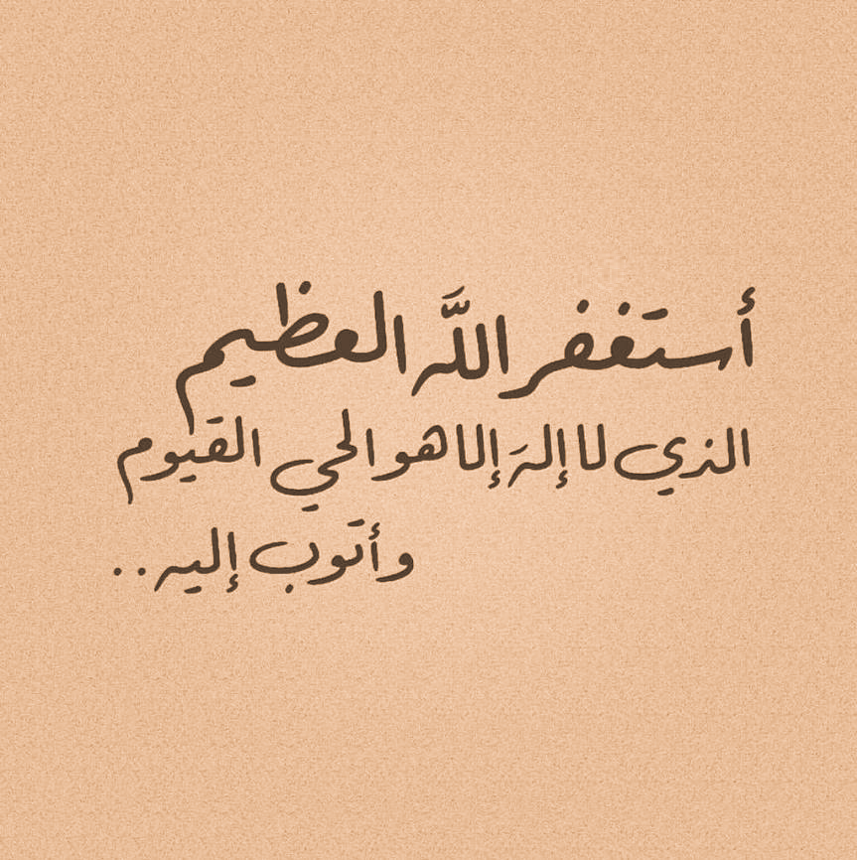
Throughout the days
[A] What should we be doing in these days?
Lots and lots of dhikr
Fast
Stay away from sins
Qur’an
Du’a
Tahajjud
Qurbani

Slide 7
Dhul Hijjah
[A] Can you remember what happens/we should do in these days?
1-9
8
9
10
11-13
Notes:
This activity assumes they have studied ‘hajj’ as a topic previously

Slide 8
Dhul Hijjah
1-9
8
9
10
11-13
Fast (Non-pilgrims)
Other good deeds, especially DHIKR
Day of ‘Arafah
Day of ‘Eid/Nahr
Days of Tashriq
Eating, drinking & dhikr
Qurbani
Du’a, protection from Hell-fire & fasting
Pilgrims in Mina
Notes:
Briefly explain what each category/bullet point entails

Slide 9
Day of ‘Arafah
On this day, we should:
1)
2)
3)
Notes:
Fast
When the Messenger of Allah ﷺ was asked about the fast of the day of ʿArafah, he said: “It wipes away the (sins) of the past and upcoming year.” (Muslim)
Du’a
Ask Allah for freedom rom Hell-fire

Slide 10
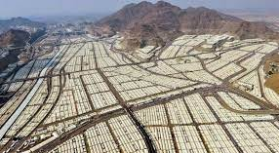
Takbirat of Tashriq
اللهُ أَكْبَرُ اللهُ أَكْبَرُ ، لَا إلَهَ إِلَّا اللهُ واللهُ أَكْبَرُ ،
اللهُ أَكْبَرُ وَللهِ الْحَمْدُ
Recite audibly after each fard salāh
From Fajr of the 9th of Dhul Hijjah - ʿAsr of the 13th Dhul Hijjah.
Notes:
Along with this, the takbīrāt of tashrīq (اللهُ أَكْبَرُ اللهُ أَكْبَرُ ، لَا إلَه إِلَّا اللهُ واللهُ أَكْبَرُ ، اللهُ أَكْبَرُ وَللهِ الْحَمْدُ) are to be recited audibly after each farḍ ṣalāh, starting from the Fajr of the 9th of Dhul Ḥijjah till the ʿAṣr of the 13th Dhul Ḥijjah.
Ask a student to translate. Explain the translation.

Slide 11
Plenary
What did the Prophet ﷺ say about these 10 days?
What date of Dhul Hijjah is ‘Eid?
What should we do on the 9th of Dhul Hijjah?
What do we do from Fajr of 9th till Asr of 13th Dhul Hijjah?
Can you translate the takbirat of tashriq?

