Slide 1
The 10 Days of Dhul Hijjah
KS3 Y8 /Y9
Notes:
[A] = Activity. This could be oral/written/typed up/in pairs/group/mini-whiteboard/flip-chart paper/discussion etc.
Feel free to swap the English translation (found in notes of each slide).
For students who study Arabic, ask them to translate etc and then ask them what they think it means/explain yourself
Please refer to ‘The Best Days of Your Life’ by Life With Allah for a detailed read on the topic:
https://alifewithallah.com/publications/

Slide 2
Quick Quiz
What date of Dhul Hijjah is ‘Eid?
What do we do from Fajr of 9^{h} till Asr of 13th Dhul Hijjah?
Is Qurbani wajib or sunnah?
What should you not do once the 10 days start + you are intending to do Qurbani?
How do you attain the reward of Ḥajj and ‘Umrah without being there?

Slide 3
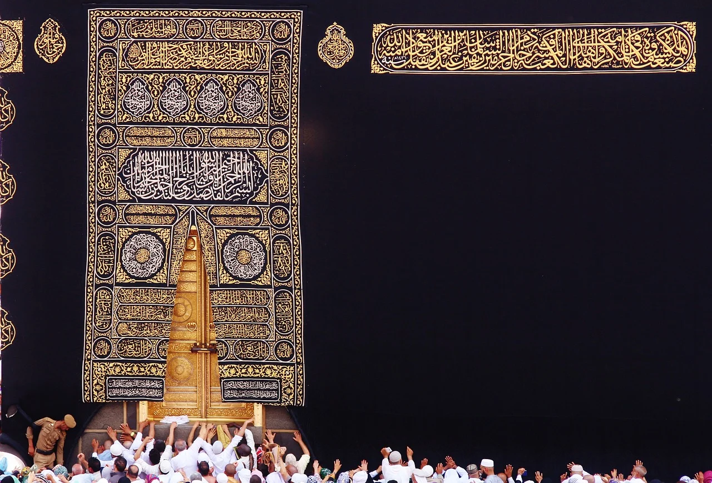
[A]
# What is so special about these 10 days?

Slide 4
The Best Days
‏"‏ مَا مِنْ أَيَّامٍ الْعَمَلُ الصَّالِحُ فِيهِنَّ أَحَبُّ إِلَى اللَّهِ مِنْ هَذِهِ الأَيَّامِ الْعَشْرِ ‏"‏ ‏.‏ فَقَالُوا يَا رَسُولَ اللَّهِ وَلاَ الْجِهَادُ فِي سَبِيلِ اللَّهِ فَقَالَ رَسُولُ اللَّهِ صلى الله عليه وسلم ‏"‏ وَلاَ الْجِهَادُ فِي سَبِيلِ اللَّهِ إِلاَّ رَجُلٌ خَرَجَ بِنَفْسِهِ وَمَالِهِ فَلَمْ يَرْجِعْ مِنْ ذَلِكَ بِشَيْءٍ ‏"‏ ‏.‏
These days are better than the days of Ramadan.
Notes:
The Messenger of Allah ﷺ said: “There are no days on which righteous deeds are more beloved to Allah than these ten days (the first ten of Dhul Ḥijjah).” The (Ṣaḥābah) asked: “Not even jihād in the path of Allah?” The Messenger of Allah ﷺ replied: “Not even jihād in the path of Allah, unless a man goes out himself for jihād taking his wealth with him and does not return with anything from it.” (Tirmidhī)
The Messenger of Allah ﷺ also said: “There are no better days in the sight of Allah than the 10 days of Dhul Ḥijjah.” (Ibn Ḥibbān)
Ibn Ḥajar (raḥimahullāh) said the reason that these 10 days are so special is because all of the major acts of worship occur in them, which doesn’t happen in other days: Ṣalāh, fasting, charity and Ḥajj. i.e. Although it is possible to combine the first three deeds on an ordinary day, the great worship of Ḥajj is restricted to these blessed days.

Slide 5
Special Days
[A] Write Q89:1-2
وَٱلْفَجْرِ ﴿١﴾ وَلَيَالٍ عَشْرٍ ﴿٢﴾
‏"‏ إِنَّ أَعْظَمَ الأَيَّامِ عِنْدَ اللَّهِ تَبَارَكَ وَتَعَالَى
يَوْمُ النَّحْرِ ثُمَّ يَوْمُ الْقَرِّ ‏"‏
Notes:
Allah c says: “By the Daybreak, and by Ten Nights.” (89:1-2)
The Messenger of Allah (saw) said: “The greatest day in the sight of Allah is the day of Naḥr (10th of Dhul Ḥijjah) and then the day of Qarr (11th of Dhul Ḥijjah).” (Abū Dāwūd)

Slide 6
Actions:
[A] What specific actions should we carry out in these 10 days?
1. Dhikr: [HALLMARK OF THESE DAYS!]
“There are no days greater in the sight of Allah or in which good deeds are more beloved to Him than these 10 days. So recite a great deal of tahlīl, takbīr and taḥmīd.” (Ahmad)
2. Fast
Notes:
These words should be said in the masjids, in the homes and in the streets. Men should proclaim them loudly. ‘Abdullāh b. ‘Umar and Abū Hurayrah (raḍiy Allāhu ‘anhum) would go out in the marketplaces and recite takbīr loudly in these 10 days. Upon hearing them, the people would follow in suit and recite takbīr.
One of the wives of the Messenger of Allah ﷺ said: “The Messenger of Allah ﷺ used to fast on the first nine days of Dhul Ḥijjah; the day of ʿĀshūrā’ and three days of each month…” (Nasā’ī)
عَنْ هُنَيْدَةَ بْنِ خَالِدٍ، عَنِ امْرَأَتِهِ، قَالَتْ حَدَّثَتْنِي بَعْضُ، نِسَاءِ النَّبِيِّ صلى الله عليه وسلم أَنَّ النَّبِيَّ صلى الله عليه وسلم كَانَ يَصُومُ يَوْمَ عَاشُورَاءَ وَتِسْعًا مِنْ ذِي الْحِجَّةِ وَثَلاَثَةَ أَيَّامٍ مِنَ الشَّهْرِ أَوَّلَ اثْنَيْنِ مِنَ الشَّهْرِ وَخَمِيسَيْنِ ‏.‏

Slide 7
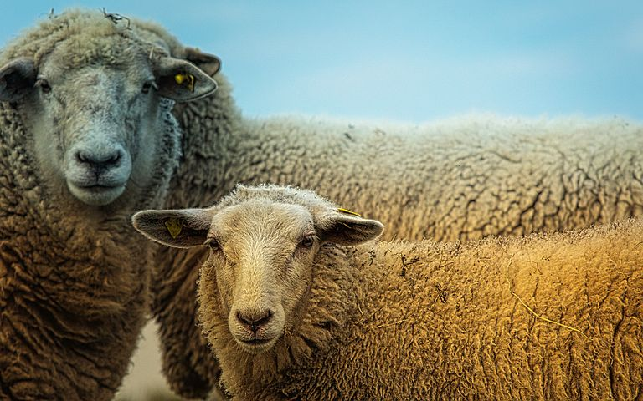
3. Qurbani
4. Qur’an
5. Charity
6. Du‘a

Slide 8
Attain the Reward of Hajj and ‘Umrah
Notes:
The Messenger of Allah ﷺ said: “Whoever offers Fajr in congregation and remains seated, engaging in the remembrance of Allah until the sun has risen, and then offers two rakʿahs, he will have a reward equal to that of performing ḥajj and ʿumrah.” He ﷺ said: “Complete, complete, complete (i.e. complete reward).” (Tirmidhī)
The scholars have also stated that this reward is equally applicable to a woman (praying at home) who sits in the place where she performs Fajr and remembers Allah or recites the Qur’ān until sunrise.

Slide 9
Part II:
The Day
of ‘Arafah

Slide 10
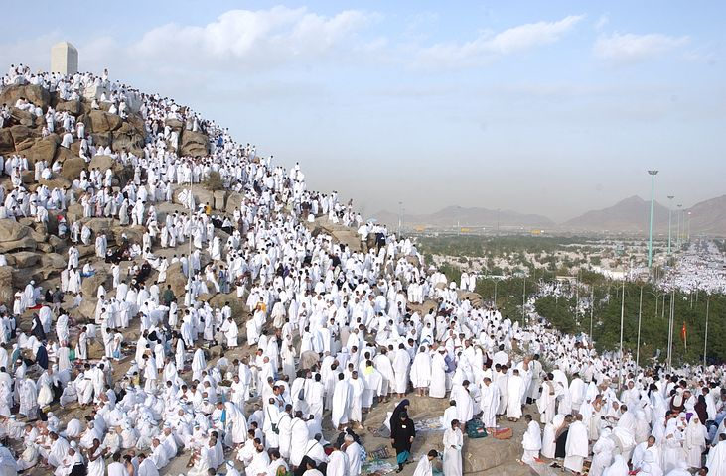
[A]
# What do you know about the Day of ‘Arafah?

Slide 11
The Day of Arafah: Virtues
1. A special day
الْيَوْمَ أَكْمَلْتُ لَكُمْ دِينَكُمْ وَأَتْمَمْتُ عَلَيْكُمْ نِعْمَتِي وَرَضِيتُ لَكُمُ الإِسْلاَمَ دِينًا‏‏‏.
2. Freedom from Hell-fire
"‏ مَا مِنْ يَوْمٍ أَكْثَرَ مِنْ أَنْ يُعْتِقَ اللَّهُ فِيهِ عَبْدًا مِنَ النَّارِ مِنْ يَوْمِ عَرَفَةَ وَإِنَّهُ لَيَدْنُو ثُمَّ يُبَاهِي بِهِمُ الْمَلاَئِكَةَ فَيَقُولُ مَا أَرَادَ هَؤُلاَءِ ‏"‏‏.‏
Notes:
عَنْ عُمَرَ بْنِ الْخَطَّابِ، أَنَّ رَجُلاً، مِنَ الْيَهُودِ قَالَ لَهُ يَا أَمِيرَ الْمُؤْمِنِينَ، آيَةٌ فِي كِتَابِكُمْ تَقْرَءُونَهَا لَوْ عَلَيْنَا مَعْشَرَ الْيَهُودِ نَزَلَتْ لاَتَّخَذْنَا ذَلِكَ الْيَوْمَ عِيدًا‏.‏ قَالَ أَىُّ آيَةٍ قَالَ :
الْيَوْمَ أَكْمَلْتُ لَكُمْ دِينَكُمْ وَأَتْمَمْتُ عَلَيْكُمْ نِعْمَتِي وَرَضِيتُ لَكُمُ الإِسْلاَمَ دِينًا‏‏‏.‏
قَالَ عُمَرُ قَدْ عَرَفْنَا ذَلِكَ الْيَوْمَ وَالْمَكَانَ الَّذِي نَزَلَتْ فِيهِ عَلَى النَّبِيِّ صلى الله عليه وسلم وَهُوَ قَائِمٌ بِعَرَفَةَ يَوْمَ جُمُعَةٍ‏.‏
‘Umar b. al-Khaṭṭāb (raḍiy Allāhu ‘anhu) narrated: ‘Once a Jew said to me: “O leader of the believers! There is a verse in your (Holy) Book which you all read; had it been revealed to us Jews, we would have taken that day (on which it was revealed) as a day of celebration.”’ ‘Umar (raḍiy Allāhu ‘anhu) asked him: “Which verse?” The Jew replied:
الْيَوْمَ أَكْمَلْتُ لَكُمْ دِينَكُمْ وَأَتْمَمْتُ عَلَيْكُمْ نِعْمَتِي وَرَضِيتُ لَكُمُ الْإِسْلَامَ دِينًا
“Today I have perfected your religion for you, completed My blessing upon you, and chosen Islam as your religion.” (5:3) ‘Umar replied: “No doubt, we know the day and the place when this verse was revealed to the Prophet. It was Friday and the Prophet was standing at ‘Arafah (i.e. the Day of Ḥajj)”. (Bukhārī)
The Prophet ﷺ said: “There is no day wherein Allah sets free more slaves from Hell-fire than the day of ‘Arafah. Indeed, He draws near, and He then boasts about them to the angels and says: ‘What do these (slaves of mine) want?’” (Muslim)The Prophet (ﷺ) said: "There is no day when Allah sets free more slaves from Hell-fire than the day of ‘Arafah. Indeed He draws near, and He then boasts about them to the angels and says: What do these (slaves of mine) want?" [Muslim]

Slide 12
3. Du’a on Day of ‘Arafah
4. Fasting on Day of ‘Arafah
Notes:
خَيْرُ الدُّعَاءِ دُعَاءُ يَوْمِ عَرَفَةَ وَخَيْرُ مَا قُلْتُ أَنَا وَالنَّبِيُّونَ مِنْ قَبْلِي لاَ إِلَهَ إِلاَّ اللَّهُ وَحْدَهُ لاَ شَرِيكَ لَهُ لَهُ الْمُلْكُ وَلَهُ الْحَمْدُ وَهُوَ عَلَى كُلِّ شَيْءٍ قَدِيرٌ ‏"‏
The Messenger of Allah ﷺ said: “The best du‘ā’ is the du‘ā’ of the day of ‘Arafah. The best of what I and the Prophets before me have said is:
لَا إِلٰهَ إِلَّا اللهُ وَحْدَهُ لَا شَرِيْكَ لَهُ ، لَهُ الْمُلْكُ وَلَهُ الْحَمْدُ وَهُوَ عَلَىٰ كُلِّ شَيْءٍ قَدِيْرٌ
There is no god worthy of worship but Allah. He is Alone and He has no partner whatsoever. To Him Alone belong all sovereignty and all praise. He is over all things All-Powerful.” (Tirmidhī)
وَصِيَامُ عَرَفَةَ إِنِّي أَحْتَسِبُ عَلَى اللَّهِ أَنْ يُكَفِّرَ السَّنَةَ الَّتِي قَبْلَهُ وَالسَّنَةَ الَّتِي بَعْدَهُ
(Muslim)
And in another narration:
When the Messenger of Allah ﷺ was asked about the fast of the day of ʿArafah, he said: “It wipes away the (sins) of the past and upcoming year.” (Muslim)

Slide 13
“
“I have been making duʿā’ on the Day of ʿArafah for the last 50 years, and not a year passes by except that I see them (answered) as clearly as the light of the morning.”
- A pious predecessor

Slide 14
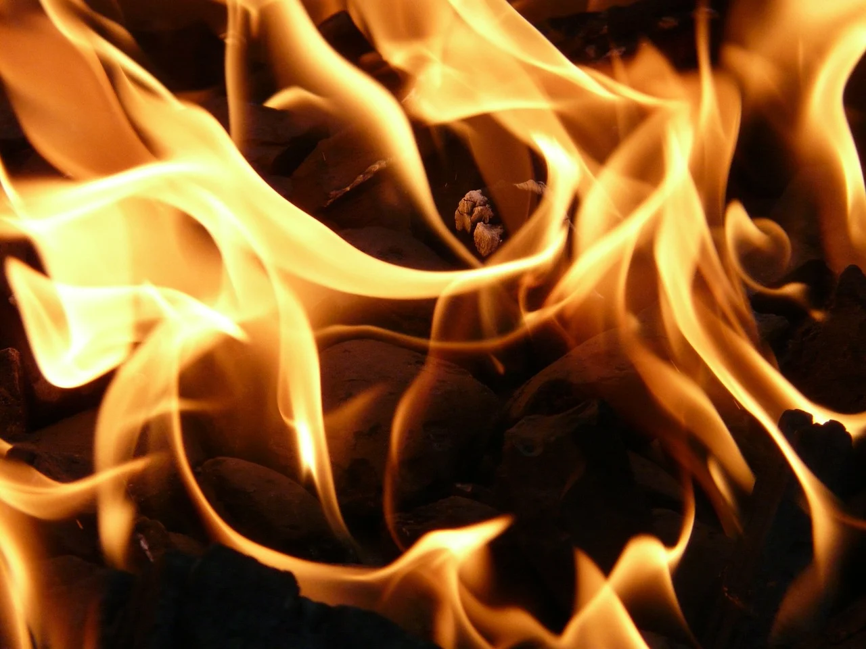
Day of ‘Arafah
Special Day
Freedom from Hell
Du‘a
Fasting

Slide 15
The Takbirat of Tashriq
اللهُ أَكْبَرُ اللهُ أَكْبَرُ ، لَا إلَهَ إِلَّا اللهُ واللهُ أَكْبَرُ ، اللهُ أَكْبَرُ وَللهِ الْحَمْدُ
After each fard salah
Starting from the Fajr of the 9th of Dhul Hijjah
Until the ‘Asr of the 13th Dhul Hijjah.

Slide 16
Plenary
Which ayah and surah makes reference to these 10 days?
What did the Prophet g say about these 10 days?
What is the hallmark of these 10 days?
What 4 things should you remember about the Day of ‘Arafah?
When should the takbirat be recited?
How can you attain the reward of Ḥajj and ‘Umrah without being there?

